Slide 1
Performance Modeling and Analysis
Samuel Williams
Computational Research Division
Lawrence Berkeley National Lab
SWWilliams@lbl.gov

Slide 2
Acknowledgements
Jack Deslippe, Charlene Yang, Doug Doerfler, Matt Cordery, Khaled Ibrahim, Lenny Oliker, Protonu Basu, Terry Ligocki, Brian Van Straalen (LBL), Linda Lo (formerly Utah), Zakhar Matveev (Intel), Roman Belenov (Intel)

Slide 3
Acknowledgements
This material is based upon work supported by the Advanced Scientific Computing Research Program in the U.S. Department of Energy, Office of Science, under Award Number DE-AC02-05CH11231.
This material is based upon work supported by the DOE RAPIDS SciDAC Institute.
This research used resources of the National Energy Research Scientific Computing Center (NERSC), which is supported by the Office of Science of the U.S. Department of Energy under contract DE-AC02-05CH11231.
This research used resources of the Oak Ridge Leadership Facility at the Oak Ridge National Laboratory, which is supported by the Office of Science of the U.S. Department of Energy under Contract No. DE-AC05-00OR22725.

Slide 4
Introduction to
Performance
Modeling

Slide 5
Why Use Performance Models or Tools?
Understand performance differences between Architectures, Programming Models, implementations, etc…
Predict performance on future machines / architectures
Sets realistic expectations on performance for future procurements
Used for HW/SW Co-Design to ensure future architectures are well-suited for the computational needs of today’s applications.
Identify performance bottlenecks & motivate software optimizations
Determine when we’re done optimizing
Assess performance relative to machine capabilities
Motivate need for algorithmic changes

Slide 6
Computational Complexity
Assume run time is correlated with the number of operations (e.g. FP ops)
Users define parameterize their algorithms, solvers, kernels
Count the number of operations as a function of those parameters
Demonstrate run time is correlated with those parameters
#pragma omp parallel for
for(i=0;i<N;i++){
Z[i] = alpha*X[i] + Y[i];
}
#pragma omp parallel for
for(i=0;i<N;i++){
for(j=0;j<N;j++){
double Cij=0;
for(k=0;k<N;k++){
Cij += A[i][k] * B[k][j];
}
C[i][j] = sum;
}}
?
DAXPY: O(N) complexity where N is the number of elements
What are the scaling constants?
DGEMM: O(N³) complexity where N is the number of rows (equations)
?
FFTs: O(NlogN) in the number of elements
CG: O(N^{1.33}) in the number of elements (equations)
MG: O(N) in the number of elements (equations)
N-body: O(N²) in the number of particles (per time step)
Why did we depart from ideal scaling?
Notes:
i.e.
1) How do we make complexity predictive of run time
2) Ideal scaling may only apply for a range of N and there can be abrupt cliffs in run time.

Slide 7
Data Movement Complexity
Assume run time is correlated with the amount of data accessed (or moved)
Easy to calculate amount of data accessed… count array accesses
Operation
FLOPs
Data
AI
DAXPY
DGEMV
DGEMM
FFTs
CG
MG
N-body
O(N)
O(N²)
O(N³)
O(NlogN)
O(N^{1.33})
O(N)
O(N²)
O(N)
O(N²)
O(N²)
O(N)
O(N^{1.33})
O(N)
O(N)
O(1)
O(1)
O(N)
O(N)
O(1)
O(1)
O(N)
?
Data moved is more complex as it requires understanding cache behavior…
Compulsory¹ data movement (array sizes) is a good initial guess…
… but needs refinement for the effects of finite cache capacities
Which is more expensive…
Performing FLOPs, or
Moving words from memory
¹Hill et al, “Evaluating Associativity in CPU Caches”, IEEE Trans. Comput., 1989.

Slide 8
Machine Balance and Arithmetic Intensity
Data movement and computation can operate at different rates
Operation
FLOPs
Data
AI (ideal)
!
DAXPY
DGEMV
DGEMM
FFTs
CG
MG
N-body
O(N)
O(N²)
O(N³)
O(NlogN)
O(N^{1.33})
O(N)
O(N²)
O(N)
O(N²)
O(N²)
O(N)
O(N^{1.33})
O(N)
O(N)
O(1)
O(1)
O(N)
O(logN)
O(1)
O(1)
O(N)
We define machine balance as the ratio of…
Balance =
Peak DP FLOP/s
Peak Bandwidth
Kernels with AI
less than machine balance are ultimately bandwidth limited
…and arithmetic intensity as the ratio of…
AI =
FLOPs Performed
Data Moved
Notes:
Former is a characteristic of the machine
Latter is a characteristic of both the code and the machine (cache effects)
All that’s really saying is that it takes longer to compute than move the data

Slide 9
Distributed Memory Performance Modeling
In distributed memory, one communicates by sending messages between processors.
Messaging time can be constrained by several components…
Overhead (CPU time to send/receive a message)
Latency (time message is in the network; can be hidden)
Message throughput (rate at which one can send small messages… messages/second)
Bandwidth (rate one can send large messages… GBytes/s)
Bandwidths and latencies are further constrained by the interplay of network architecture and contention
Distributed memory versions of our algorithms can be differently stressed by these components depending on N and P (#processors)

Slide 10
Computational Depth
Parallel machines incur substantial overheads on synchronization (shared memory), point-to-point communication, reductions, and broadcasts.
We can classify algorithms by depth (max depth of the algorithm’s dependency chain)
If dependency chain crosses process boundaries, we incur substantial overheads.
!
Operation
FLOPs
Data
AI (ideal)
Depth
DAXPY
DGEMV
DGEMM
FFTs
CG
MG
N-body
O(N)
O(N²)
O(N³)
O(NlogN)
O(N^{1.33})
O(N)
O(N²)
O(N)
O(N²)
O(N²)
O(N)
O(N^{1.33})
O(N)
O(N)
O(1)
O(1)
O(N)
O(logN)
O(1)
O(1)
O(N)
O(1)
O(logN)
O(logN)
O(logN)
O(N^{0.33} logN)
O(logN)
O(logN)
Overheads can dominate at high concurrency or small problems

Slide 11
Performance Models
Many different components can contribute to kernel run time.
Some are characteristics of the application, some are characteristics of the machine, and some are both (memory access pattern + caches).
#FP operations
Cache data movement
DRAM data movement
PCIe data movement
Depth
MPI Message Size
MPI Send:Wait ratio
#MPI Wait’s
FLOP/s
Cache GB/s
DRAM GB/s
PCIe bandwidth
OMP Overhead
Network Bandwidth
Network Gap
Network Latency

Slide 12
Performance Models
Can’t think about all these terms all the time for every application…
Computational
Complexity
#FP operations
Cache data movement
DRAM data movement
PCIe data movement
Depth
MPI Message Size
MPI Send:Wait ratio
#MPI Wait’s
FLOP/s
Cache GB/s
DRAM GB/s
PCIe bandwidth
OMP Overhead
Network Bandwidth
Network Gap
Network Latency

Slide 13
Performance Models
Because there are so many components, performance models often conceptualize the system as being dominated by one or more of these components.
#FP operations
Cache data movement
DRAM data movement
PCIe data movement
Depth
MPI Message Size
MPI Send:Wait ratio
#MPI Wait’s
FLOP/s
Cache GB/s
DRAM GB/s
PCIe bandwidth
OMP Overhead
Network Bandwidth
Network Gap
Network Latency
LogP
Culler, et al, "LogP: a practical model of parallel computation", CACM, 1996.

Slide 14
Performance Models
Because there are so many components, performance models often conceptualize the system as being dominated by one or more of these components.
#FP operations
Cache data movement
DRAM data movement
PCIe data movement
Depth
MPI Message Size
MPI Send:Wait ratio
#MPI Wait’s
FLOP/s
Cache GB/s
DRAM GB/s
PCIe bandwidth
OMP Overhead
Network Bandwidth
Network Gap
Network Latency
LogGP
Alexandrov, et al, "LogGP: incorporating long messages into the LogP model - one step closer towards a realistic model for parallel computation", SPAA, 1995.

Slide 15
Performance Models
Because there are so many components, performance models often conceptualize the system as being dominated by one or more of these components.
#FP operations
Cache data movement
DRAM data movement
PCIe data movement
Depth
MPI Message Size
MPI Send:Wait ratio
#MPI Wait’s
FLOP/s
Cache GB/s
DRAM GB/s
PCIe bandwidth
OMP Overhead
Network Bandwidth
Network Gap
Network Latency
LogCA
Bin Altaf et al, "LogCA: A High-Level Performance Model for Hardware Accelerators", ISCA, 2017.

Slide 16
Implications of Architectural Evolution…
Historically, many performance models and simulators tracked time to predict performance (i.e. counting seconds or counting cycles)
The last two decades saw a number of latency-hiding techniques…
Out-of-order execution (hardware discovers parallelism to hide latency)
HW stream prefetching (hardware speculatively loads data)
Massive thread parallelism (independent threads satisfy the latency-bandwidth product)
… resulted in a shift from a latency-limited computing regime to a throughput-limited computing regime

Slide 17

Roofline Model
Roofline Model is a throughput-oriented performance model
Tracks rates not times
Uses bound and bottleneck analysis
Independent of ISA and architecture (applies to CPUs, GPUs, Google TPUs¹, etc…)
https://crd.lbl.gov/departments/computer-science/PAR/research/roofline
¹Jouppi et al, “In-Datacenter Performance Analysis of a Tensor Processing Unit”, ISCA, 2017.

Slide 18
Performance Models
Because there are so many components, performance models often conceptualize the system as being dominated by one or more of these components.
!
Roofline
Model
#FP operations
Cache data movement
DRAM data movement
PCIe data movement
Depth
MPI Message Size
MPI Send:Wait ratio
#MPI Wait’s
FLOP/s
Cache GB/s
DRAM GB/s
PCIe bandwidth
OMP Overhead
Network Bandwidth
Network Gap
Network Latency
Use the
right model
Williams et al, "Roofline: An Insightful Visual Performance Model For Multicore Architectures", CACM, 2009.
Notes:
Roofline focused on processors operating in the throughput-limited regime

Slide 19
Introduction to the
Roofline Model

Slide 20
(DRAM) Roofline
One could hope to always attain peak performance (FLOP/s)
However, finite locality (reuse) and bandwidth limit performance.
Assume:
Idealized processor/caches
Cold start (data in DRAM)
CPU
(compute, FLOP/s)
DRAM Bandwidth
(GB/s)
DRAM
(data, GB)
Time = max
#FP ops / Peak GFLOP/s
#Bytes / Peak GB/s

Slide 21
(DRAM) Roofline
One could hope to always attain peak performance (FLOP/s)
However, finite locality (reuse) and bandwidth limit performance.
Assume:
Idealized processor/caches
Cold start (data in DRAM)
CPU
(compute, FLOP/s)
DRAM Bandwidth
(GB/s)
DRAM
(data, GB)
Time
#FP ops
= max
1 / Peak GFLOP/s
#Bytes / #FP ops / Peak GB/s

Slide 22
(DRAM) Roofline
One could hope to always attain peak performance (FLOP/s)
However, finite locality (reuse) and bandwidth limit performance.
Assume:
Idealized processor/caches
Cold start (data in DRAM)
CPU
(compute, FLOP/s)
DRAM Bandwidth
(GB/s)
DRAM
(data, GB)
#FP ops
Time
= min
Peak GFLOP/s
(#FP ops / #Bytes) * Peak GB/s

Slide 23
(DRAM) Roofline
One could hope to always attain peak performance (FLOP/s)
However, finite locality (reuse) and bandwidth limit performance.
Assume:
Idealized processor/caches
Cold start (data in DRAM)
CPU
(compute, FLOP/s)
DRAM Bandwidth
(GB/s)
DRAM
(data, GB)
GFLOP/s = min
Peak GFLOP/s
AI * Peak GB/s
Note, Arithmetic Intensity (AI) = Flops / Bytes (as presented to DRAM )

Slide 24
Arithmetic Intensity
The most important concept in Roofline is Arithmetic Intensity
Measure of data locality (data reuse)
Ratio of Total Flops performed to Total Bytes moved
For the DRAM Roofline…
Total Bytes to/from DRAM and includes all cache and prefetcher effects
Can be very different from total loads/stores (bytes requested)
Equal to ratio of sustained GFLOP/s to sustained GB/s (time cancels)

Slide 25
(DRAM) Roofline
Plot Roofline bound using Arithmetic Intensity as the x-axis
Log-log scale makes it easy to doodle, extrapolate performance along Moore’s Law, etc…
Kernels with AI less than machine balance are ultimately DRAM bound (we’ll refine this later…)
Peak FLOP/s
Attainable FLOP/s
DRAM GB/s
DRAM-bound
Compute-bound
Arithmetic Intensity (FLOP:Byte)
Transition @ AI =
Machine Balance

Slide 26
Roofline Example #1
Typical machine balance is 5-10 flops per byte…
40-80 flops per double to exploit compute capability
Artifact of technology and money
Unlikely to improve
Consider STREAM Triad…
2 flops per iteration
Transfer 24 bytes per iteration (read X[i], Y[i], write Z[i])
AI = 0.083 flops per byte == Memory bound
Peak FLOP/s
Attainable FLOP/s
DRAM GB/s
GFLOP/s ≤ AI * DRAM GB/s
#pragma omp parallel for
for(i=0;i<N;i++){
Z[i] = X[i] + alpha*Y[i];
}
TRIAD
0.083
Arithmetic Intensity (FLOP:Byte)

Slide 27
Roofline Example #2
Conversely, 7-point constant coefficient stencil…
7 flops
8 memory references (7 reads, 1 store) per point
AI = 0.11 flops per byte (L1)
CPU
(compute, FLOP/s)
#pragma omp parallel for
for(k=1;k<dim+1;k++){
for(j=1;j<dim+1;j++){
for(i=1;i<dim+1;i++){
new[k][j][i] = -6.0*old[k ][j ][i ]
+ old[k ][j ][i-1]
+ old[k ][j ][i+1]
+ old[k ][j-1][i ]
+ old[k ][j+1][i ]
+ old[k-1][j ][i ]
+ old[k+1][j ][i ];
}}}
DRAM Bandwidth
(GB/s)
DRAM
(data, GB)

Slide 28
Roofline Example #2
Conversely, 7-point constant coefficient stencil…
7 flops
8 memory references (7 reads, 1 store) per point
Cache can filter all but 1 read and 1 write per point
AI = 0.44 flops per byte
CPU
(compute, FLOP/s)
Cache Bandwidth
(GB/s)
CACHE
(only compulsory misses)
#pragma omp parallel for
for(k=1;k<dim+1;k++){
for(j=1;j<dim+1;j++){
for(i=1;i<dim+1;i++){
new[k][j][i] = -6.0*old[k ][j ][i ]
+ old[k ][j ][i-1]
+ old[k ][j ][i+1]
+ old[k ][j-1][i ]
+ old[k ][j+1][i ]
+ old[k-1][j ][i ]
+ old[k+1][j ][i ];
}}}
DRAM Bandwidth
(GB/s)
DRAM
(data, GB)

Slide 29
Roofline Example #2
Conversely, 7-point constant coefficient stencil…
7 flops
8 memory references (7 reads, 1 store) per point
Cache can filter all but 1 read and 1 write per point
AI = 0.44 flops per byte == memory bound,
but 5x the flop rate
Peak FLOP/s
GFLOP/s ≤ AI * DRAM GB/s
Attainable FLOP/s
DRAM GB/s
#pragma omp parallel for
for(k=1;k<dim+1;k++){
for(j=1;j<dim+1;j++){
for(i=1;i<dim+1;i++){
new[k][j][i] = -6.0*old[k ][j ][i ]
+ old[k ][j ][i-1]
+ old[k ][j ][i+1]
+ old[k ][j-1][i ]
+ old[k ][j+1][i ]
+ old[k-1][j ][i ]
+ old[k+1][j ][i ];
}}}
7-point
Stencil
TRIAD
0.083
0.44
Arithmetic Intensity (FLOP:Byte)

Slide 30
Question:
Will Performance Always Lie on the Roofline?

Slide 31
Can performance be below the Roofline?
Analogous to stating that one can always attain either…
Peak Bandwidth
Peak FLOP/s
No, there can be other performance bottlenecks…
Cache bandwidth / locality
Lack of vectorization / SIMDization
Load imbalance
…

Slide 32
Extending the Roofline:
Memory Hierarchy

Slide 33
Hierarchical Roofline
Processors have multiple levels of memory/cache
Registers
L1, L2, L3 cache
MCDRAM/HBM (KNL/GPU device memory)
DDR (main memory)
NVRAM (non-volatile memory)
Applications have locality in each level
Unique data movements imply unique AI’s
Moreover, each level will have unique peak and sustained bandwidths
Bandwidth
Data Movement
CPU
L1 GB/s
L1 GB
L1 D$
L2 GB/s
L2 GB
L2 D$
MCDRAM GB/s
MCDRAM GB
MCDRAM
DRAM GB/s
DRAM GB
DRAM

Slide 34
Hierarchical Roofline
Processors have multiple levels of memory/cache
Registers
L1, L2, L3 cache
MCDRAM/HBM (KNL/GPU device memory)
DDR (main memory)
NVRAM (non-volatile memory)
Applications have locality in each level
Unique data movements imply unique AI’s
Moreover, each level will have unique peak and sustained bandwidths
Machine Balance
Data Movement
CPU
GFLOP/s
L1 GB/s
L1 GB
L1 D$
GFLOP/s
L2 GB/s
L2 GB
L2 D$
GFLOP/s
MCDRAM GB/s
MCDRAM GB
MCDRAM
GFLOP/s
DRAM GB/s
DRAM GB
DRAM

Slide 35
Hierarchical Roofline
Processors have multiple levels of memory/cache
Registers
L1, L2, L3 cache
MCDRAM/HBM (KNL/GPU device memory)
DDR (main memory)
NVRAM (non-volatile memory)
Applications have locality in each level
Unique data movements imply unique AI’s
Moreover, each level will have unique peak and sustained bandwidths
Machine Balance
Arithmetic Intensity
CPU
GFLOP/s
L1 GB/s
GFLOPs
L1 GB
L1 D$
GFLOP/s
L2 GB/s
GFLOPs
L2 GB
L2 D$
GFLOP/s
MCDRAM GB/s
GFLOPs
MCDRAM GB
MCDRAM
GFLOP/s
DRAM GB/s
GFLOPs
DRAM GB
DRAM

Slide 36
Hierarchical Roofline
Construct superposition of Rooflines…
Measure bandwidth
Measure AI for each level of memory
Although an loop nest may have multiple AI’s and multiple bounds (flops, L1, L2, … DRAM)…
… performance is bound by the minimum
Peak FLOP/s
L2 GB/s
MCDRAM cache GB/s
Attainable FLOP/s
DDR Bound
DDR AI*BW <
MCDRAM AI*BW
DDR GB/s
Arithmetic Intensity (FLOP:Byte)

Slide 37
Hierarchical Roofline
Construct superposition of Rooflines…
Measure bandwidth
Measure AI for each level of memory
Although an loop nest may have multiple AI’s and multiple bounds (flops, L1, L2, … DRAM)…
… performance is bound by the minimum
Peak FLOP/s
L2 GB/s
MCDRAM cache GB/s
Attainable FLOP/s
DDR GB/s
DDR bottleneck pulls performance below MCDRAM Roofline
Arithmetic Intensity (FLOP:Byte)

Slide 38
Hierarchical Roofline
Construct superposition of Rooflines…
Measure bandwidth
Measure AI for each level of memory
Although an loop nest may have multiple AI’s and multiple bounds (flops, L1, L2, … DRAM)…
… performance is bound by the minimum
Peak FLOP/s
L2 GB/s
MCDRAM cache GB/s
Attainable FLOP/s
MCDRAM bound
MCDRAM AI*BW <
DDR AI*BW
DDR GB/s
Arithmetic Intensity (FLOP:Byte)

Slide 39
Hierarchical Roofline
Construct superposition of Rooflines…
Measure bandwidth
Measure AI for each level of memory
Although an loop nest may have multiple AI’s and multiple bounds (flops, L1, L2, … DRAM)…
… performance is bound by the minimum
Peak FLOP/s
L2 GB/s
MCDRAM cache GB/s
Attainable FLOP/s
DDR GB/s
MCDRAM bottleneck pulls performance below DDR Roofline
Arithmetic Intensity (FLOP:Byte)

Slide 40
NUMA Effects
Cori’s Haswell nodes are built from 2 Xeon processors (sockets)
Memory attached to each socket (fast)
Interconnect that allows remote memory access (slow == NUMA)
Improper memory allocation can result in more than a 2x performance penalty
Peak FLOP/s
Attainable FLOP/s
DDR GB/s
DDR GB/s (NUMA)
Without proper NUMA optimization, bandwidth is constrained
CPU0
cores 0-15
CPU1
cores 16-31
~50GB/s
~50GB/s
Arithmetic Intensity (FLOP:Byte)
DRAM
DRAM

Slide 41
Extending the Roofline: In-Core Effects

Slide 42
In-Core Parallelism
We have assumed one can attain peak flops with high locality.
In reality, we must …
Vectorize loops (16 flops per instruction)
Use special instructions (e.g. FMA)
Ensure FP instructions dominate the instruction mix
Use all cores & sockets
Without these, …
Peak performance is not attainable
Some kernels can transition from memory-bound to compute-bound

Slide 43
Data Parallelism (e.g. SIMD)
Most processors exploit some form of SIMD or vectors.
KNL uses 512b vectors (8x64b)
GPUs use 32-thread warps (32x64b)
In reality, applications are a mix of scalar and vector instructions.
Performance is a weighted average between SIMD and no SIMD
Full vectorization
Attainable FLOP/s
DDR GB/s
No vectorization
Lack of full vectorization pulls performance below DDR Roofline
Arithmetic Intensity (FLOP:Byte)

Slide 44
Data Parallelism (e.g. SIMD)
Most processors exploit some form of SIMD or vectors.
KNL uses 512b vectors (8x64b)
GPUs use 32-thread warps (32x64b)
In reality, applications are a mix of scalar and vector instructions.
Performance is a weighted average between SIMD and no SIMD
There is an implicit ceiling based on this weighted average
Full vectorization
Attainable FLOP/s
DDR GB/s
Partial
vectorization
No vectorization
Memory-bound codes can become compute-bound
Arithmetic Intensity (FLOP:Byte)

Slide 45
Return of Complex Instruction Set Computing
Death of Moore’s Law is reinvigorating CISC
Modern CPUs and GPUs are increasingly reliant on special (fused) instructions that perform multiple operations.
FMA (Fused Multiply Add): z=a*x+y …z,x,y are vectors or scalars
4FMA (quad FMA): z=A*x+z …A is a FP32 matrix; x,z are vectors
WMMA (Tensor Core): Z=AB+C …Z,A,B,C are FP16 matrices
Performance is now a weighted average of scalar, vector, FMA, and WMMA operations.

Slide 46
Return of CISC
Total lack of FMA reduces performance by 2x on KNL.
(4x on Haswell)
VFMA Peak
Partial FMA
In reality, applications are a mix of FMA, FAdd, and FMul.
Performance is a weighted average
There is an implicit ceiling based on this weighted average
VAdd Peak
Attainable FLOP/s
DDR GB/s
FAdd Peak
Arithmetic Intensity (FLOP:Byte)

Slide 47
Return of CISC
On Volta, Tensor cores can provide 100TFLOPs of FP16 performance
(vs. 7.5 TFLOPS for DP FMA)
Tensor Peak
Observe, machine balance has now grown to …
100 TFLOP/s / 800 GB/s
= 250 FP16 ops per word !!
Attainable FLOP/s
HBM GB/s
DP FMA Peak
DP Add Peak
Arithmetic Intensity (FLOP:Byte)

Slide 48
Superscalar vs. Instruction mix
Superscalar processors have finite instruction fetch/decode/issue bandwidth (e.g. 4 instructions per cycle)
Moreover, the number of FP units dictates the FP issue rate required to hit peak (e.g. 2 vector instructions per cycle)
Ratio of these two rates is the minimum FP instruction fraction required to hit peak

Slide 49
Superscalar vs. Instruction mix
Haswell CPU
4-issue superscalar
Only 2 FP data paths
Requires 50% of the instructions to be FP to get peak performance
Peak FLOP/s
≥50% FP
25% FP (75% int)
DDR GB/s
12% FP (88% int)
Attainable FLOP/s
Arithmetic Intensity (FLOP:Byte)

Slide 50
Superscalar vs. Instruction mix
Haswell CPU
4-issue superscalar
Only 2 FP data paths
Requires 50% of the instructions to be FP to get peak performance
Peak FLOP/s
100% FP
50% FP (50% int)
DDR GB/s
25% FP (75% int)
Attainable FLOP/s
Conversely, on KNL…
2-issue superscalar
2 FP data paths
Requires 100% of the instructions to be FP to get peak performance
Arithmetic Intensity (FLOP:Byte)

Slide 51
Superscalar vs. Instruction mix
Haswell CPU
4-issue superscalar
Only 2 FP data paths
Requires 50% of the instructions to be FP to get peak performance
Peak FLOP/s
100% FP
50% FP (50% int)
DDR GB/s
25% FP (75% int)
Attainable FLOP/s
Conversely, on KNL…
2-issue superscalar
2 FP data paths
Requires 100% of the instructions to be FP to get peak performance
Arithmetic Intensity (FLOP:Byte)

Slide 52
Superscalar vs. Instruction mix
Haswell CPU
4-issue superscalar
Only 2 FP data paths
Requires 50% of the instructions to be FP to get peak performance
Peak FLOP/s
100% FP
50% FP (50% int)
DDR GB/s
25% FP (75% int)
Attainable FLOP/s
Conversely, on KNL…
2-issue superscalar
2 FP data paths
Requires 100% of the instructions to be FP to get peak performance
Codes that would have been memory-bound are now decode/issue-bound.
non-FP instructions sap issue bandwidth and pull performance below the Roofline
Arithmetic Intensity (FLOP:Byte)

Slide 53
Superscalar vs. Instruction mix
On Volta, each SM is partitioned among 4 warp schedulers
Each warp scheduler can dispatch 32 threads per cycle
However, it can only execute 8 DP FP instructions per cycle.
i.e. there is plenty of excess instruction issue bandwidth available for non-FP instructions.
Peak FLOP/s
≥25% FP
12% FP (88% int)
DDR GB/s
6% FP (94% int)
Attainable FLOP/s
Arithmetic Intensity (FLOP:Byte)

Slide 54
Extending the Roofline: Modeling Cache Effects

Slide 55
Locality Walls
Naively, we can bound AI using only compulsory cache misses
Peak FLOP/s
No FMA
Attainable FLOP/s
DDR GB/s
No vectorization
Compulsory AI
AI =
#FLOPs
Compulsory Misses
Arithmetic Intensity (FLOP:Byte)

Slide 56
Locality Walls
Naively, we can bound AI using only compulsory cache misses
However, write allocate caches can lower AI
Peak FLOP/s
No FMA
Attainable FLOP/s
DDR GB/s
No vectorization
+Write Allocate
Compulsory AI
AI =
#FLOPs
Compulsory Misses + Write Allocates
Arithmetic Intensity (FLOP:Byte)

Slide 57
Locality Walls
Naively, we can bound AI using only compulsory cache misses
However, write allocate caches can lower AI
Cache capacity misses can have a huge penalty
Peak FLOP/s
No FMA
Attainable FLOP/s
DDR GB/s
+Capacity Misses
No vectorization
+Write Allocate
Compulsory AI
AI =
#FLOPs
Compulsory Misses + Write Allocates + Capacity Misses
Arithmetic Intensity (FLOP:Byte)

Slide 58
Locality Walls
Naively, we can bound AI using only compulsory cache misses
However, write allocate caches can lower AI
Cache capacity misses can have a huge penalty
Compute bound became memory bound
Peak FLOP/s
No FMA
!
Attainable FLOP/s
DDR GB/s
+Capacity Misses
No vectorization
+Write Allocate
Compulsory AI
Know the theoretical
bounds on your AI.
AI =
#FLOPs
Compulsory Misses + Write Allocates + Capacity Misses
Arithmetic Intensity (FLOP:Byte)

Slide 59
So Why is Roofline Useful?

Slide 60
Why is Roofline Useful?
Imagine a mix of loop nests
FLOP/s alone may not be useful in deciding which to optimize first
FLOP/s
Kernel (or apps)

Slide 61
Why is Roofline Useful?
We can sort kernels by AI …
Attainable FLOP/s
Arithmetic Intensity (FLOP:Byte)

Slide 62
Why is Roofline Useful?
We can sort kernels by AI …
… and compare performance relative to machine capabilities
Peak FLOP/s
Attainable FLOP/s
DDR GB/s
Arithmetic Intensity (FLOP:Byte)

Slide 63
Why is Roofline Useful?
Kernels near the roofline are making good use of computational resources
kernels can have low performance (GFLOP/s), but make good use of a machine
kernels can have high performance (GFLOP/s), but make poor use of a machine
Peak FLOP/s
50% of Peak
Attainable FLOP/s
DDR GB/s
50% of STREAM
Arithmetic Intensity (FLOP:Byte)

Slide 64
Tracking Progress Towards Optimality
One can conduct a Roofline optimization after every optimization (or once per quarter)
Tracks progress towards optimality
Allows one to quantitatively speak to ultimate performance / KPPs
Can be used as a motivator for new algorithms.
Peak FLOP/s
Q4
Attainable FLOP/s
DDR GB/s
Q3
Q2
Q1
Arithmetic Intensity (FLOP:Byte)

Slide 65
Roofline Scaling Trajectories
Often, one plots performance as a function of thread concurrency
Carries no insight or analysis
Provides no actionable information.
1
2
4
8
16
32
64
#Threads

Slide 66
Roofline Scaling Trajectories
Often, one plots performance as a function of thread concurrency
Carries no insight or analysis
Provides no actionable information.
Khaled Ibrahim developed a new way of using Roofline to analyze thread (or process) scalability
Create a 2D scatter plot of performance as a function of AI and thread concurrency
Can identify loss in performance due to increased cache pressure
Khaled Ibrahim, Samuel Williams, Leonid Oliker, "Roofline Scaling Trajectories: A Method for Parallel Application and Architectural Performance Analysis", HPCS Special Session on High Performance Computing Benchmarking and Optimization (HPBench), July 2018.

Slide 67
Roofline Scaling Trajectories
Observe…
AI (data movement) varies with both thread concurrency and problem size
Large problems (green and red) move much more data per thread, and eventually exhaust cache capacity
Resultant fall in AI means they hit the bandwidth ceiling quickly and degrade.
Smaller problems see reduced AI, but don’t hit the bandwidth ceiling

Slide 68
Driving Performance Optimization
Broadly speaking, there are three approaches to improving performance:
Peak FLOP/s
No FMA
Attainable FLOP/s
DDR GB/s
DDR GB/s (NUMA)
No vectorization
Arithmetic Intensity (FLOP:Byte)

Slide 69
Driving Performance Optimization
Broadly speaking, there are three approaches to improving performance:
Maximize in-core performance (e.g. get compiler to vectorize)
Peak FLOP/s
No FMA
Attainable FLOP/s
DDR GB/s
DDR GB/s (NUMA)
No vectorization
Arithmetic Intensity (FLOP:Byte)

Slide 70
Driving Performance Optimization
Broadly speaking, there are three approaches to improving performance:
Maximize in-core performance (e.g. get compiler to vectorize)
Maximize memory bandwidth (e.g. NUMA-aware, unit-stride)
Peak FLOP/s
No FMA
Attainable FLOP/s
DDR GB/s
DDR GB/s (NUMA)
Arithmetic Intensity (FLOP:Byte)

Slide 71
Driving Performance Optimization
Broadly speaking, there are three approaches to improving performance:
Maximize in-core performance (e.g. get compiler to vectorize)
Maximize memory bandwidth (e.g. NUMA-aware, unit stride)
Minimize data movement
(e.g. cache blocking)
Peak FLOP/s
No FMA
Attainable FLOP/s
DDR GB/s
Compulsory AI
Current AI
Arithmetic Intensity (FLOP:Byte)

Slide 72
How do I build and use Roofline?

Slide 73
Machine Characterization
“Theoretical Performance” numbers can be highly optimistic…
Pin BW vs. sustained bandwidth
TurboMode at low concurrency
Underclocking for AVX
Compiler failing on high-AI loops.
Take marketing numbers with a grain of salt

Slide 74
Machine Characterization
To create a Roofline model, we must benchmark…
Sustained Flops
Double/single/half precision
With and without FMA (e.g. compiler flag)
With and without SIMD (e.g. compiler flag)
Sustained Bandwidth
Measure between each level of memory/cache
Iterate on working sets of various sizes and identify plateaus
Identify bandwidth asymmetry (read:write ratio)
Benchmark must run long enough to observe effects of power throttling

Slide 75
Machine Characterization
Cori / KNL
“Theoretical Performance” numbers can be highly optimistic…
Pin BW vs. sustained bandwidth
TurboMode / Underclock for AVX
compiler failings on high-AI loops.
SummitDev / 4GPUs
LBL developed the Empirical Roofline Toolkit (ERT)…
      Characterize CPU/GPU systems
      Peak Flop rates
      Bandwidths for each level of memory
      MPI+OpenMP/CUDA == multiple GPUs
https://bitbucket.org/berkeleylab/cs-roofline-toolkit/
https://github.com/cyanguwa/nersc-roofline/
https://crd.lbl.gov/departments/computer-science/PAR/research/roofline/
Notes:
* Shows ERT on Cori / KNL and SummitDev/Pascal
* Highlight the fact that KNL peak is only 2.45 instead of 3.0 (1.4GHz -> 1.2GHz)

Slide 76
ERT Configuration
Kernel.c
actual compute
customizable
Kernel.c
loop over ntrials
distribute dataset on threads and each computes ERT_FLOPS
Kernel.h
ERT_FLOPS=1: a = b + c
ERT_FLOPS=2: a = a x b + c
config script
set up ranges of parameters
config.txt
ERT_FLOPS 1,2,4,8,16,32,64
ERT_MPI_PROCS 2,4,8,16,32,64
ERT_OPENMP_THREADS 1-256
ERT_MEMORY_MAX 1073741824
ERT_WORKING_SET_MIN 1
ERT_TRIALS_MIN 1
...
Driver.c
setup
call kernels
loop over parameters
Driver.c (uses some Macros from config.txt)
initialize MPI, OpenMP
loop over dataset sizes <= ERT_MEMORY_MAX
loop over trial sizes >= ERT_TRIALS_MIN
start timer
call kernel
end timer
job script
submit the job and run it
Job script
./ert config.txt
ert (Python)
create directories
loop over ERT_FLOPS, MPI_PROCS/OMP_THREADS
call driver, kernel
https://bitbucket.org/berkeleylab/cs-roofline-toolkit/
https://github.com/cyanguwa/nersc-roofline/
https://crd.lbl.gov/departments/computer-science/PAR/research/roofline/

Slide 77
Measuring Application AI and Performance
To characterize execution with Roofline we need…
Time
Flops (=> FLOPs / time)
Data movement between each level of memory (=> FLOPs / GB’s)
We can look at the full application…
Coarse grained, 30-min average
Misses many details and bottlenecks
or we can look at individual loop nests…
Requires auto-instrumentation on a loop by loop basis
Moreover, we should probably differentiate data movement or flops on a core-by-core basis.

Slide 78
How Do We Count FLOPs?
Manual Counting
Go thru each loop nest and count the number of FP operations
Works best for deterministic loop bounds
or parameterize by the number of iterations (recorded at run time)
Not scalable
Perf. Counters
Read counter before/after
More Accurate
Low overhead (<%) == can run full MPI applications
Can detect load imbalance
Requires privileged access
Requires manual instrumentation (+overhead) or full-app characterization
Broken counters = garbage
May not differentiate FMADD from FADD
No insight into special pipelines
Binary Instrumentation
Automated inspection of assembly at run time
Most Accurate
FMA-, VL-, and mask-aware
Can count instructions by class/type
Can detect load imbalance
Can include effects from non-FP instructions
Automated application to multiple loop nests
>10x overhead (short runs / reduced concurrency)

Slide 79
How Do We Measure Data Movement?
Manual Counting
Go thru each loop nest and estimate how many bytes will be moved
Use a mental model of caches
Works best for simple loops that stream from DRAM (stencils, FFTs, spare, …)
N/A for complex caches
Not scalable
Perf. Counters
Read counter before/after
Applies to full hierarchy (L2, DRAM,
Much more Accurate
Low overhead (<%) == can run full MPI applications
Can detect load imbalance
Requires privileged access
Requires manual instrumentation (+overhead) or full-app characterization
Cache Simulation
Build a full cache simulator driven by memory addresses
Applies to full hierarchy and multicore
Can detect load imbalance
Automated application to multiple loop nests
Ignores prefetchers
>10x overhead (short runs / reduced concurrency)

Slide 80

Initially Cobbled Together Tools…
Use tools known/observed to work on NERSC’s Cori (KNL, HSW)…
Used Intel SDE (Pin binary instrumentation + emulation) to create software Flop counters
Used Intel VTune performance tool (NERSC/Cray approved) to access uncore counters
Accurate measurement of FLOPs (HSW) and DRAM data movement (HSW and KNL)
Used by NESAP (NERSC KNL application readiness project) to characterize apps on Cori…
    http://www.nersc.gov/users/application-performance/measuring-arithmetic-intensity/
NERSC is LBL’s production computing division
CRD is LBL’s Computational Research Division
NESAP is NERSC’s KNL application readiness project
LBL is part of SUPER (DOE SciDAC3 Computer Science Institute)

Slide 81
More Recently…
Use tools known/observed to work on NERSC’s Cori (KNL, HSW)…
Used Intel SDE (Pin binary instrumentation + emulation) to create software Flop counters
Used LIKWID performance counter tool (NERSC/Cray approved) to access uncore counters
Accurate measurement of FLOPs (HSW) and DRAM data movement (HSW and KNL)
Used by NESAP (NERSC KNL application readiness project) to characterize apps on Cori…
    http://www.nersc.gov/users/application-performance/measuring-arithmetic-intensity/
NERSC is LBL’s production computing division
CRD is LBL’s Computational Research Division
NESAP is NERSC’s KNL application readiness project
LBL is part of SUPER (DOE SciDAC3 Computer Science Institute)

Slide 82
LIKWID
LIKWID provides easy to use wrappers for measuring performance counters...
Works on NERSC production systems
Distills counters into user-friendly metrics (e.g. MCDRAM Bandwidth)
Minimal overhead (<1%)
Scalable in distributed memory (MPI-friendly)
Fast, high-level characterization
No timing breakdowns
Suffers from Garbage-in/Garbage Out
(i.e. hardware counter must be sufficient and correct)
https://github.com/RRZE-HPC/likwid
http://www.nersc.gov/users/software/performance-and-debugging-tools/likwid

Slide 83
Profiling with LIKWID
likwid-perfctr (threaded) + likwid-mpirun (MPI/hybrid)
no GUI
low overhead -> SDE, VTune, etc
no code instrumentation required -> CrayPat-tracing
no root access required -> VTune
no extra modules required to be installed -> VTune
use Linux ‘msr’ module to access MSR (Model Specific Register) files
Cori:
  module load vtune
  sbatch/salloc --perf=likwid
  module load likwid

Slide 84
Profiling with LIKWID (2)
Alternately, one can construct a script and monitor only process 0
srun -n8 -c32 ./a.out args
srun -n8 -c32 ./perfctr.sh ./a.out args
where perfctr.sh is
#!/bin/bash
let SLURM_MPI_RANK=$SLURM_PROCID
if [ $SLURM_MPI_RANK = 0 ];then
# only process 0 runs likwid and it monitors only logical CPUs 0-31
likwid-perfctr -C 0-31 -g CACHES $@
else
$@
fi

Slide 85
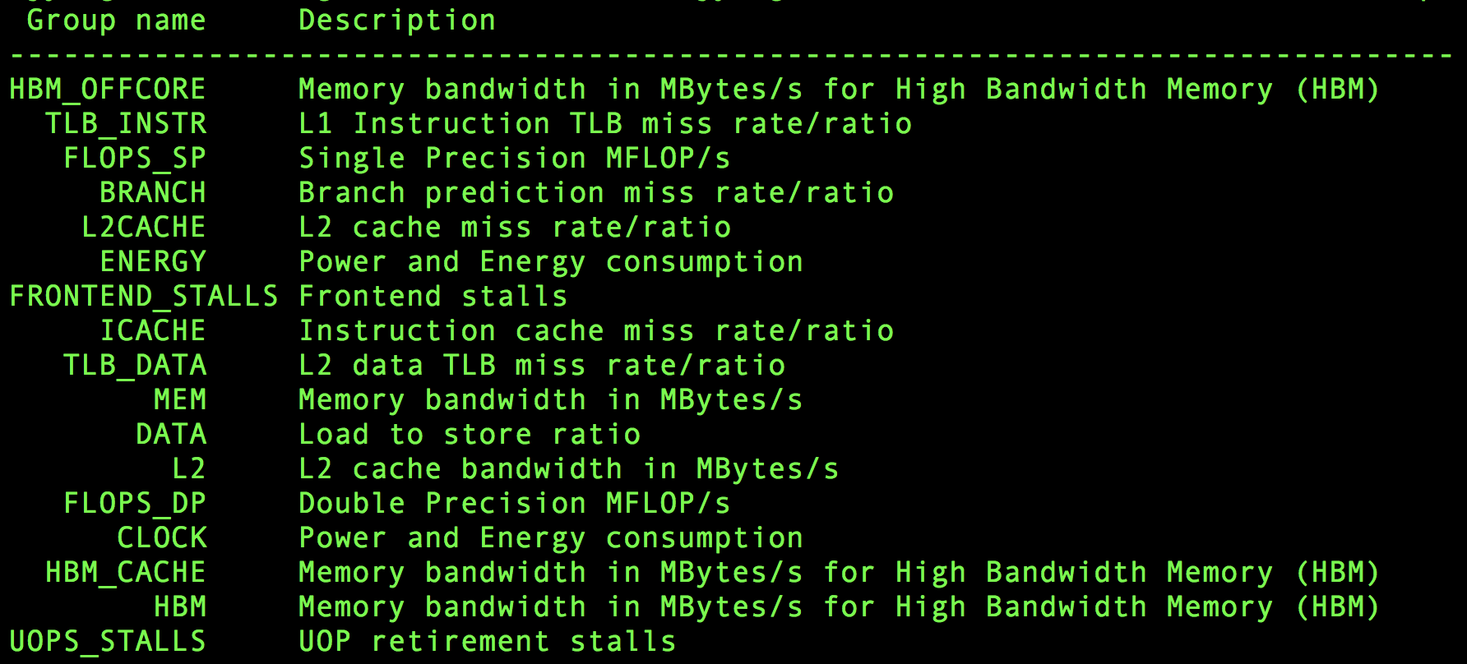
Likwid-perfctr –a (KNL)

Slide 86
Using LIKWID for Roofline
GPP kernel from BerkeleyGW
Arithmetic Intensity = FLOPS / Bytes (= SDE / VTune)
= FLOPS/sec / Bytes/sec = FLOPS_DP / Bandwidth
AI (DRAM) = FLOPS_DP / Bandwidth (DRAM)
AI (MCDRAM) = FLOPS_DP / Bandwidth (MCDRAM)
AI (L2) = FLOPS_DP / Bandwidth (L2)
AI (L1) = FLOPS_DP / Bandwidth (L1)
Performance = FLOPS_DP
Peak FLOP/s
L1 GB/s
L2 GB/s
MCDRAM cache GB/s
Attainable FLOP/s
DDR GB/s
Arithmetic Intensity

Slide 87
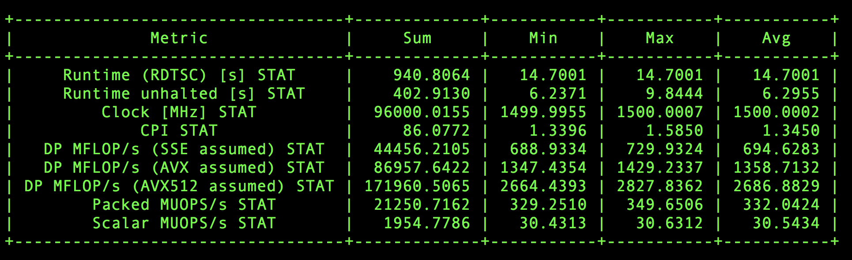
GFLOP/s
GPP kernel on KNL: 171.960 GFLOPS/sec
  UOPS_RETIRED_PACKED_SIMD
  UOPS_RETIRED_SCALAR_SIMD
likwid-perfctr -C 0-63 -g FLOPS_DP ./gpp.knl.ex 512 2 32768 20
  8*UOPS_RETIRED_PACKED_SIMD+UOPS_RETIRED_SCALAR_SIMD

Slide 88
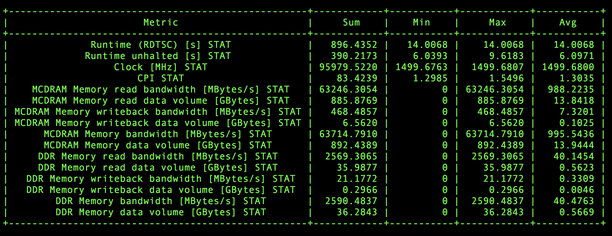
MCDRAM and DDR GB/s
kernel on KNL: DDR 2.59GB/s + MCDRAM 63.71GB/s
  MC_CAS_READS/ MC_CAS_WRITES
  EDC_RPQ_INSERTS/ EDC_WPQ_INSERTS
  EDC_MISS_CLEAN/ EDC_MISS_DIRTY
  likwid-perfctr -C 0-63 -g HBM_CACHE ./gpp.knl.ex 512 2 32768 20

Slide 89
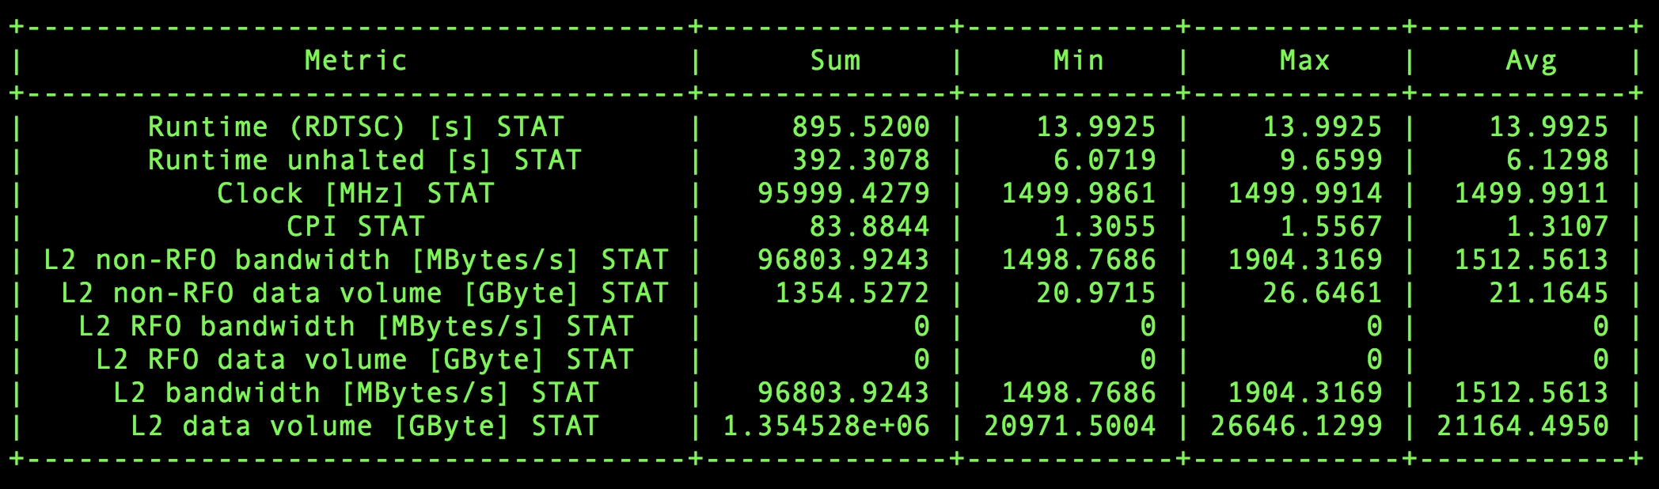
L2 GB/s
kernel on KNL: L2 96.80GB/s
  L2_REQUESTS_REFERENCE
  OFFCORE_RESPONSE_0_OPTIONS
  likwid-perfctr -C 0-63 -g L2 ./gpp.knl.ex 512 2 32768 20

Slide 90
L1 GB/s
kernel on KNL: L1 170.77GB/s
  MEM_UOPS_RETIRED_ALL_LOADS
  MEM_UOPS_RETIRED_ALL_STORES
  likwid-perfctr -C 0-63 -g DATA ./gpp.knl.ex 512 2 32768 20
  (MEM_UOPS_RETIRED_ALL_LOADS + MEM_UOPS_RETIRED_ALL_STORES)*64/runtime
  -g DATA is for load-to-store ratio, but can be used to estimate L1 bandwidth (assume all loads are vector loads)

Slide 91
Resultant Roofline
AI (DRAM): 66.39
AI (MCDRAM): 2.70
AI (L2): 1.78
AI (L1): 1.01
Performance: 171.960 GFLOPS/s
L1 12.2TB/s
L2 2.0TB/s
MCDRAM 368.5GB/s
DDR 77.0GB/s
2.7TFLOP/s
171.96GFLOP/s
Attainable FLOP/s
1.01
1.78
2.70
66.39
Arithmetic Intensity

Slide 92
LIKWID on AMReX apps
Used LIKWID to characterize AMReX applications
Measured cache and DRAM bytes.
Averaged over 30min executions and 32 processes
Only 2 applications (not counting HPGMG proxy) used >50% of memory bandwidth on average
Used this data to estimate average AI for each level of the memory hierarchy
Used this data to infer requisite cache tapering

Slide 93
Likwid-mpirun
srun -n 2 -c 32 --cpu-bind=cores likwid-perfctr -C 0,8 -g MEM -o test_%h_%p_%r.txt ./xthi.x
%h hostname
%p process ID
%r MPI rank
likwid-mpirun -pin S0:0,8_S1:0,8 -g MEM ./xthi.x
      Hello from rank 0, thread 0, on nid00191. (core affinity = 0)
      Hello from rank 0, thread 1, on nid00191. (core affinity = 8)
      Hello from rank 1, thread 0, on nid00191. (core affinity = 16)
      Hello from rank 1, thread 1, on nid00191. (core affinity = 24)
Uncore counters are measured on a per-socket basis
HSW

Slide 94
Marking Specific Regions
  #include <likwid.h>
  ……
  LIKWID_MARKER_INIT;
  #pragma omp parallel {
  LIKWID_MARKER_THREADINIT;
  }
  #pragma omp parallel {
  LIKWID_MARKER_START("foo");
  #pragma omp for
  for(i = 0; i < N; i++) {
  data[i] = omp_get_thread_num();
  }
  LIKWID_MARKER_STOP("foo");
  }
  LIKWID_MARKER_CLOSE;
cc -qopenmp -DLIKWID_PERFMON -I$LIKWID_INCLUDE -L$LIKWID_LIB -llikwid -dynamic test.c -o test.x
likwid-perfctr -C 0-3 -g MEM -m ./test.x
focus on specific code regions

Slide 95
Why isn’t LIKWID good enough?
LIKWID counts vector uops
KNL vuop counters aren’t…
VL-aware
precision-aware
mask-aware
FMA-aware
Counters don’t differentiate instruction types (FP, int, shuffle, …)
Flop counters were broken on Haswell.
Thus, LIKWID might be a good starting point, but its not perfect.
Need tools that actually count flops correctly and ones that can be used to understand nuances of instruction mixes.

Slide 96
Intel Software Development Emulator (SDE)
Dynamic instruction tracing
Accounts for actual loop lengths and branches
Counts instruction types, lengths, etc…
Can mark individual regions
Support for MPI+OpenMP
Can be used to calculate FLOPs (VL-, FMA-, and precision-aware)
Post processing can be expensive.
No insights into cache behavior or DRAM data movement
X86 only
https://software.intel.com/en-us/articles/intel-software-development-emulator

Slide 97
Compiling with SDE at NERSC
Makefile…
MPICC = cc
CFLAGS = -g -O3 -dynamic -qopenmp -restrict -qopt-streaming-stores always \
-DSTREAM_ARRAY_SIZE=400000000 -DNTIMES=50 \
-I$(VTUNE_AMPLIFIER_XE_2018_DIR)/include
LDFLAGS = -L$(VTUNE_AMPLIFIER_XE_2018_DIR)/lib64 -littnotify
stream_mpi.exe: stream_mpi.c Makefile
$(MPICC) $(CFLAGS) stream_mpi.c -o stream_mpi.exe $(LDFLAGS)
clean:
rm -f stream_mpi.exe
module load sde
make
https://bitbucket.org/dwdoerf/stream-ai-example.git

Slide 98
Running with SDE at NERSC
srun -n 4 -c 6 sde -ivb -d -iform 1 -omix my_mix.out -i -global_region -start_ssc_mark 111:repeat -stop_ssc_mark 222:repeat -- foo.exe
-ivb is used to target Edison's Ivy Bridge ISA (for Cori use -hsw for Haswell or -knl for KNL processors)
-d specifies to only collect dynamic profile information
-iform 1 turns on compute ISA iform mix
-omix specifies the output file (and turns on -mix)
-i specifies that each process will have a unique file name based on process ID (needed for MPI)
-global_region will include any threads spawned by a process (needed for OpenMP)
http://www.nersc.gov/users/application-performance/measuring-arithmetic-intensity/

Slide 99
Parsing the Output
When the job completes, you’ll have a series of files prefixed with “sde_”.
Parse the output to summarize the results…
./parse-sde.sh sde_2p16t*
Use the “Total FLOPs” line as the numerator in all AI’s and performance
Use the “Total Bytes” line as the denominator in the L1 AI
Can infer vectorization rates and precision
$ ./parse-sde.sh sde_2p16t*
Search stanza is "EMIT_GLOBAL_DYNAMIC_STATS"
elements_fp_single_1 = 0
elements_fp_single_2 = 0
elements_fp_single_4 = 0
elements_fp_single_8 = 0
elements_fp_single_16 = 0
elements_fp_double_1 = 2960
elements_fp_double_2 = 0
elements_fp_double_4 = 999999360
elements_fp_double_8 = 0
--->Total single-precision FLOPs = 0
--->Total double-precision FLOPs = 4000000400
--->Total FLOPs = 4000000400
mem-read-1 = 8618384
mem-read-2 = 1232
mem-read-4 = 137276433
mem-read-8 = 149329207
mem-read-16 = 1999998720
mem-read-32 = 0
mem-read-64 = 0
mem-write-1 = 264992
mem-write-2 = 560
mem-write-4 = 285974
mem-write-8 = 14508338
mem-write-16 = 0
mem-write-32 = 499999680
mem-write-64 = 0
--->Total Bytes read = 33752339756
--->Total Bytes written = 16117466472
--->Total Bytes = 49869806228

Slide 100
Marking Regions of Interest for SDE
// Code must be built with appropriate paths for VTune include file (ittnotify.h) and library (-littnotify)
#include <ittnotify.h>
__SSC_MARK(0x111); // start SDE tracing, note it uses 2 underscores
__itt_resume(); // start VTune, again use 2 underscores
for (k=0; k<NTIMES; k++) {
#pragma omp parallel for
for (j=0; j<STREAM_ARRAY_SIZE; j++)
a[j] = b[j]+scalar*c[j];
}
__itt_pause(); // stop VTune
__SSC_MARK(0x222); // stop SDE tracing
!
Essential when
analyzing Individual
kernels
http://www.nersc.gov/users/application-performance/measuring-arithmetic-intensity/

Slide 101
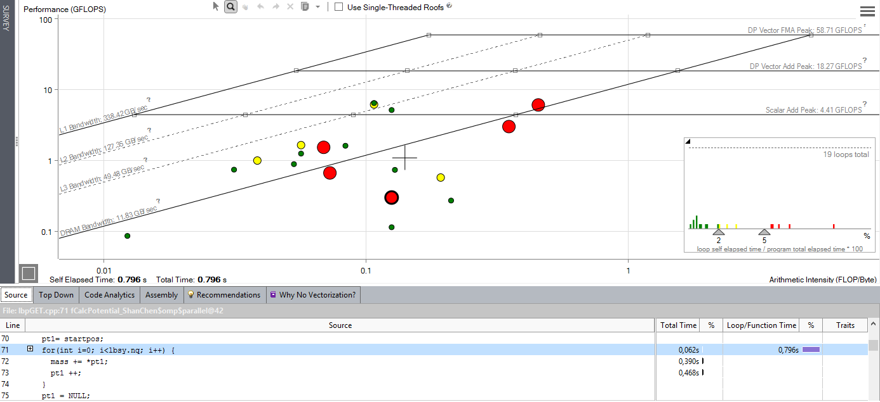
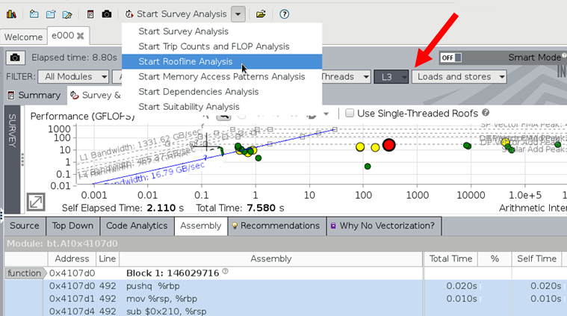
Intel Advisor
Includes Roofline Automation…
Automatically instruments applications
(one dot per loop nest/function)
Computes FLOPS and AI for each function (CARM)
AVX-512 support that incorporates masks
Integrated Cache Simulator¹ (hierarchical roofline / multiple AI’s)
Automatically benchmarks target system (calculates ceilings)
Full integration with existing Advisor capabilities
Memory-bound, invest into cache blocking etc
Compute bound: invest into SIMD,..
http://www.nersc.gov/users/training/events/roofline-training-1182017-1192017
¹Experimental Feature, the look and feel and exact behavior is subject for change

Slide 102
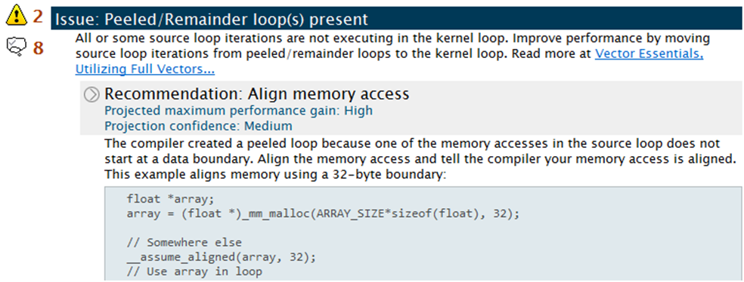
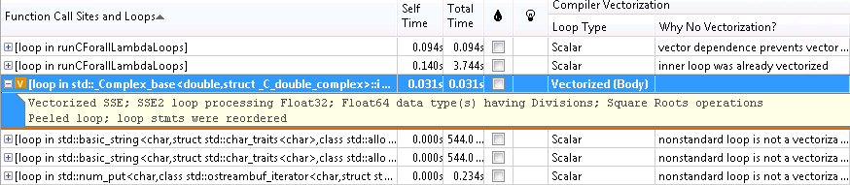
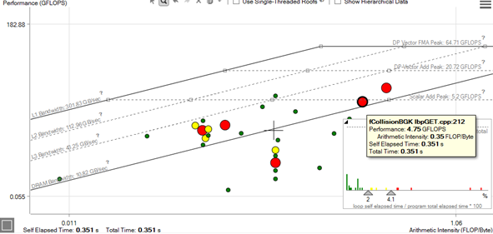
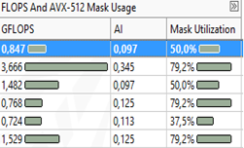
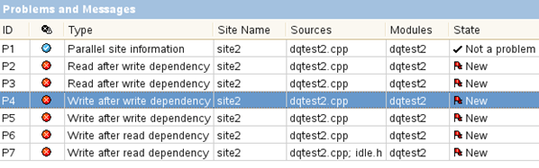
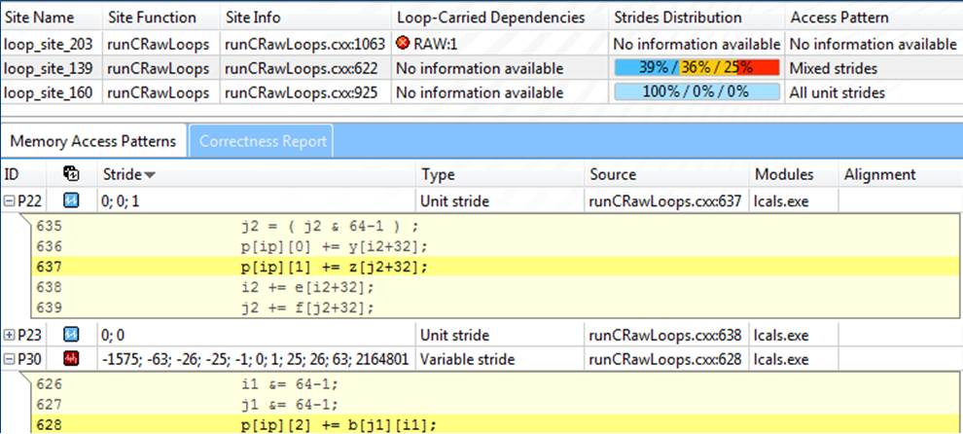
Intel® Advisor: Components
What’s new in
“2019” release
    Step 1. Compiler diagnostics + Performance Data + SIMD efficiency information
Guidance: detect problem and recommend how to fix it
    Step 2. “Precise” Trip Counts & FLOPs. Roofline analysis.
    Characterize your application.
Roofline for INT OP/S
Integrated Roofline (exp)
Interactive(!) HTML export
MAC OS viewer
Function call counts
Python API..
Step 3. Loop-Carried Dependency Analysis
Step 4. Memory Access Patterns Analysis

Slide 103
Intel® Advisor: 2-pass Approach
Roofline: X-Axis (AI): #FLOPs / #Bytes Y-Axis (FLOP/s): #FLOP(mask-aware)/time | Overhead
Step 1: Survey (-collect survey) Records run times User-mode sampling; non-intrusive No need for root access | 1x
Step 2: FLOPs (-collect tripcounts –flops) Record #FLOPs, #Bytes, AVX512 masks Precise, instrumentation-based count of the number of instructions No need for root access | 3-5x (8-37x)¹
¹With Integrated Roofline (Cache Simulator) enabled.

Slide 104
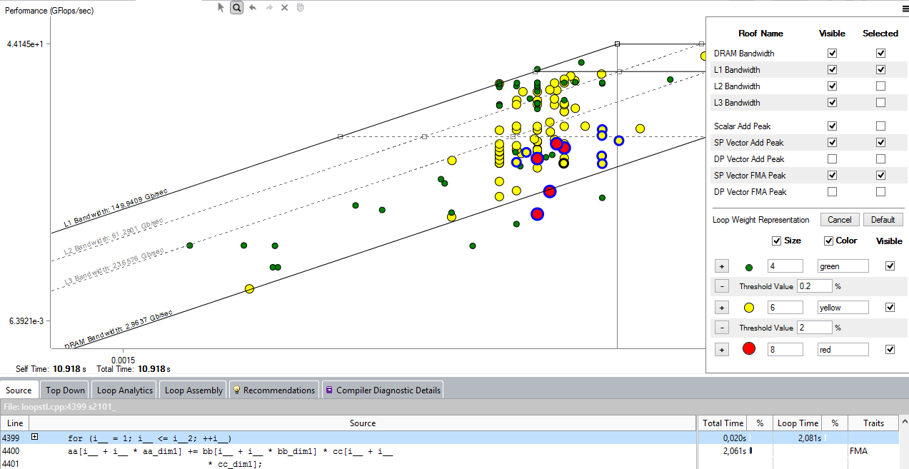
Intel® Advisor: Roofline Automation
Each Ceiling provides peak CPU/Memory throughput
of your PLATFORM (benchmarked)
Each Dot represents loop or function in YOUR APPLICATION (profiled)
Automatic and integrated – first class citizen in Intel® Advisor

Slide 105
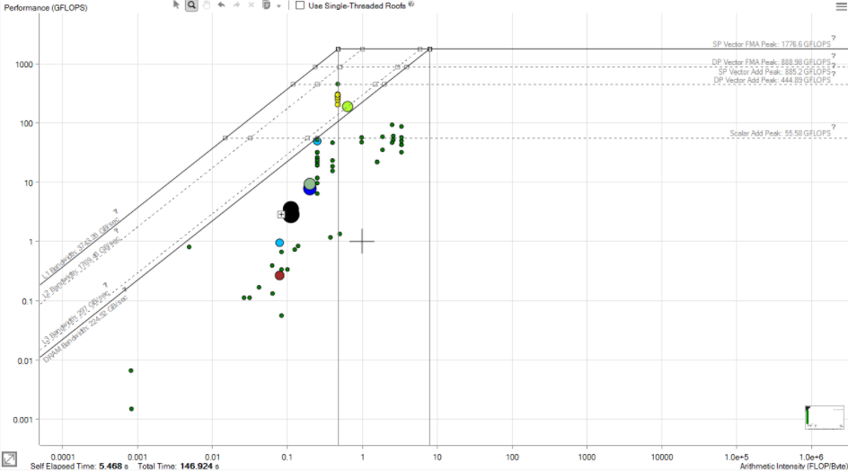
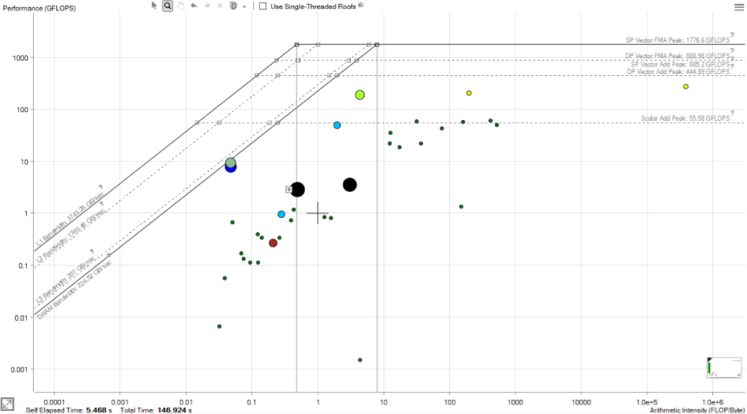
NEW: Integrated Roofline
CARM (L1+NTS)
CPU perspective
DRAM (ORM)
Highly optimized
All hotspots but 1
are not CPU-bound
Not Memory bound
Some Locality
Full waveform Inversion. Seismic Workload
Data: Courtesy
Philippe Thierry

Slide 106
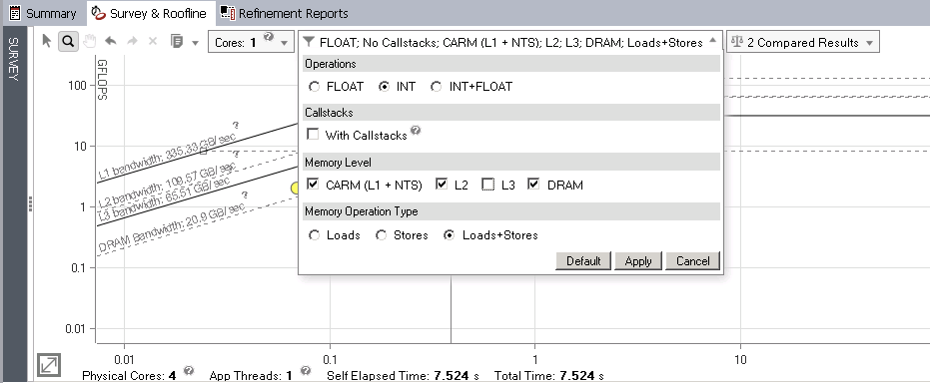
NEW: Integer, Float, Int+Float Rooflines

Slide 107
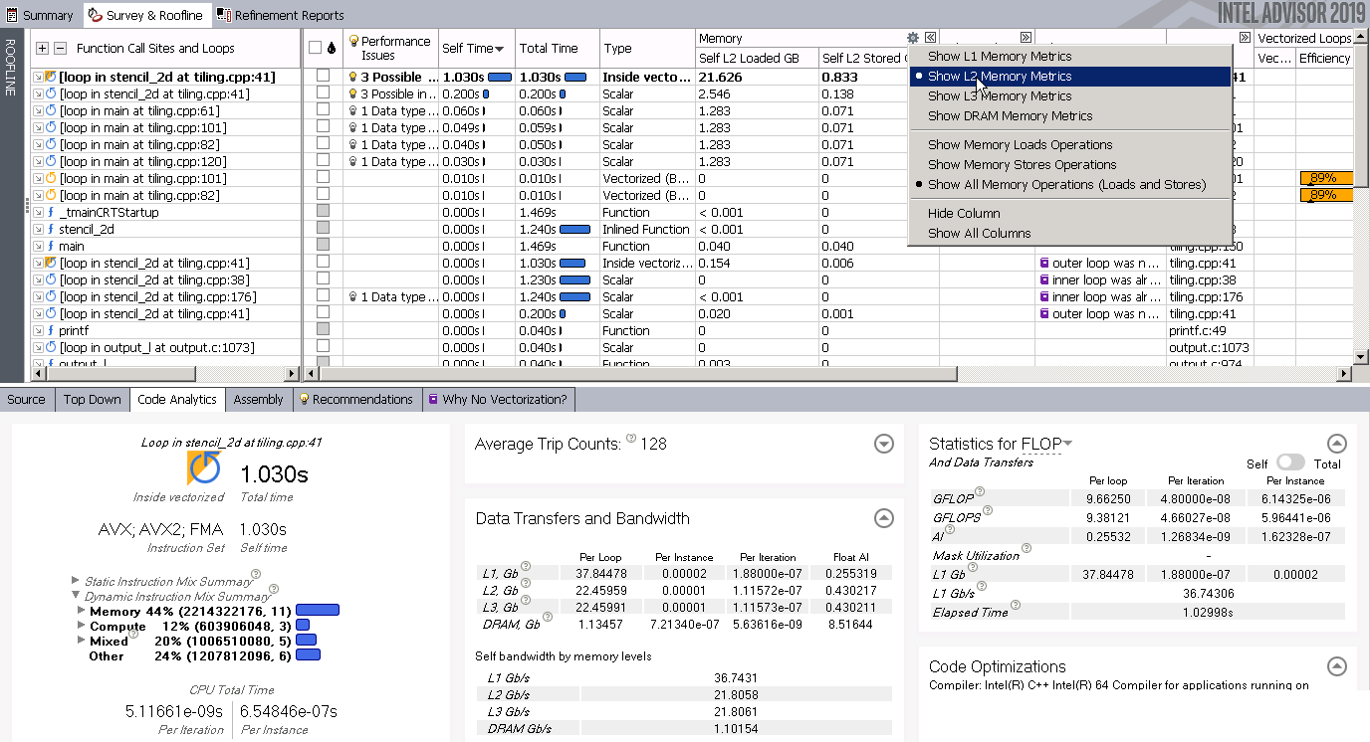
NEW: Memory Traffic in Survey Grid

Slide 108
Integrated Roofline Model
Old Approach…
source advixe-vars.sh
advixe-cl -collect survey --project-dir ./your_project -- <your-executable-with-parameters>
advixe-cl -collect tripcounts -enable-cache-simulation -flop --project-dir ./your_project -- <your-executable-with-parameters>
New Approach (but not compatible with MPI)…
source advixe-vars.sh
advixe-cl -collect roofline -enable-cache-simulation --project-dir ./your_project -- <your-executable-with-parameters>
(optional) copy data to your UI desktop system
advixe-gui ./your_project
https://software.intel.com/en-us/articles/integrated-roofline-model-with-intel-advisor

Slide 109
Advisor on NERSC’s Cori
http://www.nersc.gov/users/software/performance-and-debugging-tools/advisor/
module load advisor/2018.integrated_roofline
cc -g -dynamic -openmp -O2 -o mycode.exe mycode.c
Best to run advisor only on rank 0... srun calls a script like…
#!/bin/bash
if [[ $SLURM_PROCID == 0 ]];then
advixe-cl -collect=survey --project-dir knl-result -data-limit=0 -- ./a.out
else
sleep 30
./a.out
fi

Slide 110

Exporting Roofline Figures
Advisor can directly export a
HTML Roofline figure …
Alternately, you can output directly from the command line (no GUI needed)…
  advixe-cl -report roofline --project-dir ./your_project > roofline.html

Slide 111
Tools for Roofline Analysis on GPUs slides provided by Charlene Yang (CJYang@lbl.gov)

Slide 112
Roofline on GPUs (Overview)
Use ERT to obtain empirical Roofline ceilings
compute: FMA, no-FMA
bandwidth: system memory, device memory, L2, L1
Use nvprof to obtain application performance
FLOPs: active non-predicated threads, divides-aware
bytes: read + write; system memory, device memory, L2, L1
runtime: --print-gpu-summary, --print-gpu-trace
Plot Roofline with Python and Matplotlib

Slide 113
Characterizing NVIDIA GPUs
Empirical Roofline Toolkit (ERT)
https://bitbucket.org/berkeleylab/cs-roofline-toolkit/
Sweeps through a variety of configurations:
  1 data element per thread -> multiple
  1 FLOP operation per data element -> multiple
  number of threadblocks/threads
  number of trails, dataset sizes, etc
Four components
  Driver.c, Kernel.c, configuration script, and job script

Slide 114
Characterizing NVIDIA GPUs
Kernel.c
actual compute
customizable
Driver.c
setup
call kernels
loop over parameters
Kernel.c
loop over ntrails
distribute dataset on threads and each computes ERT_FLOPS
Kernel.h
ERT_FLOPS=1: a = b + c
ERT_FLOPS=2: a = a x b + c
Driver.c (uses some Macros from config.txt)
initialize MPI, CUDA
loop over dataset sizes <= ERT_MEMORY_MAX
loop over trial sizes >= ERT_TRIALS_MIN
cudaMemcpy
start timer
call kernel
end timer
config script
set up ranges of parameters
job script
submit the job and run it
config.txt
ERT_FLOPS 1,2,4,8,16,32,64,128,256
ERT_GPU_BLOCKS 80,160,320,640,1280,2560
ERT_GPU_THREADS 64,128,256,512,1024
ERT_MEMORY_MAX 1073741824
ERT_WORKING_SET_MIN 128
ERT_TRIALS_MIN 1
...
Job script
./ert config.txt
ert (Python)
create directories
loop over ERT_FLOPS, ERT_GPU_BLOCKS/THREADS
call driver, kernel
Empirical Roofline Toolkit. https://bitbucket.org/berkeleylab/cs-roofline-toolkit/
Tutorial code. https://github.com/cyanguwa/nersc-roofline/
Roofline documentation. https://crd.lbl.gov/departments/computer-science/PAR/research/roofline/

Slide 115
Peak Bandwidth
NVIDIA V100, Voltar at Oregon
ERT_FLOPS=1, GPU_BLOCKS=640, GPU_THREADS=256
Bandwidth: HBM 828GB/s, L2 3TB/s → These are the peak bandwidths!
GFLOP/s: 200GFLOP/s → Still in a bandwidth-bound regime

Slide 116
Peak Performance
NVIDIA V100, Voltar at Oregon
ERT_FLOPS=1024, GPU_BLOCKS=640, GPU_THREADS=256
Bandwidth: HBM 100GB/s → ERT is now in a compute-bound regime
GFLOP/s: 7TFLOP/s → This is the peak GFLOP/s!

Slide 117


Characterizing GPU-accelerated Applications
Three measurements: Time, FLOPs, Bytes (on each cache level)
Runtime:
time per invocation of a kernel
nvprof --print-gpu-trace ./application args
average time over multiple invocations
nvprof --print-gpu-summary ./application args
same kernel with different input parameters are grouped separately
$$\text{Performance}\text{ = }\frac{nvprof \text{FLOPs}}{\text{Runtime}}\text{ ,}$$
$$\text{Arithmetic} \text{Intensity}\text{ = }\frac{nvprof \text{FLOPs}}{nvprof \text{Data} \text{Movement}}$$

Slide 118
Characterizing GPU-accelerated Applications
FLOPs:
  predication aware, and divides aware, dp/dp_add/dp_mul/dp_fma, sp*
  nvprof --kernels ‘kernel_name’ --metrics ‘flop_count_xx’ ./application
Bytes for different cache levels to construct hierarchical Roofline
  nvprof --kernels ‘kernel_name’ --metrics ‘metric_name’./application
  Bytes = (read transactions + write transactions) x transaction size
Memory Level | Metrics | Transaction Size
L1 Cache | gld_transactions, gst_transactions | 32B
L2 Cache | l2_read_transactions, l2_write_transactions | 32B
Device Memory | dram_read_transactions, dram_write_transactions | 32B
System Memory | system_read_transactions, system_write_transactions | 32B

Slide 119
Example Output
[cjyang@voltar source]$ nvprof --kernels "1:7:smooth_kernel:1" --metrics flop_count_dp --metrics gld_transactions --metrics gst_transactions --metrics l2_read_transactions --metrics l2_write_transactions --metrics dram_read_transactions --metrics dram_write_transactions --metrics sysmem_read_bytes --metrics sysmem_write_bytes ./backup-bin/hpgmg-fv-fp 5 8
Can collect all metrics at once or one at a time (slowdown)
Output in CSV; Python/Excel for multiple output files

Slide 120
Plotting Rooflines of NVProf Data
Python scripts using Matplotlib
https://github.com/cyanguwa/nersc-roofline/tree/master/Plotting
Simple example: plot_roofline.py data.txt
Tweaking needed for more sophisticated plotting, see examples
data.txt
# all data is space delimited
memroofs 828.758
mem_roof_names 'HBM’
comproofs 7068.86 3535.79
comp_roof_names 'FMA' ’No-FMA’
# omit the following if only plotting roofs
# AI: arithmetic intensity; GFLOPs: performance
AI 2.584785579
GFLOPs 2085.756683
labels ‘FMA, nw=1’

Slide 121
HBM Roofline on GPUs
Use BerkeleyGW Proxy app GPP to see GPU effects
HBM Roofline
AI increases as nw grows
bandwidth bound →
compute bound
Disable FMA in the compiler…
(-fmad=true/false)
“No-FMA” converges to its ceiling
But FMA doesn’t

Slide 122
Hierarchical Roofline on GPUs
GPP is HBM bound
L1/L2 performance far from L1/L2 ceiling
FLOPs are proportional to nw
Increase in HBM AI →
HBM bytes approx. constant
(good L2 locality)
Slow increase in L2 AI →
L2 bytes increase for nw>1
(poor L1 locality)
Increase in L1 AI →
L1 bytes approx. constant
(good register file locality)

Slide 123
Summary

Slide 124
Summary
Performance Models
Roofline Model
Tools for Roofline Analysis…
Machine Characterization (ERT)
Using LIKWID to access performance counters
Using SDE to get more accurate FLOP counts
Using Advisor to provide a single tool that integrates cache simulation and accurate FLOP counts.
Using NVProf to affect Roofline on GPUs

Slide 125
Questions?

Slide 126
Backup

Slide 127
Hierarchical Roofline vs.
Cache-Aware Roofline
…understanding different Roofline formulations in Advisor

Slide 128
There are two Major Roofline Formulations:
Hierarchical Roofline (original Roofline w/ DRAM, L3, L2, …)…
      Williams, et al, “Roofline: An Insightful Visual Performance Model for Multicore Architectures”, CACM, 2009
      Chapter 4 of “Auto-tuning Performance on Multicore Computers”, 2008
      Defines multiple bandwidth ceilings and multiple AI’s per kernel
      Performance bound is the minimum of flops and the memory intercepts (superposition of original, single-metric Rooflines)
Cache-Aware Roofline
      Ilic et al, "Cache-aware Roofline model: Upgrading the loft", IEEE Computer Architecture Letters, 2014
      Defines multiple bandwidth ceilings, but uses a single AI (FLOP:L1 bytes)
      As one looses cache locality (capacity, conflict, …) performance falls from one BW ceiling to a lower one at constant AI
Why Does this matter?
      Some tools use the Hierarchical Roofline, some use cache-aware == Users need to understand the differences
      Cache-Aware Roofline model was integrated into production Intel Advisor
      Evaluation version of Hierarchical Roofline¹ (cache simulator) has also been integrated into Intel Advisor
¹Technology Preview, not in official product roadmap so far.

Slide 129
Hierarchical Roofline
Cache-Aware Roofline
Captures cache effects
Captures cache effects
AI is FLOP:Bytes after being filtered by lower cache levels
AI is FLOP:Bytes as presented to the L1 cache (plus non-temporal stores)
Multiple Arithmetic Intensities
(one per level of memory)
Single Arithmetic Intensity
AI dependent on problem size
(capacity misses reduce AI)
AI independent of problem size
Memory/Cache/Locality effects are observed as decreased AI
Memory/Cache/Locality effects are observed as decreased performance
Requires performance counters or cache simulator to correctly measure AI
Requires static analysis or binary instrumentation to measure AI
Notes:
Some tools use one…
some tools use the other…
some use both.

Slide 130
Example: STREAM
L1 AI…
      2 flops
      2 x 8B load (old)
      1 x 8B store (new)
      = 0.08 flops per byte
    No cache reuse…
      Iteration i doesn’t touch any data associated with iteration i+delta for any delta.
… leads to a DRAM AI equal to the L1 AI
#pragma omp parallel for
for(i=0;i<N;i++){
Z[i] = X[i] + alpha*Y[i];
}

Slide 131
Example: STREAM
Hierarchical Roofline
Cache-Aware Roofline
Peak FLOP/s
Peak FLOP/s
Performance is bound to
the minimum of the two
Intercepts…
AI_{L1} * L1 GB/s
AI_{DRAM} * DRAM GB/s
Observed performance
is correlated with DRAM
bandwidth
Attainable FLOP/s
Attainable FLOP/s
L1 GB/s
L1 GB/s
Multiple AI’s….
FLOP:DRAM bytes
FLOP:L1 bytes (same)
DRAM GB/s
DRAM GB/s
Single AI based on FLOP:L1 bytes
0.083
0.083
Arithmetic Intensity (FLOP:Byte)
Arithmetic Intensity (FLOP:Byte)

Slide 132
Example: 7-point Stencil (Small Problem)
L1 AI…
      7 flops
      7 x 8B load (old)
      1 x 8B store (new)
      = 0.11 flops per byte
      some compilers may do register shuffles to reduce the number of loads.
    Moderate cache reuse…
      old[ijk] is reused on subsequent iterations of i,j,k
      old[ijk-1] is reused on subsequent iterations of i.
      old[ijk-jStride] is reused on subsequent iterations of j.
      old[ijk-kStride] is reused on subsequent iterations of k.
… leads to DRAM AI larger than the L1 AI
#pragma omp parallel for
for(k=1;k<dim+1;k++){
for(j=1;j<dim+1;j++){
for(i=1;i<dim+1;i++){
int ijk = i + j*jStride + k*kStride;
new[ijk] = -6.0*old[ijk ]
+ old[ijk-1 ]
+ old[ijk+1 ]
+ old[ijk-jStride]
+ old[ijk+jStride]
+ old[ijk-kStride]
+ old[ijk+kStride];
}}}

Slide 133
Example: 7-point Stencil (Small Problem)
Hierarchical Roofline
Cache-Aware Roofline
Peak FLOP/s
Peak FLOP/s
Attainable FLOP/s
Attainable FLOP/s
L1 GB/s
Performance bound is
the minimum of the two
L1 GB/s
Multiple AI’s….
FLOP:DRAM ~ 0.44
FLOP:L1 ~ 0.11
DRAM GB/s
DRAM GB/s
0.11
0.44
0.11
Arithmetic Intensity (FLOP:Byte)
Arithmetic Intensity (FLOP:Byte)

Slide 134
Example: 7-point Stencil (Small Problem)
Hierarchical Roofline
Cache-Aware Roofline
Peak FLOP/s
Peak FLOP/s
Observed performance
is between L1 and DRAM lines
(== some cache locality)
Attainable FLOP/s
Attainable FLOP/s
L1 GB/s
Performance bound is
the minimum of the two
L1 GB/s
Multiple AI’s….
FLOP:DRAM ~ 0.44
FLOP:L1 ~ 0.11
DRAM GB/s
DRAM GB/s
Single AI based on FLOP:L1 bytes
0.11
0.44
0.11
Arithmetic Intensity (FLOP:Byte)
Arithmetic Intensity (FLOP:Byte)

Slide 135
Example: 7-point Stencil (Large Problem)
Hierarchical Roofline
Cache-Aware Roofline
Peak FLOP/s
Peak FLOP/s
Observed performance
is closer to DRAM line
(== less cache locality)
Attainable FLOP/s
Attainable FLOP/s
L1 GB/s
Capacity misses reduce
DRAM AI and performance
L1 GB/s
Multiple AI’s….
FLOP:DRAM ~ 0.20
FLOP:L1 ~ 0.11
DRAM GB/s
DRAM GB/s
Single AI based on FLOP:L1 bytes
0.11
0.20
0.11
Arithmetic Intensity (FLOP:Byte)
Arithmetic Intensity (FLOP:Byte)

Slide 136
Example: 7-point Stencil (Observed Perf.)
Hierarchical Roofline
Cache-Aware Roofline
Peak FLOP/s
Peak FLOP/s
Observed performance
is closer to DRAM line
(== less cache locality)
Attainable FLOP/s
Attainable FLOP/s
L1 GB/s
L1 GB/s
Actual observed performance
is tied to the bottlenecked resource
and can be well below a cache
Roofline (e.g. L1).
DRAM GB/s
DRAM GB/s
Single AI based on FLOP:L1 bytes
0.11
0.20
0.11
Arithmetic Intensity (FLOP:Byte)
Arithmetic Intensity (FLOP:Byte)

Slide 137
Example: 7-point Stencil (Observed Perf.)
Hierarchical Roofline
Cache-Aware Roofline
Peak FLOP/s
Peak FLOP/s
Observed performance
is closer to DRAM line
(== less cache locality)
Attainable FLOP/s
Attainable FLOP/s
L1 GB/s
L1 GB/s
Actual observed performance
is tied to the bottlenecked resource
and can be well below a cache
Roofline (e.g. L1).
DRAM GB/s
DRAM GB/s
Single AI based on FLOP:L1 bytes
0.11
0.20
0.11
Arithmetic Intensity (FLOP:Byte)
Arithmetic Intensity (FLOP:Byte)

