Slide 1
Performance Modeling and Analysis
Samuel Williams
Computational Research Division
Lawrence Berkeley National Lab
SWWilliams@lbl.gov

Slide 2
Acknowledgements
This material is based upon work supported by the Advanced Scientific Computing Research Program in the U.S. Department of Energy, Office of Science, under Award Number DE-AC02-05CH11231.
This material is based upon work supported by the DOE RAPIDS SciDAC Institute.
This research used resources of the National Energy Research Scientific Computing Center (NERSC), which is supported by the Office of Science of the U.S. Department of Energy under contract DE-AC02-05CH11231.
This research used resources of the Oak Ridge Leadership Facility at the Oak Ridge National Laboratory, which is supported by the Office of Science of the U.S. Department of Energy under Contract No. DE-AC05-00OR22725.
Tuomas Koskela for his creation of the Roofline Advisor demo slides

Slide 3
Introduction to
Performance
Modeling

Slide 4
Why Use Performance Models or Tools?
Identify performance bottlenecks
Motivate software optimizations
Determine when we’re done optimizing
Assess performance relative to machine capabilities
Motivate need for algorithmic changes
Predict performance on future machines / architectures
Sets realistic expectations on performance for future procurements
Used for HW/SW Co-Design to ensure future architectures are well-suited for the computational needs of today’s applications.

Slide 5
Computational Complexity
Assume run time is correlated with the number of operations (e.g. FP ops)
Users define parameterize their algorithms, solvers, kernels
Count the number of operations as a function of those parameters
Demonstrate run time is correlated with those parameters
#pragma omp parallel for
for(i=0;i<N;i++){
Z[i] = alpha*X[i] + Y[i];
}
#pragma omp parallel for
for(i=0;i<N;i++){
for(j=0;j<N;j++){
double Cij=0;
for(k=0;k<N;k++){
Cij += A[i][k] * B[k][j];
}
C[i][j] = sum;
}}
?
DAXPY: O(N) complexity where N is the number of elements
What are the scaling constants?
DGEMM: O(N³) complexity where N is the number of rows (equations)
?
FFTs: O(NlogN) in the number of elements
CG: O(N^{1.33}) in the number of elements (equations)
MG: O(N) in the number of elements (equations)
N-body: O(N²) in the number of particles (per time step)
Why did we depart from ideal scaling?
Notes:
i.e.
1) How do we make complexity predictive of run time
2) Ideal scaling may only apply for a range of N and there can be abrupt cliffs in run time.

Slide 6
Data Movement Complexity
Assume run time is correlated with the amount of data accessed (or moved)
Easy to calculate amount of data accessed… count array accesses
Operation
Flop’s
Data
AI
DAXPY
DGEMV
DGEMM
FFTs
CG
MG
N-body
O(N)
O(N²)
O(N³)
O(NlogN)
O(N^{1.33})
O(N)
O(N²)
O(N)
O(N²)
O(N²)
O(N)
O(N^{1.33})
O(N)
O(N)
O(1)
O(1)
O(N)
O(N)
O(1)
O(1)
O(N)
?
Data moved is more complex as it requires understanding cache behavior…
Compulsory¹ data movement (array sizes) is a good initial guess…
… but needs refinement for the effects of finite cache capacities
Which is more expensive…
Performing Flop’s, or
Moving words from memory
¹Hill et al, “Evaluating Associativity in CPU Caches”, IEEE Trans. Comput., 1989.

Slide 7
Machine Balance and Arithmetic Intensity
Data movement and computation can operate at different rates
Operation
Flop’s
Data
AI (ideal)
!
DAXPY
DGEMV
DGEMM
FFTs
CG
MG
N-body
O(N)
O(N²)
O(N³)
O(NlogN)
O(N^{1.33})
O(N)
O(N²)
O(N)
O(N²)
O(N²)
O(N)
O(N^{1.33})
O(N)
O(N)
O(1)
O(1)
O(N)
O(logN)
O(1)
O(1)
O(N)
We define machine balance as the ratio of…
Balance =
Peak DP Flop/s
Peak Bandwidth
Kernels with AI
greater than machine balance are ultimately compute limited
…and arithmetic intensity as the ratio of…
AI =
Flop’s Performed
Data Moved
Notes:
Former is a characteristic of the machine
Latter is a characteristic of both the code and the machine (cache effects)
All that’s really saying is that it takes longer to compute than move the data

Slide 8
Distributed Memory Performance Modeling
In distributed memory, one communicates by sending messages between processors.
Messaging time can be constrained by several components…
Overhead (CPU time to send/receive a message)
Latency (time message is in the network; can be hidden)
Message throughput (rate at which one can send small messages… messages/second)
Bandwidth (rate one can send large messages… GBytes/s)
Bandwidths and latencies are further constrained by the interplay of network architecture and contention
Distributed memory versions of our algorithms can be differently stressed by these components depending on N and P (#processors)

Slide 9
Computational Depth
Parallel machines incur substantial overheads on synchronization (shared memory), point-to-point communication, reductions, and broadcasts.
We can classify algorithms by depth (max depth of the algorithm’s dependency chain)
If dependency chain crosses process boundaries, we incur substantial overheads.
Operation
Flop’s
Data
AI (ideal)
Depth
!
DAXPY
DGEMV
DGEMM
FFTs
CG
MG
N-body
O(N)
O(N²)
O(N³)
O(NlogN)
O(N^{1.33})
O(N)
O(N²)
O(N)
O(N²)
O(N²)
O(N)
O(N^{1.33})
O(N)
O(N)
O(1)
O(1)
O(N)
O(logN)
O(1)
O(1)
O(N)
O(1)
O(logN)
O(logN)
O(logN)
O(N^{0.33})
O(logN)
O(logN)
Overheads can dominate at high concurrency or small problems

Slide 10
Performance Models
Many different components can contribute to kernel run time.
Some are characteristics of the application, some are characteristics of the machine, and some are both (memory access pattern + caches).
#FP operations
Cache data movement
DRAM data movement
PCIe data movement
Depth
MPI Message Size
MPI Send:Wait ratio
#MPI Wait’s
Flop/s
Cache GB/s
DRAM GB/s
PCIe bandwidth
OMP Overhead
Network Bandwidth
Network Gap
Network Latency

Slide 11
Performance Models
Can’t think about all these terms all the time for every application…
Computational
Complexity
#FP operations
Cache data movement
DRAM data movement
PCIe data movement
Depth
MPI Message Size
MPI Send:Wait ratio
#MPI Wait’s
Flop/s
Cache GB/s
DRAM GB/s
PCIe bandwidth
OMP Overhead
Network Bandwidth
Network Gap
Network Latency

Slide 12
Performance Models
Because there are so many components, performance models often conceptualize the system as being dominated by one or more of these components.
Roofline
Model
#FP operations
Cache data movement
DRAM data movement
PCIe data movement
Depth
MPI Message Size
MPI Send:Wait ratio
#MPI Wait’s
Flop/s
Cache GB/s
DRAM GB/s
PCIe bandwidth
OMP Overhead
Network Bandwidth
Network Gap
Network Latency
Williams et al, "Roofline: An Insightful Visual Performance Model For Multicore Architectures", CACM, 2009.
Notes:
Roofline focused on processors operating in the throughput-limited regime

Slide 13
Performance Models
Because there are so many components, performance models often conceptualize the system as being dominated by one or more of these components.
#FP operations
Cache data movement
DRAM data movement
PCIe data movement
Depth
MPI Message Size
MPI Send:Wait ratio
#MPI Wait’s
Flop/s
Cache GB/s
DRAM GB/s
PCIe bandwidth
OMP Overhead
Network Bandwidth
Network Gap
Network Latency
LogP
Culler, et al, "LogP: a practical model of parallel computation", CACM, 1996.

Slide 14
Performance Models
Because there are so many components, performance models often conceptualize the system as being dominated by one or more of these components.
#FP operations
Cache data movement
DRAM data movement
PCIe data movement
Depth
MPI Message Size
MPI Send:Wait ratio
#MPI Wait’s
Flop/s
Cache GB/s
DRAM GB/s
PCIe bandwidth
OMP Overhead
Network Bandwidth
Network Gap
Network Latency
LogGP
Alexandrov, et al, "LogGP: incorporating long messages into the LogP model - one step closer towards a realistic model for parallel computation", SPAA, 1995.

Slide 15
Performance Models
Because there are so many components, performance models often conceptualize the system as being dominated by one or more of these components.
!
#FP operations
Cache data movement
DRAM data movement
PCIe data movement
Depth
MPI Message Size
MPI Send:Wait ratio
#MPI Wait’s
Flop/s
Cache GB/s
DRAM GB/s
PCIe bandwidth
OMP Overhead
Network Bandwidth
Network Gap
Network Latency
Think about which
model to use
LogCA
Bin Altaf et al, "LogCA: A High-Level Performance Model for Hardware Accelerators", ISCA, 2017.

Slide 16
Introduction to the
Roofline Model

Slide 17
Performance Models / Simulators
Historically, many performance models and simulators tracked latencies to predict performance (i.e. counting cycles)
The last two decades saw a number of latency-hiding techniques…
Out-of-order execution (hardware discovers parallelism to hide latency)
HW stream prefetching (hardware speculatively loads data)
Massive thread parallelism (independent threads satisfy the latency-bandwidth product)
Effective latency hiding has resulted in a shift from a latency-limited computing regime to a throughput-limited computing regime

Slide 18

Roofline Model
Roofline Model is a throughput-oriented performance model…
Tracks rates not times
Augmented with Little’s Law
(concurrency = latency*bandwidth)
Independent of ISA and architecture (applies to CPUs, GPUs, Google TPUs¹, etc…)
https://crd.lbl.gov/departments/computer-science/PAR/research/roofline
¹Jouppi et al, “In-Datacenter Performance Analysis of a Tensor Processing Unit”, ISCA, 2017.

Slide 19
(DRAM) Roofline
One could hope to always attain peak performance (Flop/s)
However, finite locality (reuse) and bandwidth limit performance.
Assume:
Idealized processor/caches
Cold start (data in DRAM)
CPU
(compute, flop/s)
DRAM Bandwidth
(GB/s)
DRAM
(data, GB)
Time = max
#FP ops / Peak GFlop/s
#Bytes / Peak GB/s

Slide 20
(DRAM) Roofline
One could hope to always attain peak performance (Flop/s)
However, finite locality (reuse) and bandwidth limit performance.
Assume:
Idealized processor/caches
Cold start (data in DRAM)
CPU
(compute, flop/s)
DRAM Bandwidth
(GB/s)
DRAM
(data, GB)
Time
#FP ops
= max
1 / Peak GFlop/s
#Bytes / #FP ops / Peak GB/s

Slide 21
(DRAM) Roofline
One could hope to always attain peak performance (Flop/s)
However, finite locality (reuse) and bandwidth limit performance.
Assume:
Idealized processor/caches
Cold start (data in DRAM)
CPU
(compute, flop/s)
DRAM Bandwidth
(GB/s)
DRAM
(data, GB)
#FP ops
Time
= min
Peak GFlop/s
(#FP ops / #Bytes) * Peak GB/s

Slide 22
(DRAM) Roofline
One could hope to always attain peak performance (Flop/s)
However, finite locality (reuse) and bandwidth limit performance.
Assume:
Idealized processor/caches
Cold start (data in DRAM)
CPU
(compute, flop/s)
DRAM Bandwidth
(GB/s)
DRAM
(data, GB)
GFlop/s = min
Peak GFlop/s
AI * Peak GB/s
Note, Arithmetic Intensity (AI) = Flops / Bytes (as presented to DRAM )

Slide 23
(DRAM) Roofline
Plot Roofline bound using Arithmetic Intensity as the x-axis
Log-log scale makes it easy to doodle, extrapolate performance along Moore’s Law, etc…
Kernels with AI less than machine balance are ultimately DRAM bound (we’ll refine this later…)
Peak Flop/s
Attainable Flop/s
DRAM GB/s
DRAM-bound
Compute-bound
Arithmetic Intensity (Flop:Byte)

Slide 24
Roofline Example #1
Typical machine balance is 5-10 flops per byte…
40-80 flops per double to exploit compute capability
Artifact of technology and money
Unlikely to improve
Consider STREAM Triad…
2 flops per iteration
Transfer 24 bytes per iteration (read X[i], Y[i], write Z[i])
AI = 0.083 flops per byte == Memory bound
Peak Flop/s
Attainable Flop/s
DRAM GB/s
Gflop/s ≤ AI * DRAM GB/s
#pragma omp parallel for
for(i=0;i<N;i++){
Z[i] = X[i] + alpha*Y[i];
}
TRIAD
0.083
Arithmetic Intensity (Flop:Byte)

Slide 25
Roofline Example #2
Conversely, 7-point constant coefficient stencil…
7 flops
8 memory references (7 reads, 1 store) per point
Cache can filter all but 1 read and 1 write per point
AI = 0.44 flops per byte == memory bound,
but 5x the flop rate
Peak Flop/s
Gflop/s ≤ AI * DRAM GB/s
Attainable Flop/s
DRAM GB/s
#pragma omp parallel for
for(k=1;k<dim+1;k++){
for(j=1;j<dim+1;j++){
for(i=1;i<dim+1;i++){
int ijk = i + j*jStride + k*kStride;
new[ijk] = -6.0*old[ijk ]
+ old[ijk-1 ]
+ old[ijk+1 ]
+ old[ijk-jStride]
+ old[ijk+jStride]
+ old[ijk-kStride]
+ old[ijk+kStride];
}}}
7-point
Stencil
TRIAD
0.083
0.44
Arithmetic Intensity (Flop:Byte)

Slide 26
Hierarchical Roofline
Real processors have multiple levels of memory
Registers
L1, L2, L3 cache
MCDRAM/HBM (KNL/GPU device memory)
DDR (main memory)
NVRAM (non-volatile memory)
Applications can have locality in each level
Unique data movements imply unique AI’s
Moreover, each level will have a unique bandwidth

Slide 27
Hierarchical Roofline
Construct superposition of Rooflines…
Measure a bandwidth
Measure AI for each level of memory
Although an loop nest may have multiple AI’s and multiple bounds (flops, L1, L2, … DRAM)…
… performance is bound by the minimum
Peak Flop/s
L2 GB/s
MCDRAM cache GB/s
Attainable Flop/s
DDR Bound
DDR AI*BW <
MCDRAM AI*BW
DDR GB/s
Arithmetic Intensity (Flop:Byte)

Slide 28
Hierarchical Roofline
Construct superposition of Rooflines…
Measure a bandwidth
Measure AI for each level of memory
Although an loop nest may have multiple AI’s and multiple bounds (flops, L1, L2, … DRAM)…
… performance is bound by the minimum
Peak Flop/s
L2 GB/s
MCDRAM cache GB/s
Attainable Flop/s
DDR GB/s
DDR bottleneck pulls performance below MCDRAM Roofline
Arithmetic Intensity (Flop:Byte)

Slide 29
Hierarchical Roofline
Construct superposition of Rooflines…
Measure a bandwidth
Measure AI for each level of memory
Although an loop nest may have multiple AI’s and multiple bounds (flops, L1, L2, … DRAM)…
… performance is bound by the minimum
Peak Flop/s
L2 GB/s
MCDRAM cache GB/s
Attainable Flop/s
MCDRAM bound
MCDRAM AI*BW <
DDR AI*BW
DDR GB/s
Arithmetic Intensity (Flop:Byte)

Slide 30
Hierarchical Roofline
Construct superposition of Rooflines…
Measure a bandwidth
Measure AI for each level of memory
Although an loop nest may have multiple AI’s and multiple bounds (flops, L1, L2, … DRAM)…
… performance is bound by the minimum
Peak Flop/s
L2 GB/s
MCDRAM cache GB/s
Attainable Flop/s
DDR GB/s
MCDRAM bottleneck pulls performance below DDR Roofline
Arithmetic Intensity (Flop:Byte)

Slide 31
NUMA Effects
Cori’s Haswell nodes are built from 2 Xeon processors (sockets)
Memory attached to each socket (fast)
Interconnect that allows remote memory access (slow == NUMA)
Improper memory allocation can result in more than a 2x performance penalty
Peak Flop/s
No FMA
Attainable Flop/s
DDR GB/s
DDR GB/s (NUMA)
No vectorization
CPU0
cores 0-15
CPU1
cores 16-31
~50GB/s
~50GB/s
Arithmetic Intensity (Flop:Byte)
DRAM
DRAM

Slide 32
Modeling In-Core Performance Effects

Slide 33
Data, Instruction, Thread-Level Parallelism…
Modern CPUs use several techniques to increase per core Flop/s
Fused Multiply Add
Vector Instructions
Deep pipelines
w = x*y + z is a common idiom in linear algebra
Rather than having separate multiple and add instructions, processors can use a fused multiply add (FMA)
The FPU chains the multiply and add in a single pipeline so that it can complete FMA/cycle
Many HPC codes apply the same operation to a vector of elements
Vendors provide vector instructions that apply the same operation to 2, 4, 8, 16 elements…
x [0:7] *y [0:7] + z [0:7]
Vector FPUs complete 8 vector operations/cycle
The hardware for a FMA is substantial.
Breaking a single FMA up into several smaller operations and pipelining them allows vendors to increase GHz
Little’s Law applies… need FP_Latency * FP_bandwidth independent instructions
!
Resurgence… Tensor Cores, QFMA, etc…

Slide 34
Data, Instruction, Thread-Level Parallelism…
If every instruction were an ADD (instead of FMA), performance would drop by 2x on KNL or 4x on Haswell
Similarly, if one had no vector instructions, performance would drop by another 8x on KNL and 4x on Haswell
FP Divides can be even worse.
Lack of threading will reduce performance by 64x on KNL.
Peak Flop/s
Add-only (No FMA)
Attainable Flop/s
DDR GB/s
No vectorization
Poor vectorization pulls performance below DDR Roofline
Arithmetic Intensity (Flop:Byte)

Slide 35
Superscalar vs. instruction mix
Define in-core ceilings based on instruction mix…
e.g. Haswell
4-issue superscalar
Only 2 FP data paths
Requires 50% of the instructions to be FP to get peak performance
Peak Flop/s
≥50% FP
25% FP
DDR GB/s
12% FP
Attainable Flop/s
Arithmetic Intensity (Flop:Byte)

Slide 36
Superscalar vs. instruction mix
Define in-core ceilings based on instruction mix…
e.g. Haswell
4-issue superscalar
Only 2 FP data paths
Requires 50% of the instructions to be FP to get peak performance
Peak Flop/s
100% FP
50% FP
DDR GB/s
25% FP
Attainable Flop/s
e.g. KNL
2-issue superscalar
2 FP data paths
Requires 100% of the instructions to be FP to get peak performance
Arithmetic Intensity (Flop:Byte)

Slide 37
Superscalar vs. instruction mix
Define in-core ceilings based on instruction mix…
e.g. Haswell
4-issue superscalar
Only 2 FP data paths
Requires 50% of the instructions to be FP to get peak performance
Peak Flop/s
100% FP
50% FP
DDR GB/s
25% FP
Attainable Flop/s
e.g. KNL
2-issue superscalar
2 FP data paths
Requires 100% of the instructions to be FP to get peak performance
non-FP instructions can sap instruction issue bandwidth and pull performance below Roofline
Arithmetic Intensity (Flop:Byte)

Slide 38
Modeling Cache Effects

Slide 39
Locality Walls
Naively, we can bound AI using only compulsory cache misses
Peak Flop/s
No FMA
Attainable Flop/s
DDR GB/s
No vectorization
Compulsory AI
AI =
#Flop’s
Compulsory Misses
Arithmetic Intensity (Flop:Byte)

Slide 40
Locality Walls
Naively, we can bound AI using only compulsory cache misses
However, write allocate caches can lower AI
Peak Flop/s
No FMA
Attainable Flop/s
DDR GB/s
No vectorization
+Write Allocate
Compulsory AI
AI =
#Flop’s
Compulsory Misses + Write Allocates
Arithmetic Intensity (Flop:Byte)

Slide 41
Locality Walls
Naively, we can bound AI using only compulsory cache misses
However, write allocate caches can lower AI
Cache capacity misses can have a huge penalty
Peak Flop/s
No FMA
Attainable Flop/s
DDR GB/s
+Capacity Misses
No vectorization
+Write Allocate
Compulsory AI
AI =
#Flop’s
Compulsory Misses + Write Allocates + Capacity Misses
Arithmetic Intensity (Flop:Byte)

Slide 42
Locality Walls
Naively, we can bound AI using only compulsory cache misses
However, write allocate caches can lower AI
Cache capacity misses can have a huge penalty
Compute bound became memory bound
Peak Flop/s
No FMA
!
Attainable Flop/s
DDR GB/s
+Capacity Misses
No vectorization
+Write Allocate
Compulsory AI
Know the theoretical
bounds on your AI.
AI =
#Flop’s
Compulsory Misses + Write Allocates + Capacity Misses
Arithmetic Intensity (Flop:Byte)

Slide 43
General Strategy Guide

Slide 44
General Strategy Guide
Broadly speaking, there are three approaches to improving performance:
Peak Flop/s
No FMA
Attainable Flop/s
DDR GB/s
DDR GB/s (NUMA)
No vectorization
Arithmetic Intensity (Flop:Byte)

Slide 45
General Strategy Guide
Broadly speaking, there are three approaches to improving performance:
Maximize in-core performance (e.g. get compiler to vectorize)
Peak Flop/s
No FMA
Attainable Flop/s
DDR GB/s
DDR GB/s (NUMA)
No vectorization
Arithmetic Intensity (Flop:Byte)

Slide 46
General Strategy Guide
Broadly speaking, there are three approaches to improving performance:
Maximize in-core performance (e.g. get compiler to vectorize)
Maximize memory bandwidth (e.g. NUMA-aware allocation)
Peak Flop/s
No FMA
Attainable Flop/s
DDR GB/s
DDR GB/s (NUMA)
No vectorization
Arithmetic Intensity (Flop:Byte)

Slide 47
General Strategy Guide
Broadly speaking, there are three approaches to improving performance:
Maximize in-core performance (e.g. get compiler to vectorize)
Maximize memory bandwidth (e.g. NUMA-aware allocation)
Minimize data movement (increase AI)
Peak Flop/s
No FMA
Attainable Flop/s
DDR GB/s
Current AI
DDR GB/s (NUMA)
No vectorization
Compulsory AI
Arithmetic Intensity (Flop:Byte)

Slide 48
Constructing a Roofline Model requires answering some questions…

Slide 49
Questions can overwhelm users…
Properties of the target machine
(Benchmarking)
Properties of an application’s execution
(Instrumentation)
Fundamental properties of the kernel constrained by hardware
(Theory)
?
?
What is my machine’s peak flop/s?
How much data did my kernel actually move?
?
?
Did my kernel vectorize?
?
What is my kernel’s compulsory AI?
(communication lower bounds)
How important is vectorization or FMA on my machine?
?
How many flop’s did my kernel actually do?
?
?
?
What is my machine’s DDR GB/s?
L2 GB/s?
How much did that divide hurt?
Can my kernel ever be vectorized?

Slide 50
To answer these questions, we need tools…

Slide 51
Node Characterization?
Cori / KNL
“Marketing Numbers” can be deceptive…
Pin BW vs. real bandwidth
TurboMode / Underclock for AVX
compiler failings on high-AI loops.
SummitDev / 4GPUs
LBL developed the Empirical Roofline Toolkit (ERT)…
      Characterize CPU/GPU systems
      Peak Flop rates
      Bandwidths for each level of memory
      MPI+OpenMP/CUDA == multiple GPUs
https://crd.lbl.gov/departments/computer-science/PAR/research/roofline/
Notes:
* Shows ERT on Cori / KNL and SummitDev/Pascal
* Highlight the fact that KNL peak is only 2.45 instead of 3.0 (1.4GHz -> 1.2GHz)

Slide 52
Instrumentation with Performance Counters?
Characterizing applications with performance counters can be problematic…
Flop Counters can be broken/missing in production processors
Vectorization/Masking can complicate counting Flop’s
Counting Loads and Stores doesn’t capture cache reuse while counting cache misses doesn’t account for prefetchers.
DRAM counters (Uncore PMU) might be accurate, but…
are privileged and thus nominally inaccessible in user mode
may need vendor (e.g. Cray) and center (e.g. NERSC) approved OS/kernel changes

Slide 53

Forced to Cobble Together Tools…
Use tools known/observed to work on NERSC’s Cori (KNL, HSW)…
Used Intel SDE (Pin binary instrumentation + emulation) to create software Flop counters
Used Intel VTune performance tool (NERSC/Cray approved) to access uncore counters
Accurate measurement of Flop’s (HSW) and DRAM data movement (HSW and KNL)
Used by NESAP (NERSC KNL application readiness project) to characterize apps on Cori…
    http://www.nersc.gov/users/application-performance/measuring-arithmetic-intensity/
NERSC is LBL’s production computing division
CRD is LBL’s Computational Research Division
NESAP is NERSC’s KNL application readiness project
LBL is part of SUPER (DOE SciDAC3 Computer Science Institute)

Slide 54
Initial Roofline Analysis of NESAP Codes
MFDn
EMGeo
PICSAR
DRAM-only Roofline was insufficient for PICSAR
2P HSW
KNL
Notes:
DRAM-only Roofline is insufficient for PICSAR

Slide 55
Evaluation of LIKWID
LIKWID provides easy to use wrappers for measuring performance counters…
Works on NERSC production systems
Minimal overhead (<1%)
Scalable in distributed memory (MPI-friendly)
Fast, high-level characterization
No detailed timing breakdown or optimization advice
Limited by quality of hardware performance counter implementation (garbage in/garbage out)
Useful tool that complements other tools
https://github.com/RRZE-HPC/likwid

Slide 56
Need an integrated solution…
Having to compose VTune, SDE, and plotting tools…
      worked correctly and benefited NESAP’s application readiness
      forced users to learn/run multiple tools and manually parse/graph the output
      forced users to instrument routines of interest in their application
      lacked integration with compiler/debugger/disassembly
    LIKWID was…
      fast and easy to use
      Suffered from the same limitations as VTune/SDE
ERT…
      Characterized flops, and bandwidths (cache, DRAM)
      Interoperable with MPI, OpenMP, and CUDA
      Required users to manually parse/incorporate the output

Slide 57
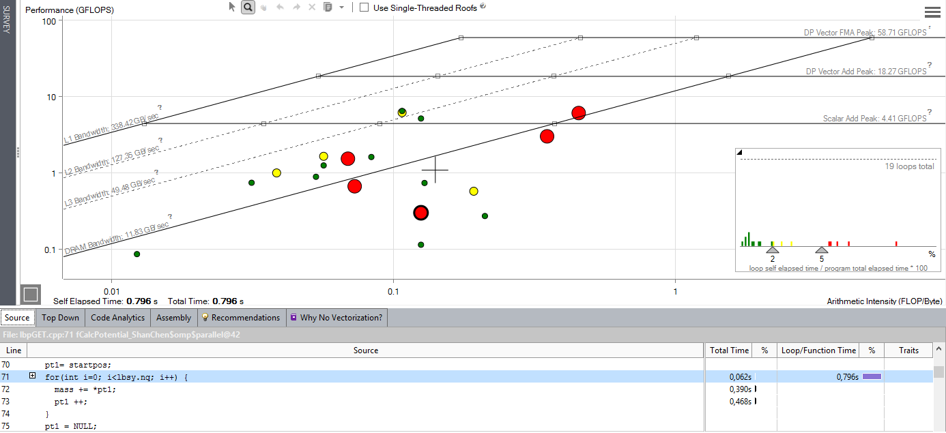
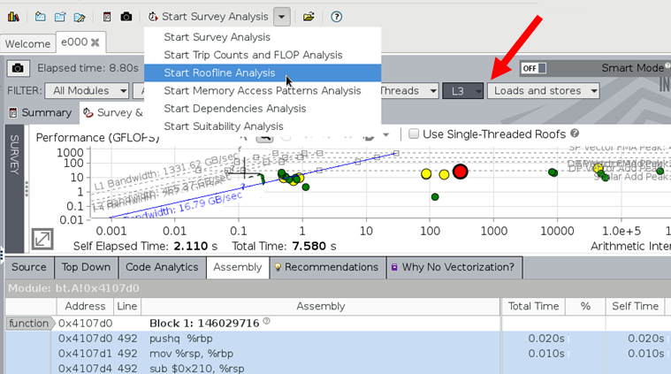
Intel Advisor
Includes Roofline Automation…
Automatically instruments applications
(one dot per loop nest/function)
Computes FLOPS and AI for each function (CARM)
AVX-512 support that incorporates masks
Integrated Cache Simulator¹ (hierarchical roofline / multiple AI’s)
Automatically benchmarks target system (calculates ceilings)
Full integration with existing Advisor capabilities
Memory-bound, invest into cache blocking etc
Compute bound: invest into SIMD,..
http://www.nersc.gov/users/training/events/roofline-training-1182017-1192017
¹Technology Preview, not in official product roadmap so far.

Slide 58
Hierarchical Roofline vs.
Cache-Aware Roofline
…understanding different Roofline formulations in Advisor

Slide 59
There are two Major Roofline Formulations:
Hierarchical Roofline (original Roofline w/ DRAM, L3, L2, …)…
      Williams, et al, “Roofline: An Insightful Visual Performance Model for Multicore Architectures”, CACM, 2009
      Chapter 4 of “Auto-tuning Performance on Multicore Computers”, 2008
      Defines multiple bandwidth ceilings and multiple AI’s per kernel
      Performance bound is the minimum of flops and the memory intercepts (superposition of original, single-metric Rooflines)
Cache-Aware Roofline
      Ilic et al, "Cache-aware Roofline model: Upgrading the loft", IEEE Computer Architecture Letters, 2014
      Defines multiple bandwidth ceilings, but uses a single AI (flop:L1 bytes)
      As one looses cache locality (capacity, conflict, …) performance falls from one BW ceiling to a lower one at constant AI
Why Does this matter?
      Some tools use the Hierarchical Roofline, some use cache-aware == Users need to understand the differences
      Cache-Aware Roofline model was integrated into production Intel Advisor
      Evaluation version of Hierarchical Roofline¹ (cache simulator) has also been integrated into Intel Advisor
¹Technology Preview, not in official product roadmap so far.

Slide 60
Hierarchical Roofline
Cache-Aware Roofline
Captures cache effects
Captures cache effects
AI is Flop:Bytes after being filtered by lower cache levels
AI is Flop:Bytes as presented to the L1 cache (plus non-temporal stores)
Multiple Arithmetic Intensities
(one per level of memory)
Single Arithmetic Intensity
AI dependent on problem size
(capacity misses reduce AI)
AI independent of problem size
Memory/Cache/Locality effects are observed as decreased AI
Memory/Cache/Locality effects are observed as decreased performance
Requires performance counters or cache simulator to correctly measure AI
Requires static analysis or binary instrumentation to measure AI
Notes:
Some tools use one…
some tools use the other…
some use both.

Slide 61
Example: STREAM
L1 AI…
      2 flops
      2 x 8B load (old)
      1 x 8B store (new)
      = 0.08 flops per byte
    No cache reuse…
      Iteration i doesn’t touch any data associated with iteration i+delta for any delta.
… leads to a DRAM AI equal to the L1 AI
#pragma omp parallel for
for(i=0;i<N;i++){
Z[i] = X[i] + alpha*Y[i];
}

Slide 62
Example: STREAM
Hierarchical Roofline
Cache-Aware Roofline
Peak Flop/s
Peak Flop/s
Performance is bound to
the minimum of the two
Intercepts…
AI_{L1} * L1 GB/s
AI_{DRAM} * DRAM GB/s
Observed performance
is correlated with DRAM
bandwidth
Attainable Flop/s
Attainable Flop/s
L1 GB/s
L1 GB/s
Multiple AI’s….
Flop:DRAM bytes
Flop:L1 bytes (same)
DRAM GB/s
DRAM GB/s
Single AI based on flop:L1 bytes
0.083
0.083
Arithmetic Intensity (Flop:Byte)
Arithmetic Intensity (Flop:Byte)

Slide 63
Example: 7-point Stencil (Small Problem)
L1 AI…
      7 flops
      7 x 8B load (old)
      1 x 8B store (new)
      = 0.11 flops per byte
      some compilers may do register shuffles to reduce the number of loads.
    Moderate cache reuse…
      old[ijk] is reused on subsequent iterations of i,j,k
      old[ijk-1] is reused on subsequent iterations of i.
      old[ijk-jStride] is reused on subsequent iterations of j.
      old[ijk-kStride] is reused on subsequent iterations of k.
… leads to DRAM AI larger than the L1 AI
#pragma omp parallel for
for(k=1;k<dim+1;k++){
for(j=1;j<dim+1;j++){
for(i=1;i<dim+1;i++){
int ijk = i + j*jStride + k*kStride;
new[ijk] = -6.0*old[ijk ]
+ old[ijk-1 ]
+ old[ijk+1 ]
+ old[ijk-jStride]
+ old[ijk+jStride]
+ old[ijk-kStride]
+ old[ijk+kStride];
}}}

Slide 64
Example: 7-point Stencil (Small Problem)
Hierarchical Roofline
Cache-Aware Roofline
Peak Flop/s
Peak Flop/s
Attainable Flop/s
Attainable Flop/s
L1 GB/s
Performance bound is
the minimum of the two
L1 GB/s
Multiple AI’s….
flop:DRAM ~ 0.44
flop:L1 ~ 0.11
DRAM GB/s
DRAM GB/s
0.11
0.44
0.11
Arithmetic Intensity (Flop:Byte)
Arithmetic Intensity (Flop:Byte)

Slide 65
Example: 7-point Stencil (Small Problem)
Hierarchical Roofline
Cache-Aware Roofline
Peak Flop/s
Peak Flop/s
Observed performance
is between L1 and DRAM lines
(== some cache locality)
Attainable Flop/s
Attainable Flop/s
L1 GB/s
Performance bound is
the minimum of the two
L1 GB/s
Multiple AI’s….
flop:DRAM ~ 0.44
flop:L1 ~ 0.11
DRAM GB/s
DRAM GB/s
Single AI based on flop:L1 bytes
0.11
0.44
0.11
Arithmetic Intensity (Flop:Byte)
Arithmetic Intensity (Flop:Byte)

Slide 66
Example: 7-point Stencil (Large Problem)
Hierarchical Roofline
Cache-Aware Roofline
Peak Flop/s
Peak Flop/s
Observed performance
is closer to DRAM line
(== less cache locality)
Attainable Flop/s
Attainable Flop/s
L1 GB/s
Capacity misses reduce
DRAM AI and performance
L1 GB/s
Multiple AI’s….
flop:DRAM ~ 0.20
flop:L1 ~ 0.11
DRAM GB/s
DRAM GB/s
Single AI based on flop:L1 bytes
0.11
0.20
0.11
Arithmetic Intensity (Flop:Byte)
Arithmetic Intensity (Flop:Byte)

Slide 67
Example: 7-point Stencil (Observed Perf.)
Hierarchical Roofline
Cache-Aware Roofline
Peak Flop/s
Peak Flop/s
Observed performance
is closer to DRAM line
(== less cache locality)
Attainable Flop/s
Attainable Flop/s
L1 GB/s
L1 GB/s
Actual observed performance
is tied to the bottlenecked resource
and can be well below a cache
Roofline (e.g. L1).
DRAM GB/s
DRAM GB/s
Single AI based on flop:L1 bytes
0.11
0.20
0.11
Arithmetic Intensity (Flop:Byte)
Arithmetic Intensity (Flop:Byte)

Slide 68
Example: 7-point Stencil (Observed Perf.)
Hierarchical Roofline
Cache-Aware Roofline
Peak Flop/s
Peak Flop/s
Observed performance
is closer to DRAM line
(== less cache locality)
Attainable Flop/s
Attainable Flop/s
L1 GB/s
L1 GB/s
Actual observed performance
is tied to the bottlenecked resource
and can be well below a cache
Roofline (e.g. L1).
DRAM GB/s
DRAM GB/s
Single AI based on flop:L1 bytes
0.11
0.20
0.11
Arithmetic Intensity (Flop:Byte)
Arithmetic Intensity (Flop:Byte)

Slide 69
Example of Roofline in Practice

Slide 70
Sparse Matrix Vector Multiplication
What’s a Sparse Matrix ?
  Most entries are 0.0
  Performance advantage in only storing/operating on the nonzeros
  Requires significant meta data to reconstruct the matrix structure
What’s SpMV ?
  Evaluate y=Ax where A is a sparse matrix, x & y are dense vectors
Challenges
  Very low arithmetic intensity (often <0.166 flops/byte)
  Difficult to exploit ILP (bad for pipelined or superscalar),
  Difficult to exploit DLP (bad for SIMD)
A
x
y
A.col[ ]
...
for (r=0; r<A.rows; r++) {
double y0 = 0.0;
for (i=A.rowStart[r]; i<A.rowStart[r+1]; i++){
y0 += A.val[i] * x[A.col[i]];
}
y[r] = y0;
}
A.val[ ]
...
...
A.rowStart[ ]
(a)
algebra conceptualization
(b)
CSR data structure
(c)
CSR reference code

Slide 71
Roofline model for SpMV
Double precision roofline models
In-core optimizations 1..i
DRAM optimizations 1..j
FMA is inherent in SpMV (place at bottom)
128
Intel Xeon E5345
(Clovertown)
128
Opteron 2356
(Barcelona)
64
peak DP
64
peak DP
32
w/out SIMD
32
w/out SIMD
16
16
attainable Gflop/s
attainable Gflop/s
w/out ILP
8
dataset dataset fits in snoop filter
w/out ILP
8
4
mul/add imbalance
4
mul/add imbalance
w/out SW prefetch
InCoreGFlops_{i}
w/out NUMA
GFlops_{i,j}(AI) = min
2
2
StreamBW_{j} * AI
1
1
¹/₁₆
¹/₈
¹/₄
¹/₂
1
2
4
8
¹/₁₆
¹/₈
¹/₄
¹/₂
1
2
4
8
flop:DRAM byte ratio
flop:DRAM byte ratio
128
Sun T2+ T5140
(Victoria Falls)
128
IBM QS20
Cell Blade
64
64
32
32
peak DP
16
peak DP
16
w/out SIMD
attainable Gflop/s
attainable Gflop/s
25% FP
bank conflicts
8
w/out SW prefetch
8
w/out ILP
w/out NUMA
w/out NUMA
4
12% FP
4
w/out FMA
2
2
1
¹/₁₆
¹/₈
¹/₄
¹/₂
1
2
4
8
1
¹/₁₆
¹/₈
¹/₄
¹/₂
1
2
4
8
flop:DRAM byte ratio
flop:DRAM byte ratio

Slide 72
Roofline model for SpMV
(overlay arithmetic intensity)
Two unit stride streams
Inherent FMA
No ILP
No DLP
FP is 12-25%
Naïve compulsory flop:byte < 0.166
128
Intel Xeon E5345
(Clovertown)
128
Opteron 2356
(Barcelona)
64
peak DP
64
peak DP
32
w/out SIMD
32
w/out SIMD
16
16
attainable Gflop/s
attainable Gflop/s
w/out ILP
8
dataset dataset fits in snoop filter
w/out ILP
8
4
mul/add imbalance
4
mul/add imbalance
w/out SW prefetch
w/out NUMA
2
2
1
¹/₁₆
¹/₈
¹/₄
¹/₂
1
2
4
8
1
¹/₁₆
¹/₈
¹/₄
¹/₂
1
2
4
8
flop:DRAM byte ratio
flop:DRAM byte ratio
128
Sun T2+ T5140
(Victoria Falls)
128
IBM QS20
Cell Blade
No naïve SPE
implementation
64
64
32
32
peak DP
16
peak DP
16
w/out SIMD
attainable Gflop/s
attainable Gflop/s
25% FP
bank conflicts
8
w/out SW prefetch
8
w/out ILP
w/out NUMA
w/out NUMA
4
12% FP
4
w/out FMA
2
2
1
¹/₁₆
¹/₈
¹/₄
¹/₂
1
2
4
8
1
¹/₁₆
¹/₈
¹/₄
¹/₂
1
2
4
8
flop:DRAM byte ratio
flop:DRAM byte ratio

Slide 73
Roofline model for SpMV
(out-of-the-box parallel)
Two unit stride streams
Inherent FMA
No ILP
No DLP
FP is 12-25%
Naïve compulsory flop:byte < 0.166
For simplicity: dense matrix in sparse format
128
Intel Xeon E5345
(Clovertown)
128
Opteron 2356
(Barcelona)
64
peak DP
64
peak DP
32
w/out SIMD
32
w/out SIMD
16
16
attainable Gflop/s
attainable Gflop/s
w/out ILP
8
dataset dataset fits in snoop filter
w/out ILP
8
4
mul/add imbalance
4
mul/add imbalance
w/out SW prefetch
w/out NUMA
2
2
1
¹/₁₆
¹/₈
¹/₄
¹/₂
1
2
4
8
1
¹/₁₆
¹/₈
¹/₄
¹/₂
1
2
4
8
flop:DRAM byte ratio
flop:DRAM byte ratio
128
Sun T2+ T5140
(Victoria Falls)
128
IBM QS20
Cell Blade
No naïve SPE
implementation
64
64
32
32
peak DP
16
peak DP
16
w/out SIMD
attainable Gflop/s
attainable Gflop/s
25% FP
bank conflicts
8
w/out SW prefetch
8
w/out ILP
w/out NUMA
w/out NUMA
4
12% FP
4
w/out FMA
2
2
1
¹/₁₆
¹/₈
¹/₄
¹/₂
1
2
4
8
1
¹/₁₆
¹/₈
¹/₄
¹/₂
1
2
4
8
flop:DRAM byte ratio
flop:DRAM byte ratio

Slide 74
Roofline model for SpMV
(NUMA & SW prefetch)
compulsory flop:byte ~ 0.166
utilize all memory channels
128
Intel Xeon E5345
(Clovertown)
128
Opteron 2356
(Barcelona)
64
peak DP
64
peak DP
32
w/out SIMD
32
w/out SIMD
16
16
attainable Gflop/s
attainable Gflop/s
w/out ILP
8
dataset dataset fits in snoop filter
w/out ILP
8
4
mul/add imbalance
4
mul/add imbalance
w/out SW prefetch
w/out NUMA
2
2
1
¹/₁₆
¹/₈
¹/₄
¹/₂
1
2
4
8
1
¹/₁₆
¹/₈
¹/₄
¹/₂
1
2
4
8
flop:DRAM byte ratio
flop:DRAM byte ratio
128
Sun T2+ T5140
(Victoria Falls)
128
IBM QS20
Cell Blade
No naïve SPE
implementation
64
64
32
32
peak DP
16
peak DP
16
w/out SIMD
attainable Gflop/s
attainable Gflop/s
25% FP
bank conflicts
8
w/out SW prefetch
8
w/out ILP
w/out NUMA
w/out NUMA
4
12% FP
4
w/out FMA
2
2
1
¹/₁₆
¹/₈
¹/₄
¹/₂
1
2
4
8
1
¹/₁₆
¹/₈
¹/₄
¹/₂
1
2
4
8
flop:DRAM byte ratio
flop:DRAM byte ratio

Slide 75
Roofline model for SpMV
(matrix compression)
Inherent FMA
Register blocking improves ILP, DLP, flop:byte ratio, and FP% of instructions
128
Intel Xeon E5345
(Clovertown)
128
Opteron 2356
(Barcelona)
64
peak DP
64
peak DP
32
w/out SIMD
32
w/out SIMD
16
16
attainable Gflop/s
attainable Gflop/s
w/out ILP
8
dataset dataset fits in snoop filter
w/out ILP
8
4
mul/add imbalance
4
mul/add imbalance
w/out SW prefetch
w/out NUMA
2
2
1
¹/₁₆
¹/₈
¹/₄
¹/₂
1
2
4
8
1
¹/₁₆
¹/₈
¹/₄
¹/₂
1
2
4
8
flop:DRAM byte ratio
flop:DRAM byte ratio
128
Sun T2+ T5140
(Victoria Falls)
128
IBM QS20
Cell Blade
64
64
32
32
peak DP
16
peak DP
16
w/out SIMD
attainable Gflop/s
attainable Gflop/s
25% FP
bank conflicts
8
w/out SW prefetch
8
w/out ILP
w/out NUMA
w/out NUMA
4
12% FP
4
w/out FMA
2
2
1
¹/₁₆
¹/₈
¹/₄
¹/₂
1
2
4
8
1
¹/₁₆
¹/₈
¹/₄
¹/₂
1
2
4
8
flop:DRAM byte ratio
flop:DRAM byte ratio

Slide 76
Roofline on CPUs and GPUs
In 2010, we began to use Roofline to compare CPU and GPU performance for a variety of double-precision kernels
Flop/s were theoretical book values;
Memory bandwidth from STREAM or SHOC
AI was based on compulsory data movement
Optimized kernel performance
was well-correlated with Roofline
for both platforms.
Some irregular applications (PIC)
underperformed and motivated
Further study.
Xeon X5550 (Nehalem)
NVIDIA C2050 (Fermi)
1024
1024
single-precision peak
512
512
double-precision peak
256
single-precision peak
256
DGEMM
DP add-only
128
double-precision peak
128
RTM/wave eqn.
64
DP add-only
DGEMM
64
Device bandwidth
32
STREAM bandwidth
RTM/wave eqn.
32
27pt Stencil
16
7pt Stencil
27pt Stencil
16
7pt Stencil
8
GTC/pushi
8
SpMV
GTC/pushi
4
SpMV
GTC/chargei
4
GTC/chargei
2
2
¹/₃₂
¹/₁₆
¹/₈
¹/₄
¹/₂
1
2
4
8
16
32
¹/₃₂
¹/₁₆
¹/₈
¹/₄
¹/₂
1
2
4
8
16
32

Slide 77
Questions?

Slide 78
Backup

Slide 79
Intel Advisor:
Introduction and General Usage
http://www.nersc.gov/users/training/events/roofline-training-1182017-1192017
*DRAM Roofline and OS/X Advisor GUI: These are preview features that may or may not be included in mainline product releases. They may not be stable as they are prototypes incorporating very new functionality. Intel provides preview features in order to collect user feedback and plans further development and productization steps based on the feedback.

Slide 80
Intel Advisor
Integrated Performance Analysis Tool
Performance information including timings, flops, and trip counts
Vectorization Tips
Memory footprint analysis
Originally used the Cache-Aware Roofline Model
All connected back to source code
CRD/NERSC began a collaboration with Intel
Ensure Advisor runs on Cori in user-mode
Push for Hierarchical (Integrated) Roofline
Make it functional/scalable to many MPI processes across multiple nodes
Validate results on NESAP, SciDAC, and ECP codes
NESAP is NERSC’s KNL application readiness project
SciDAC is the DOE Office of Science’s Scientific Discovery thru Advanced Computing program
ECP is the DOE’s Exascale Computing Project

Slide 81


Intel Advisor (Useful Links)
Background
https://software.intel.com/en-us/intel-advisor-xe
https://software.intel.com/en-us/articles/getting-started-with-intel-advisor-roofline-feature
https://www.youtube.com/watch?v=h2QEM1HpFgg
Running Advisor on NERSC Systems
http://www.nersc.gov/users/software/performance-and-debugging-tools/advisor/

Slide 82
Using Intel Advisor at NERSC
Compile…
use ‘-g’ when compiling
Submit Job…
% salloc –perf=vtune <<< interactive sessions; --perf only needed for DRAM Roofline
–or-
#SBATCH –perf=vtune <<< batch submissions; --perf only needed for DRAM Roofline
Benchmark…
% module load advisor
% export ADVIXE_EXPERIMENTAL=roofline_ex <<< only needed for DRAM Roofline
% srun [args] advixe-cl -collect survey -no-stack-stitching -project-dir $DIR -- ./a.out [args]
% srun [args] advixe-cl -collect tripcounts -flops-and-masks -callstack-flops -project-dir $DIR -- ./a.out [args]
Use Advisor GUI…
% module load advisor
% export ADVIXE_EXPERIMENTAL=roofline_ex <<< only needed for DRAM Roofline
% advixe-gui $DIR

Slide 83
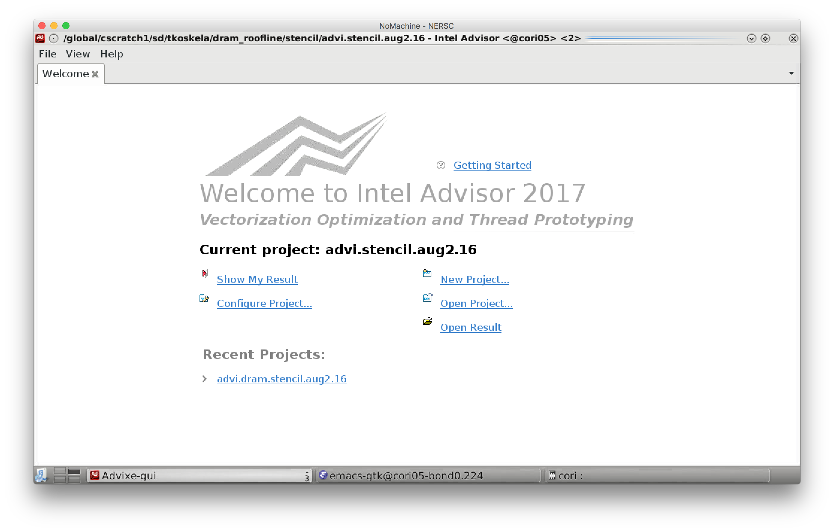

Slide 84
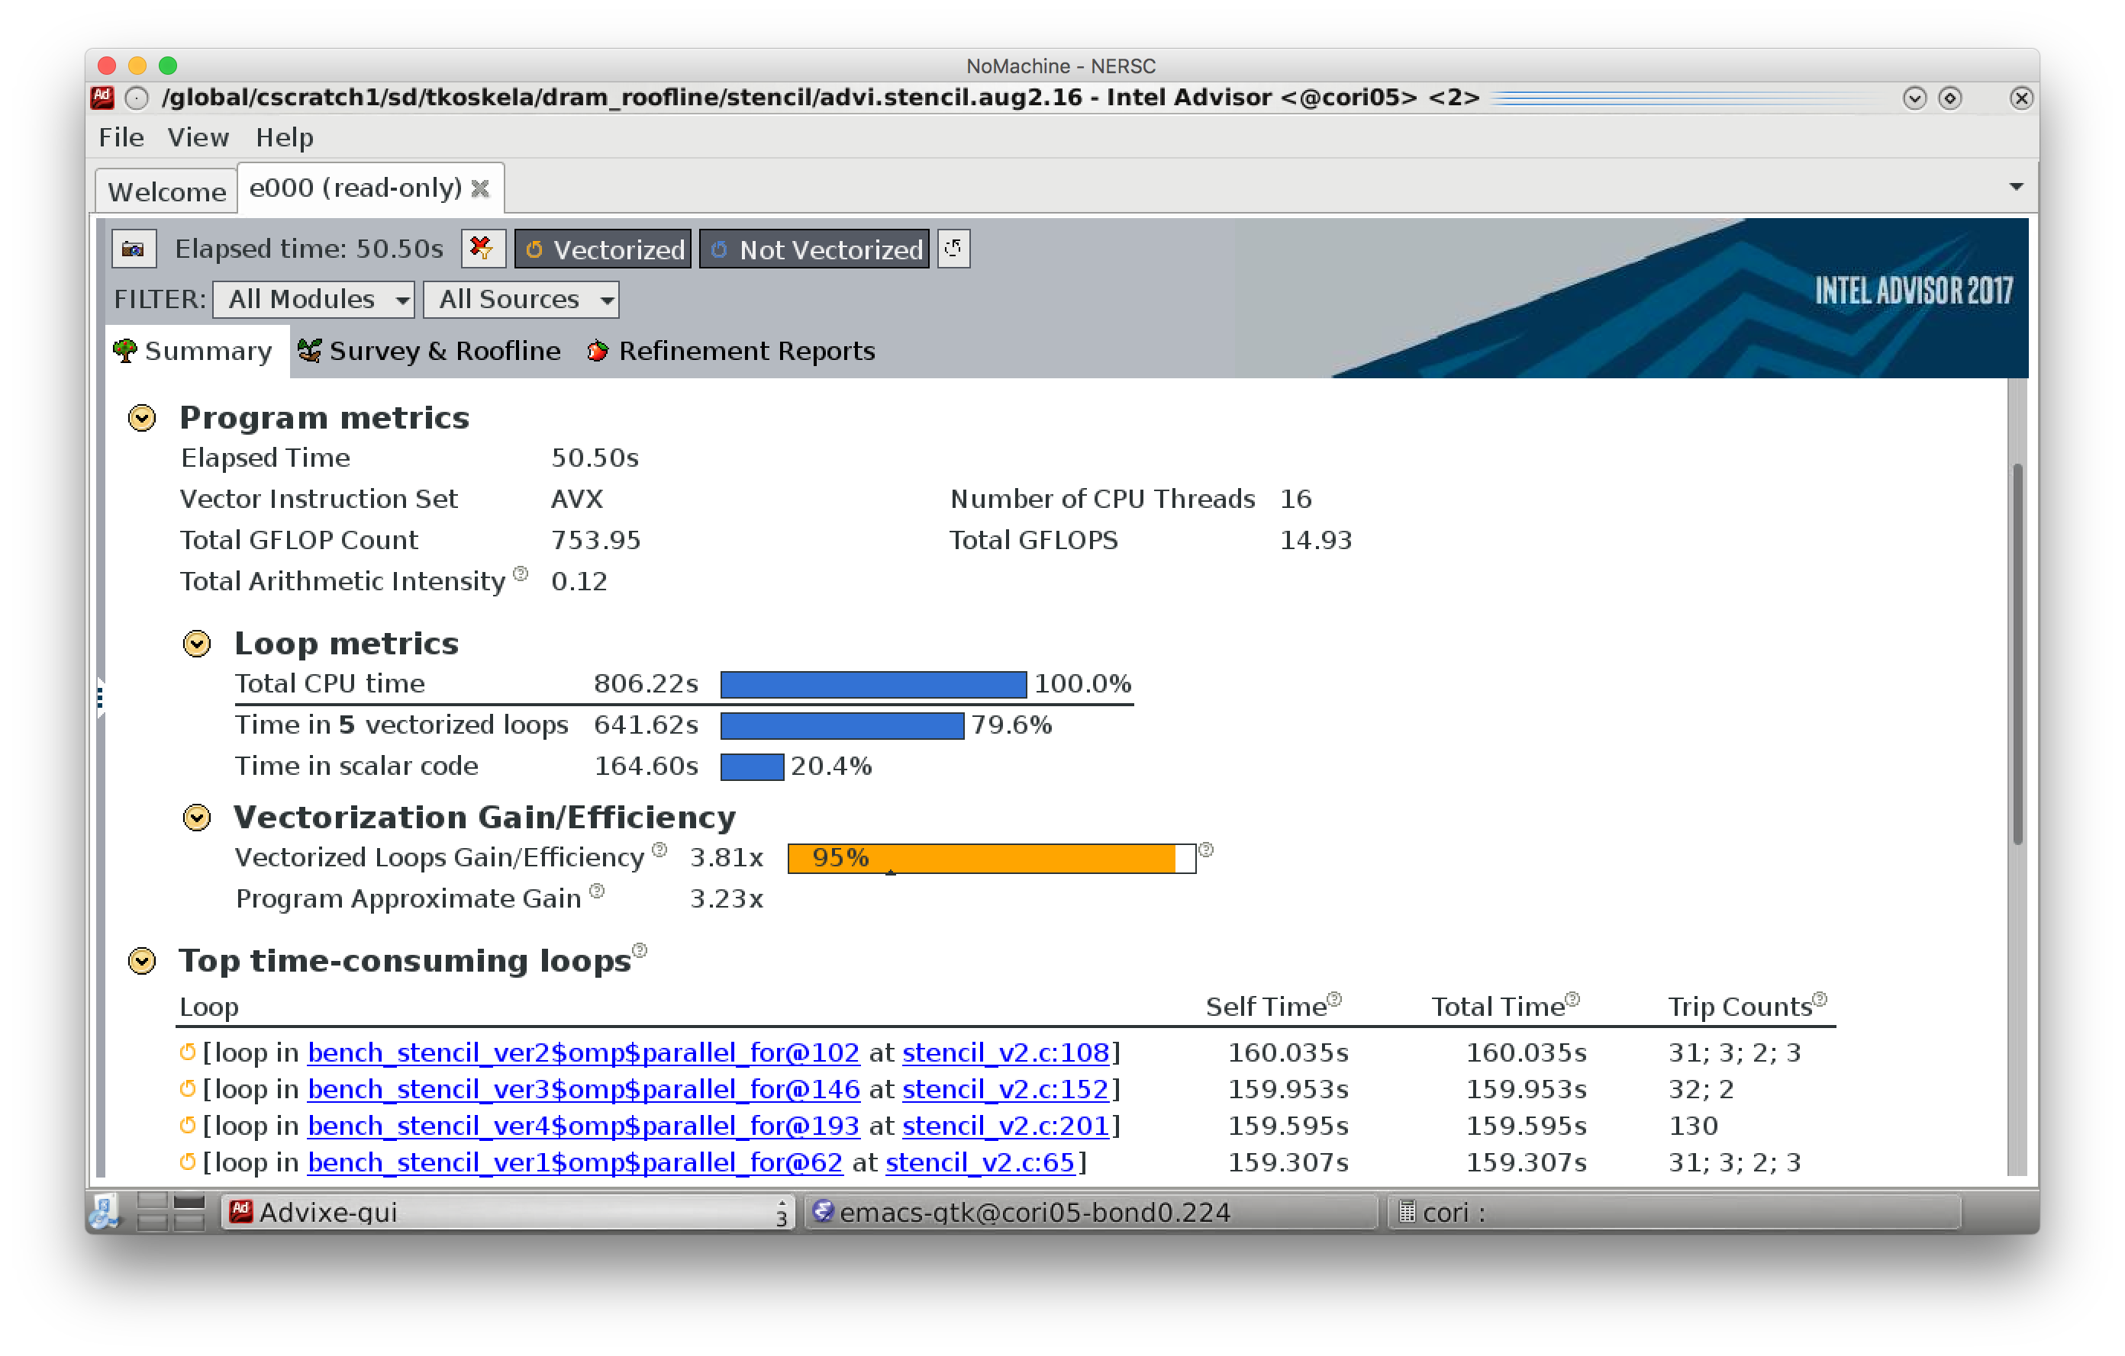

Slide 85
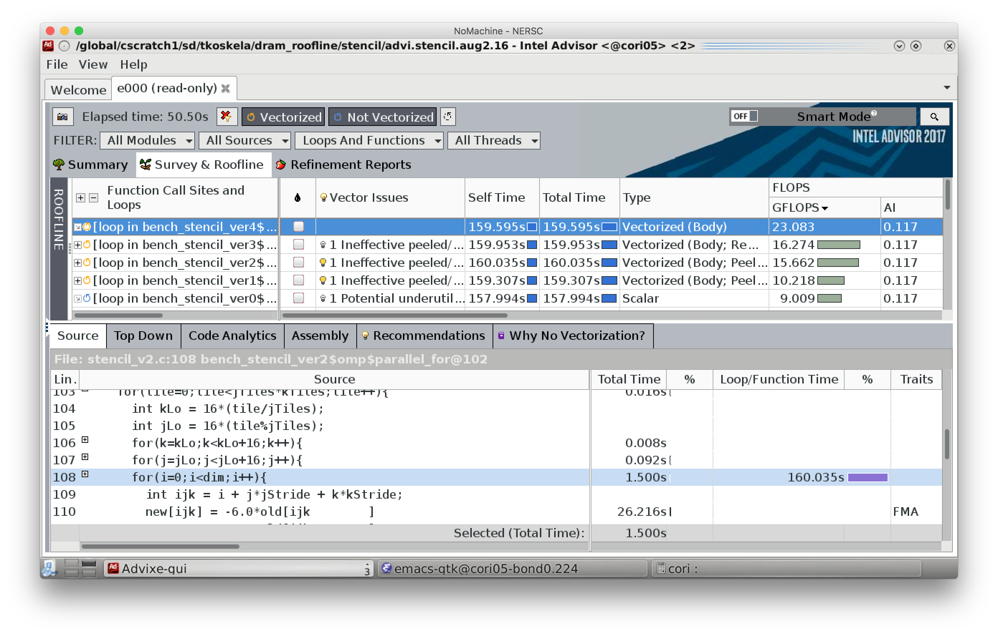

Slide 86
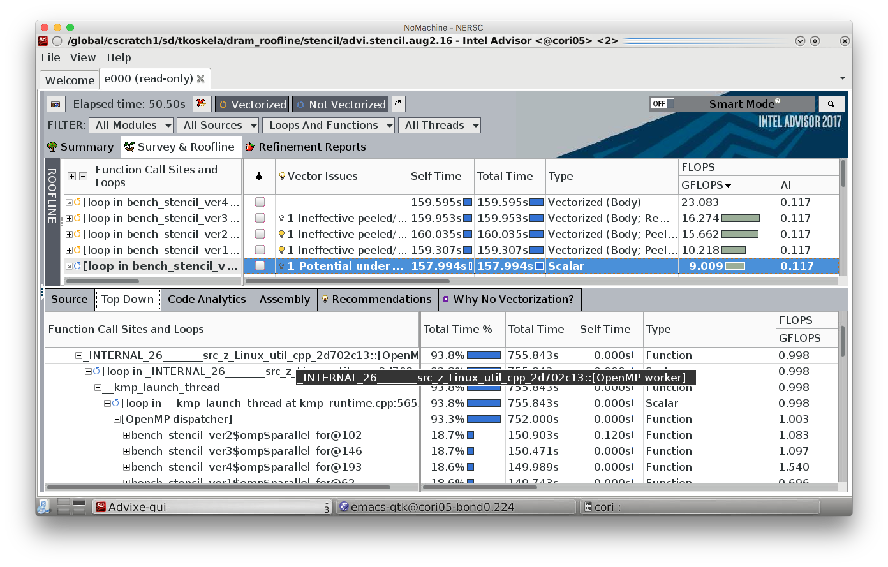

Slide 87
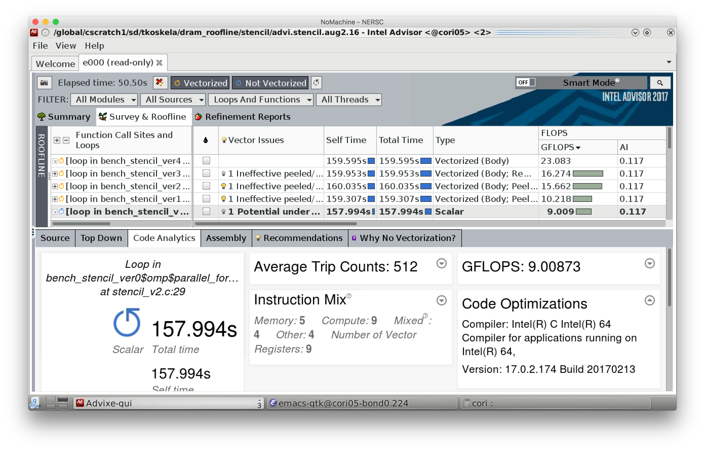

Slide 88
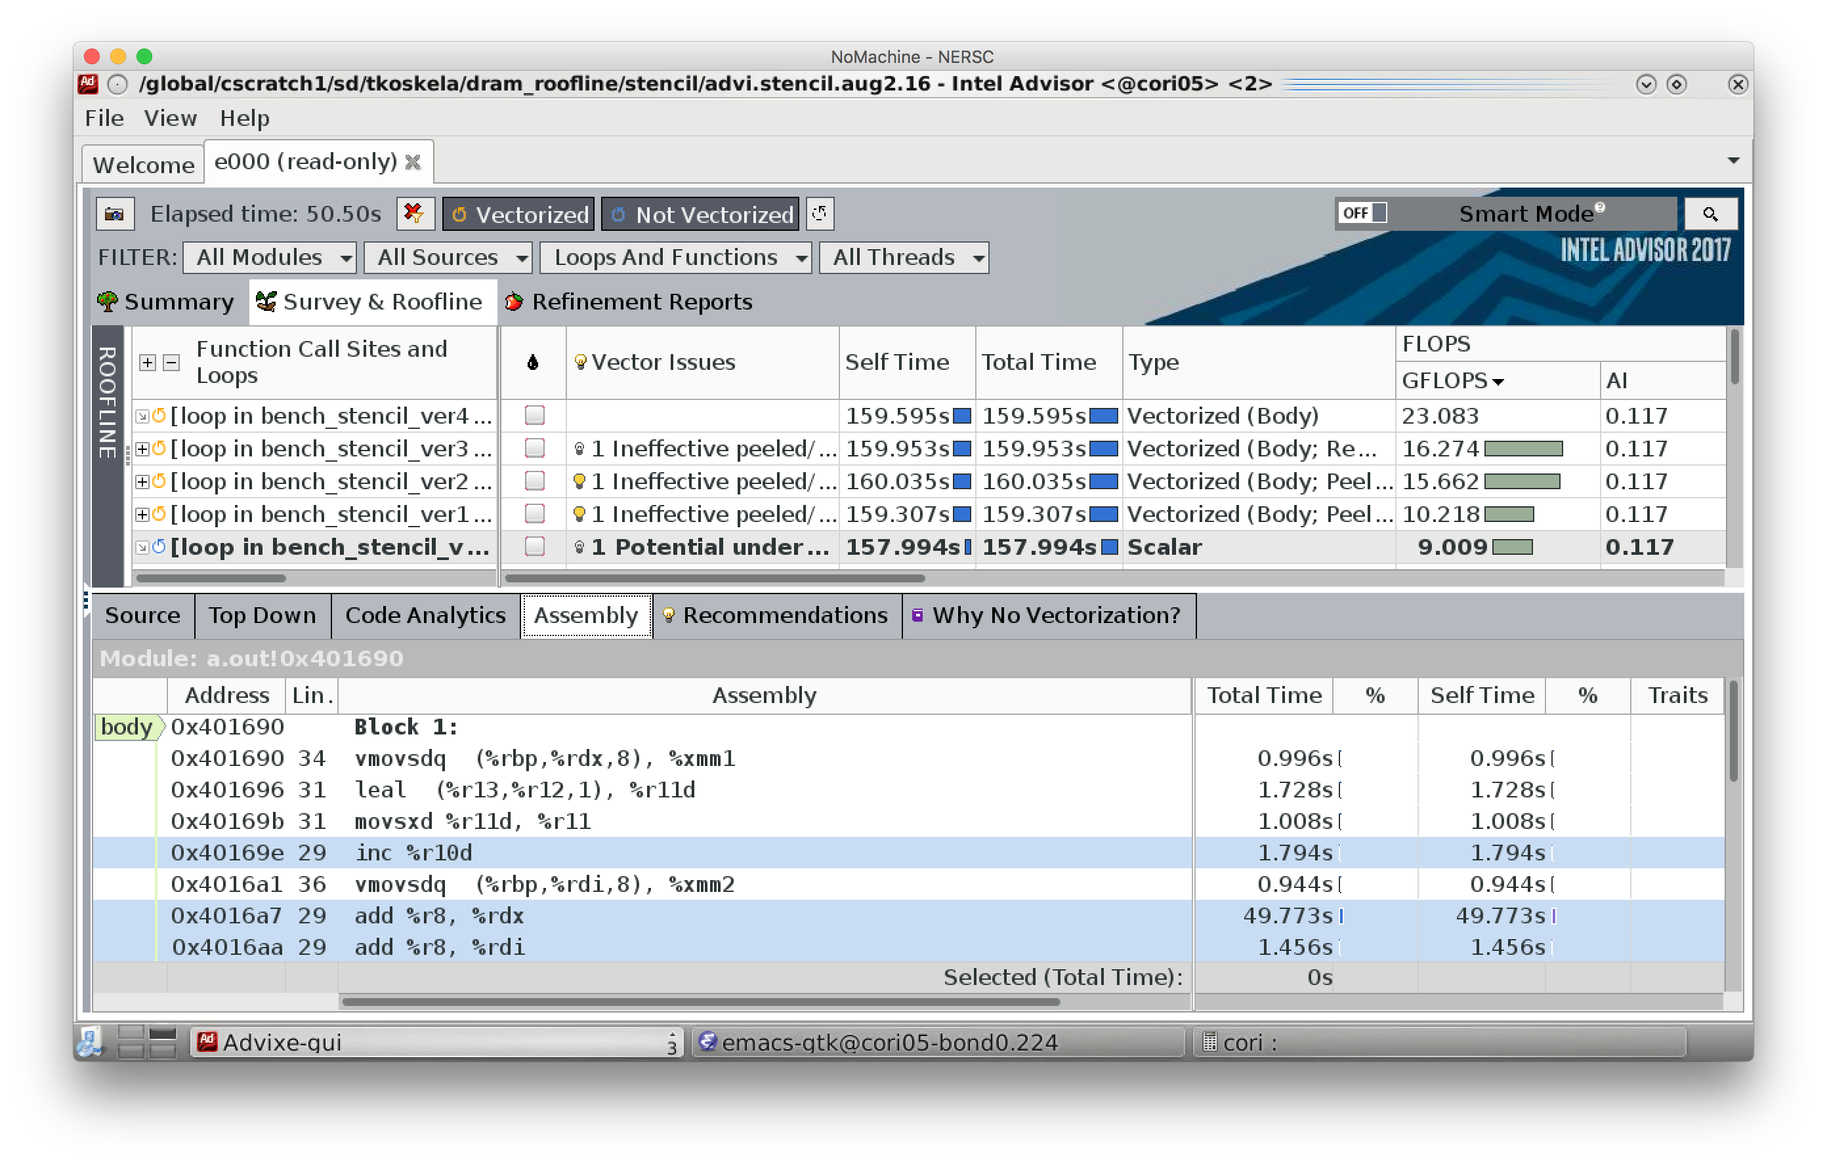

Slide 89
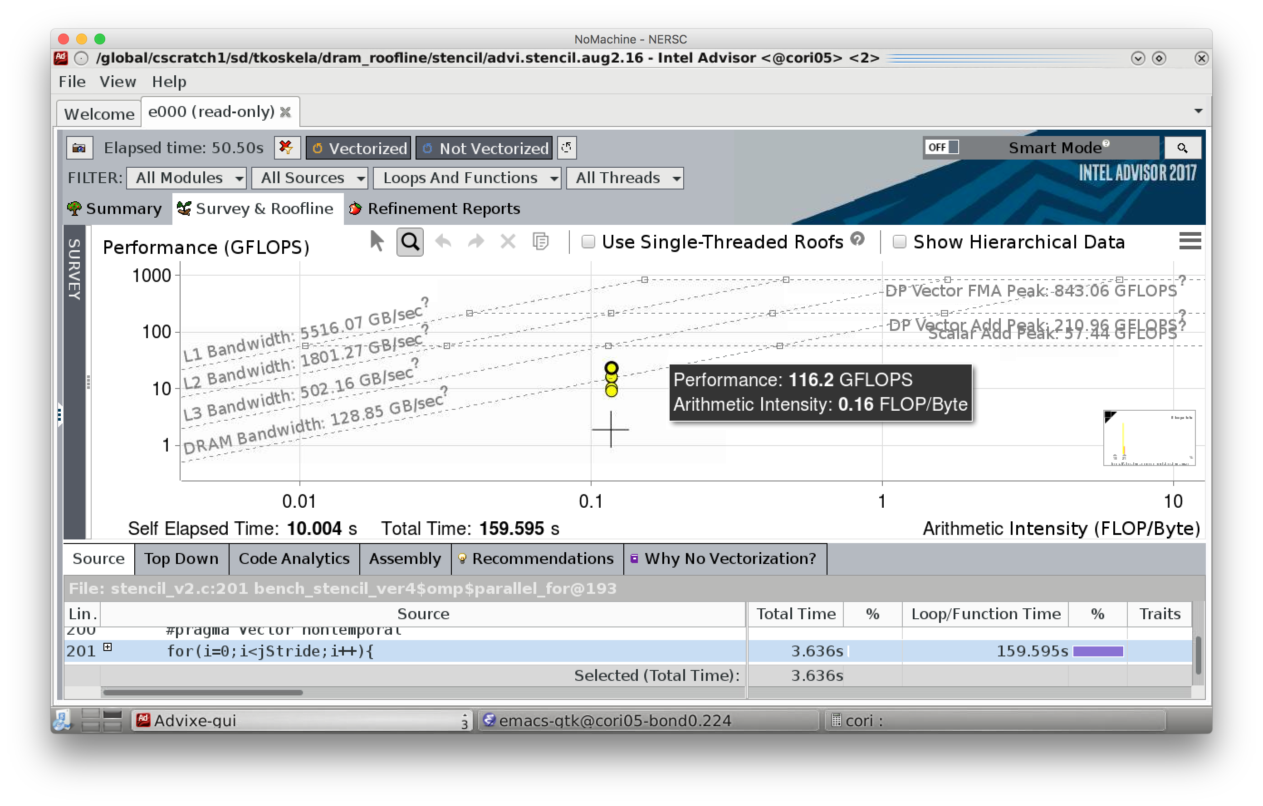

Slide 90
Intel Advisor:
Stencil Roofline Demo*
*DRAM Roofline and OS/X Advisor GUI: These are preview features that may or may not be included in mainline product releases. They may not be stable as they are prototypes incorporating very new functionality. Intel provides preview features in order to collect user feedback and plans further development and productization steps based on the feedback.

Slide 91
7-point, Constant-Coefficient Stencil
Apply to a 512³ domain on a single NUMA node (single HSW socket)
Create 5 code variants to highlight effects (as seen in advisor)
ver0. Baseline: thread over outer loop (k), but prevent vectorization
#pragma novector // prevent simd
int ijk = i*iStride + j*jStride + k*kStride; // variable iStride to confuse the compiler
ver1. Enable vectorization
int ijk = i + j*jStride + k*kStride; // unit-stride inner loop
ver2. Eliminate capacity misses
2D tiling of j-k iteration space // working set had been O(6MB) per thread
ver3. Improve vectorization
Provide aligned pointers and strides
ver4. Force vectorization / cache bypass
__assume(jstride%8 == 0); // stride by variable is still aligned
#pragma omp simd, vector nontemportal // force simd; force cache bypass

Slide 92
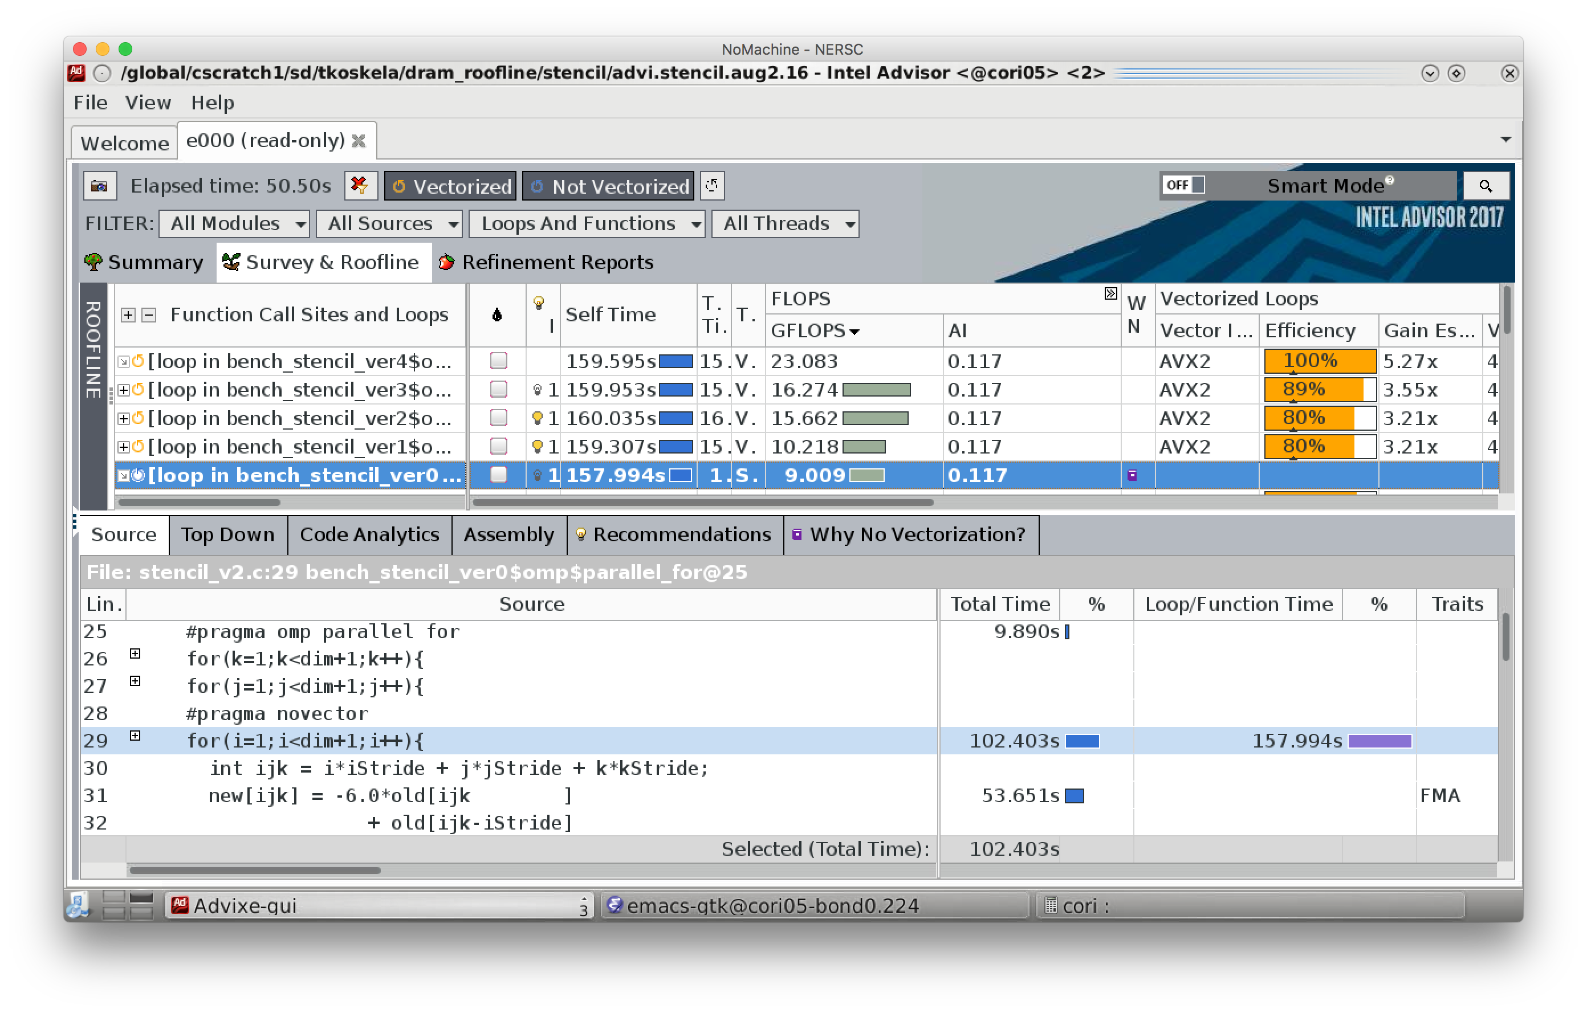

Slide 93
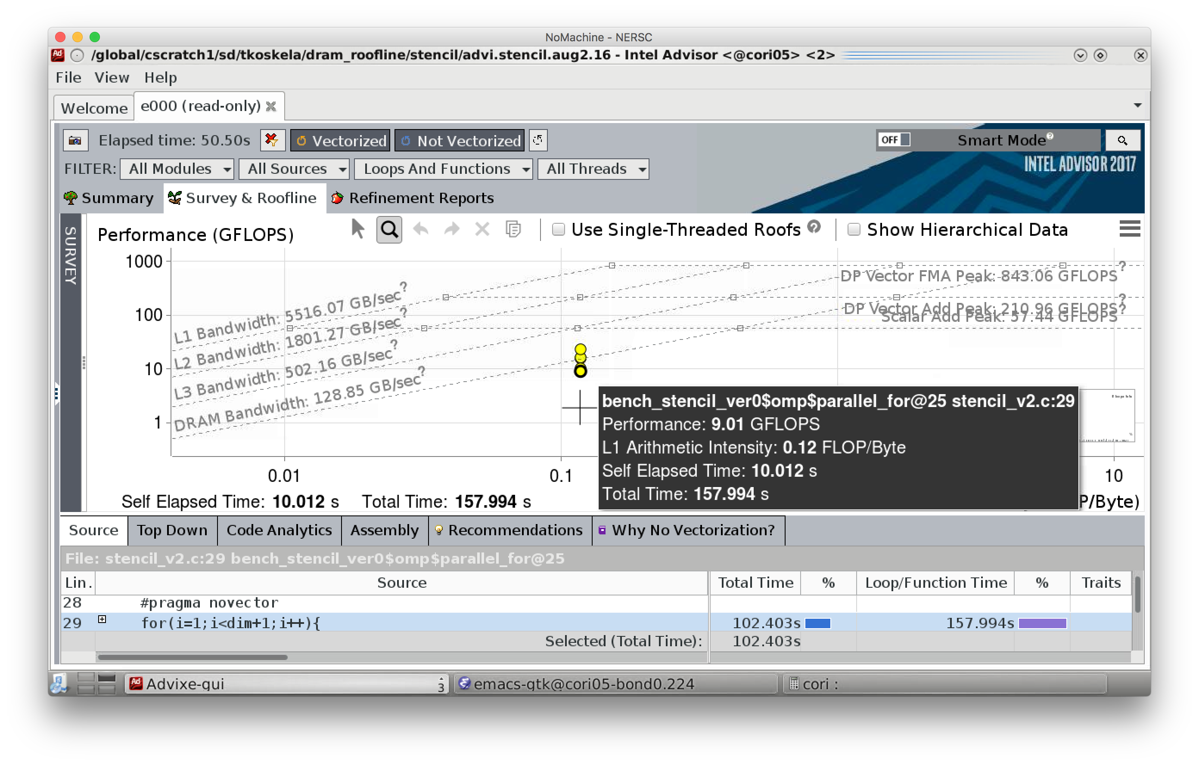
Cache-Aware Roofline

Slide 94

Cache-Aware Roofline

Slide 95
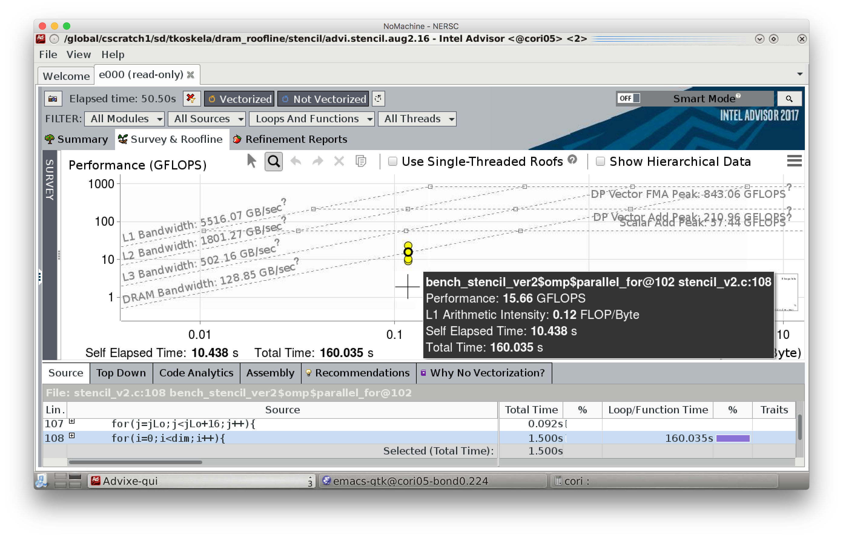
Cache-Aware Roofline

Slide 96
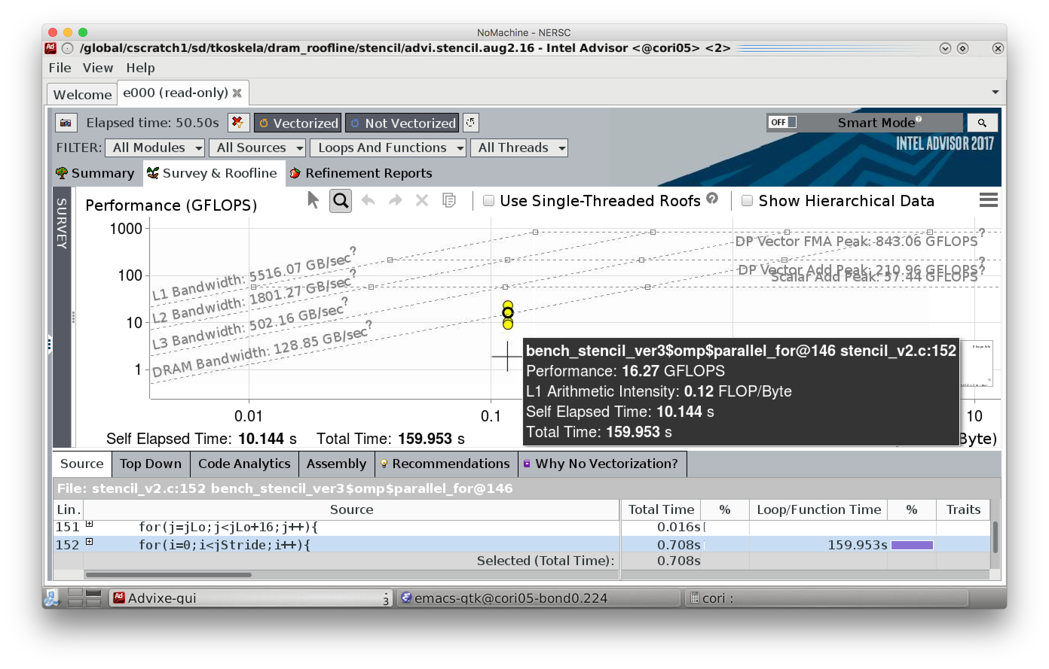
Cache-Aware Roofline

Slide 97

Cache-Aware Roofline

Slide 98
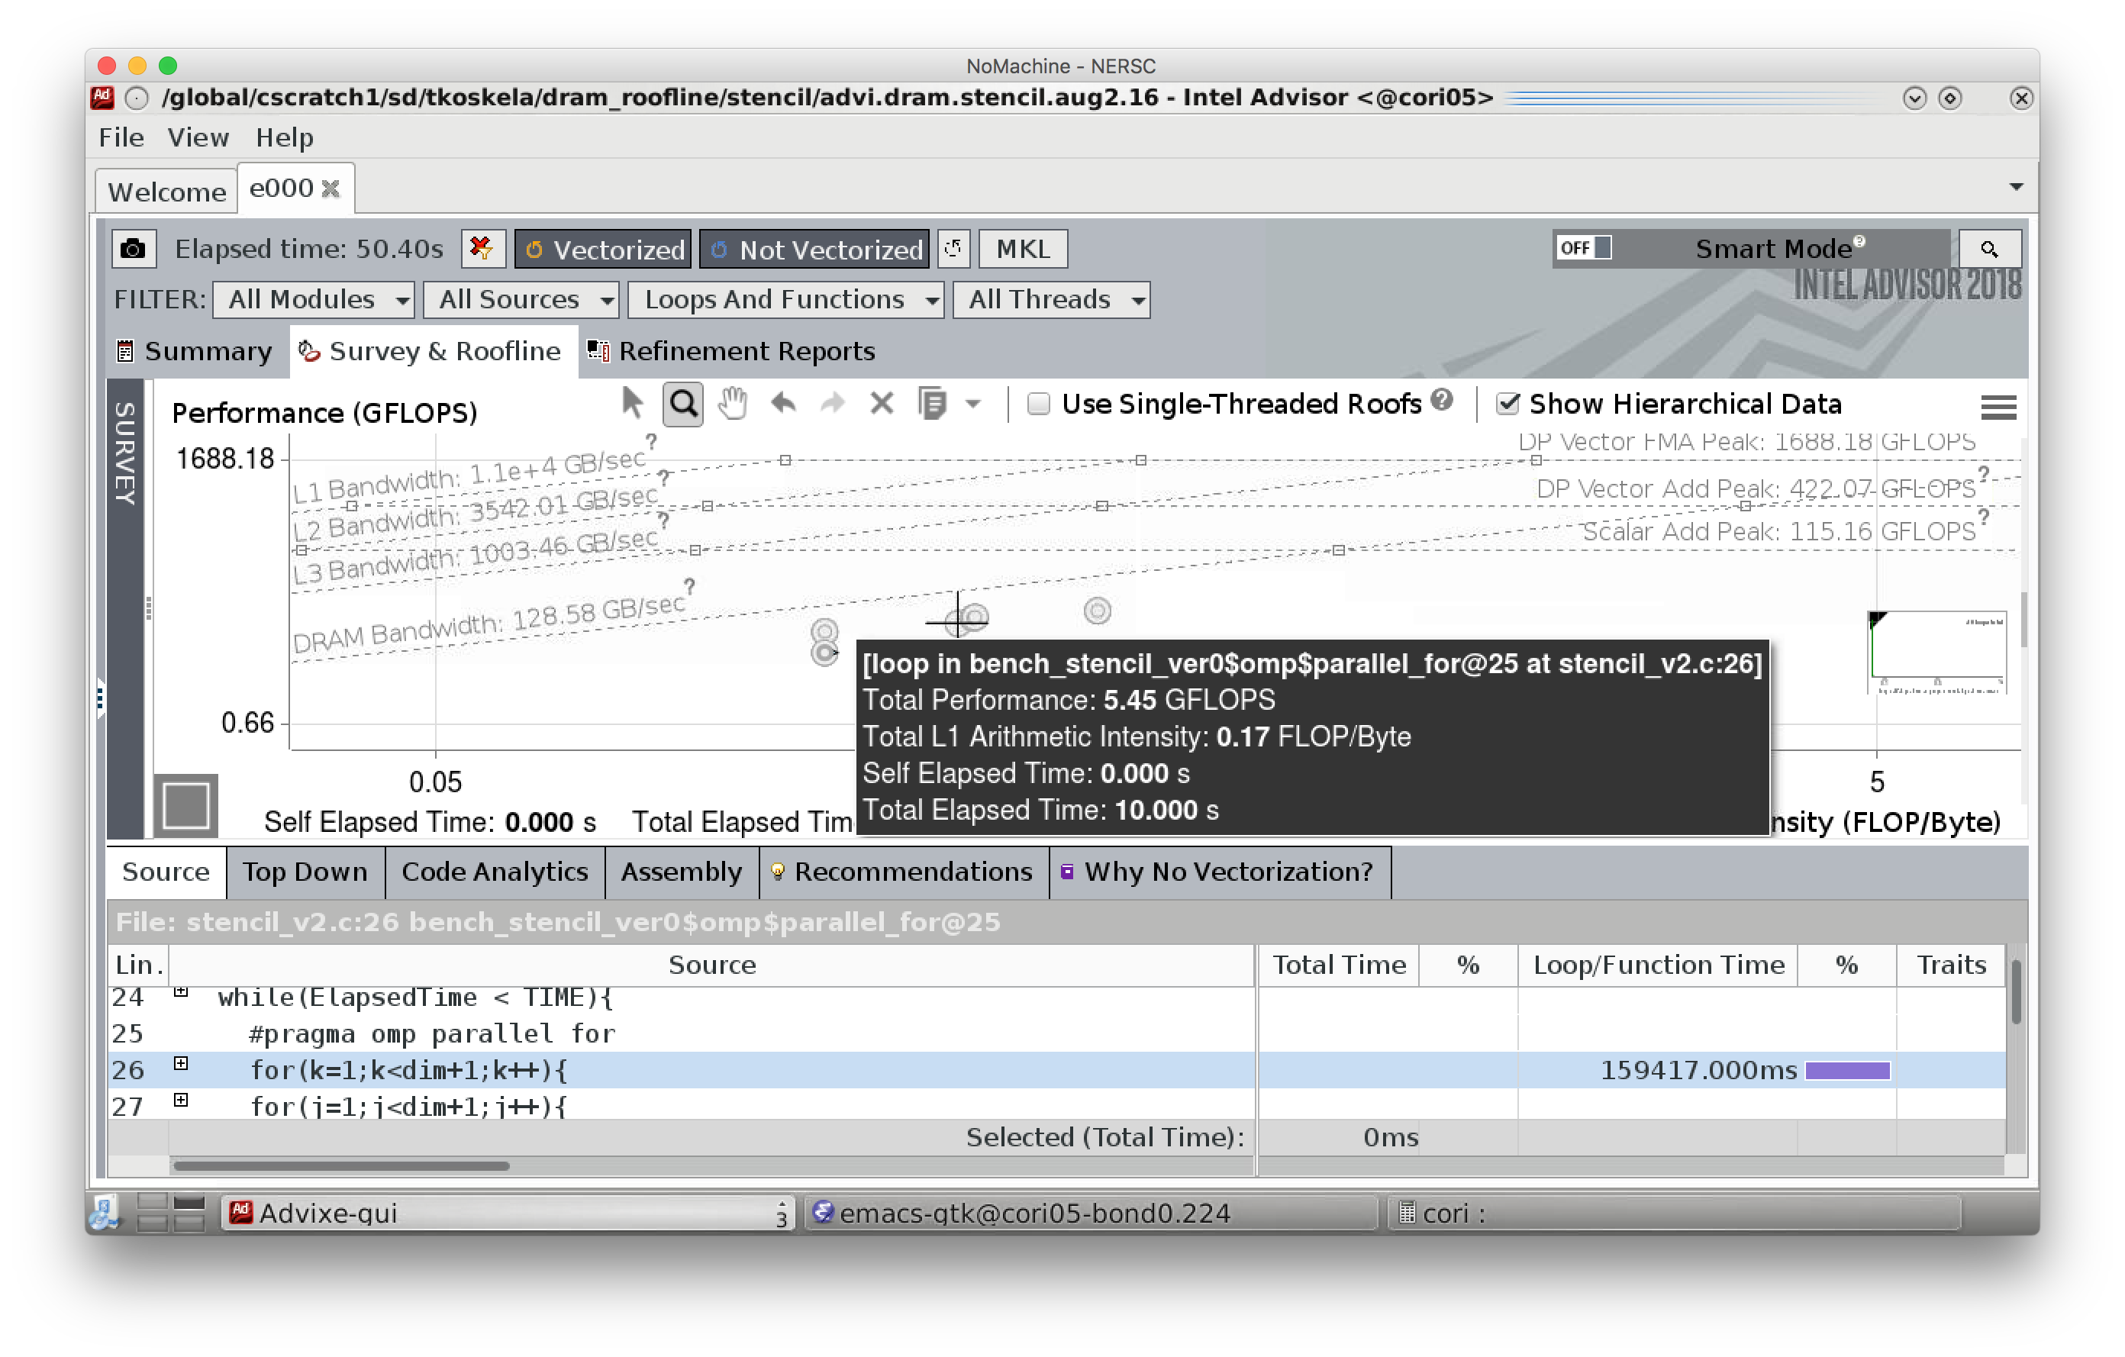
DRAM Roofline*

Slide 99

DRAM Roofline*

Slide 100
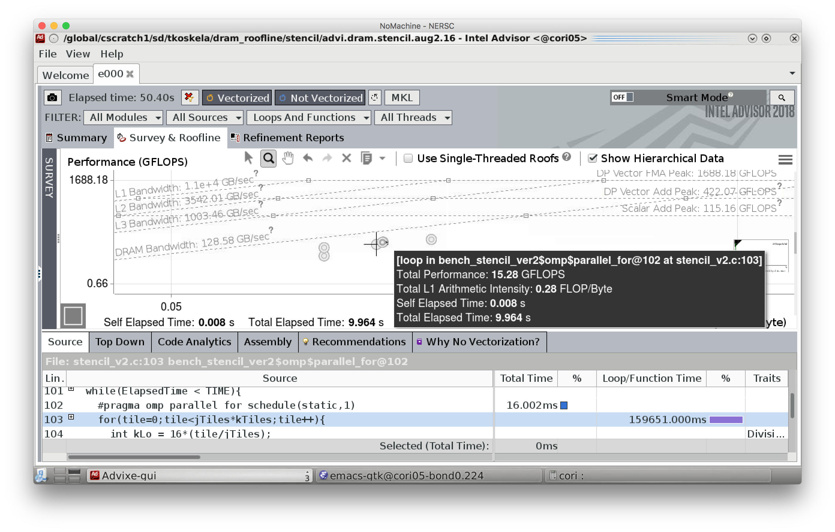
DRAM Roofline*

Slide 101

DRAM Roofline*

Slide 102
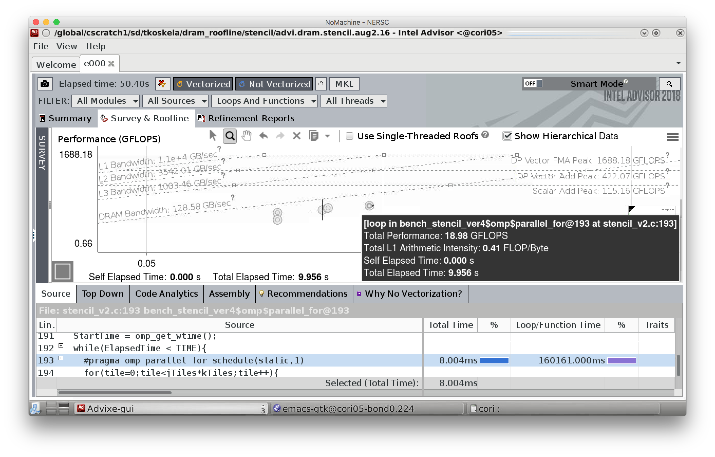
DRAM Roofline*

Slide 103
Little’s Law
Applied to Memory
Applied to FPUs
Consider a CPU with 100GB/s of bandwidth and 100ns memory latency.
Little’s law states that we must express 10KB of concurrency (independent memory operations) to the memory subsystem to attain peak performance
Solution #1: use multiple cores or threads to satisfy the requisite MLP.
Solution #2: express the memory access pattern in a streaming fashion in order to engage the prefetchers.
consider a CPU with 2 FPU’s each with a 4-cycle latency.
Little’s law states that we must express 8-way ILP to fully utilize the machine.
Solution #1: rely on OOO to find parallelism across loop iterations.
Solution #2: unroll/jam the code to express 8 independent FP operations.
Note, simply unrolling dependent operations (e.g. reduction) does not increase ILP. It simply amortizes loop overhead.

