Slide 1
Introduction to the
Roofline Model
Samuel Williams
Computational Research Division
Lawrence Berkeley National Lab
SWWilliams@lbl.gov

Slide 2
Acknowledgements
This material is based upon work supported by the Advanced Scientific Computing Research Program in the U.S. Department of Energy, Office of Science, under Award Number DE-AC02-05CH11231.
This material is based upon work supported by the DOE RAPIDS SciDAC Institute.
This research used resources of the National Energy Research Scientific Computing Center (NERSC), which is supported by the Office of Science of the U.S. Department of Energy under contract DE-AC02-05CH11231.
This research used resources of the Oak Ridge Leadership Facility at the Oak Ridge National Laboratory, which is supported by the Office of Science of the U.S. Department of Energy under Contract No. DE-AC05-00OR22725.

Slide 3
Why Use Performance Models or Tools?
Identify performance bottlenecks
Motivate software optimizations
Determine when we’re done optimizing
Assess performance relative to machine capabilities
Motivate need for algorithmic changes
Predict performance on future machines / architectures
Sets realistic expectations on performance for future procurements
Used for HW/SW Co-Design to ensure future architectures are well-suited for the computational needs of today’s applications.

Slide 4
Performance Models / Simulators
Historically, many performance models and simulators tracked latencies to predict performance (i.e. counting cycles)
The last two decades saw a number of latency-hiding techniques…
Out-of-order execution (hardware discovers parallelism to hide latency)
HW stream prefetching (hardware speculatively loads data)
Massive thread parallelism (independent threads satisfy the latency-bandwidth product)
Effectively latency hiding has resulted in a shift from a latency-limited computing regime to a throughput-limited computing regime

Slide 5

Roofline Model
The Roofline Model is a throughput-oriented performance model…
Tracks rates not times
Augmented with Little’s Law
(concurrency = latency*bandwidth)
Independent of ISA and architecture
(applies to CPUs, GPUs, Google TPUs¹, etc…)
Three Components:
Machine Characterization
(realistic performance potential of the system)
Application Execution Monitoring
Theoretical Application Bounds
(how well could my app perform with perfect
compilers, caches, overlap, …)
https://crd.lbl.gov/departments/computer-science/PAR/research/roofline
¹Jouppi et al, “In-Datacenter Performance Analysis of a Tensor Processing Unit”, ISCA, 2017.

Slide 6
(DRAM) Roofline
One could hope to always attain peak performance (Flop/s)
However, finite locality (reuse) and bandwidth limit performance.
Consider idealized processor/caches
Plot the performance bound using Arithmetic Intensity (AI) as the x-axis…
AI = Flops / Bytes presented to DRAM
Attainable Flop/s = min( peak Flop/s, AI * peak GB/s )
Log-log scale makes it easy to doodle, extrapolate performance along Moore’s Law, etc…
Kernels with AI less than machine balance are ultimately DRAM bound (we’ll refine this later…)
Peak Flop/s
Attainable Flop/s
DRAM GB/s
Memory-bound
Compute-bound
Arithmetic Intensity (Flop:Byte)

Slide 7
Roofline Example #1
Typical machine balance is 5-10 flops per byte…
40-80 flops per double to exploit compute capability
Artifact of technology and money
Unlikely to improve
Consider STREAM Triad…
2 flops per iteration
Transfer 24 bytes per iteration (read X[i], Y[i], write Z[i])
AI = 0.083 flops per byte == Memory bound
Peak Flop/s
Attainable Flop/s
DRAM GB/s
Gflop/s ≤ AI * DRAM GB/s
#pragma omp parallel for
for(i=0;i<N;i++){
Z[i] = X[i] + alpha*Y[i];
}
TRIAD
0.083
Arithmetic Intensity (Flop:Byte)

Slide 8
Roofline Example #2
Conversely, 7-point constant coefficient stencil…
7 flops
8 memory references (7 reads, 1 store) per point
Cache can filter all but 1 read and 1 write per point
AI = 0.44 flops per byte == memory bound,
but 5x the flop rate
Peak Flop/s
Gflop/s ≤ AI * DRAM GB/s
Attainable Flop/s
DRAM GB/s
#pragma omp parallel for
for(k=1;k<dim+1;k++){
for(j=1;j<dim+1;j++){
for(i=1;i<dim+1;i++){
int ijk = i + j*jStride + k*kStride;
new[ijk] = -6.0*old[ijk ]
+ old[ijk-1 ]
+ old[ijk+1 ]
+ old[ijk-jStride]
+ old[ijk+jStride]
+ old[ijk-kStride]
+ old[ijk+kStride];
}}}
7-point
Stencil
TRIAD
0.083
0.44
Arithmetic Intensity (Flop:Byte)

Slide 9
Hierarchical Roofline
Real processors have multiple levels of memory
Registers
L1, L2, L3 cache
MCDRAM/HBM (KNL/GPU device memory)
DDR (main memory)
NVRAM (non-volatile memory)
Applications can have locality in each level
Unique data movements imply unique AI’s
Moreover, each level will have a unique bandwidth

Slide 10
Hierarchical Roofline
Construct superposition of Rooflines…
Measure a bandwidth
Measure AI for each level of memory
Although an loop nest may have multiple AI’s and multiple bounds (flops, L1, L2, … DRAM)…
… performance is bound by the minimum
Peak Flop/s
L2 GB/s
MCDRAM cache GB/s
Attainable Flop/s
DDR Bound
DDR AI*BW <
MCDRAM AI*BW
DDR GB/s
Arithmetic Intensity (Flop:Byte)

Slide 11
Hierarchical Roofline
Construct superposition of Rooflines…
Measure a bandwidth
Measure AI for each level of memory
Although an loop nest may have multiple AI’s and multiple bounds (flops, L1, L2, … DRAM)…
… performance is bound by the minimum
Peak Flop/s
L2 GB/s
MCDRAM cache GB/s
Attainable Flop/s
DDR GB/s
DDR bottleneck pulls performance below MCDRAM Roofline
Arithmetic Intensity (Flop:Byte)

Slide 12
Hierarchical Roofline
Construct superposition of Rooflines…
Measure a bandwidth
Measure AI for each level of memory
Although an loop nest may have multiple AI’s and multiple bounds (flops, L1, L2, … DRAM)…
… performance is bound by the minimum
Peak Flop/s
L2 GB/s
MCDRAM cache GB/s
Attainable Flop/s
MCDRAM bound
MCDRAM AI*BW <
DDR AI*BW
DDR GB/s
Arithmetic Intensity (Flop:Byte)

Slide 13
Hierarchical Roofline
Construct superposition of Rooflines…
Measure a bandwidth
Measure AI for each level of memory
Although an loop nest may have multiple AI’s and multiple bounds (flops, L1, L2, … DRAM)…
… performance is bound by the minimum
Peak Flop/s
L2 GB/s
MCDRAM cache GB/s
Attainable Flop/s
DDR GB/s
MCDRAM bottleneck pulls performance below DDR Roofline
Arithmetic Intensity (Flop:Byte)

Slide 14
Data, Instruction, Thread-Level Parallelism…
We have assumed one can attain peak flops with high locality.
In reality, this is premised on sufficient…
Use special instructions (e.g. fused multiply-add)
Vectorization (16 flops per instruction)
unrolling, out-of-order execution (hide FPU latency)
OpenMP across multiple cores
Without these, …
Peak performance is not attainable
Some kernels can transition from memory-bound to compute-bound
n.b. in reality, DRAM bandwidth is often tied to DLP and TLP (single core can’t saturate BW w/scalar code)
Peak Flop/s
No FMA
Attainable Flop/s
DDR GB/s
No vectorization
Lack of DLP pulls performance below DDR Roofline
Arithmetic Intensity (Flop:Byte)

Slide 15
Initial LBL/NERSC Roofline Efforts

Slide 16
Initial LBL Roofline Efforts / Goals
Node Characterization
Application Instrumentation/Characterization
Using Roofline to drive application performance analysis and optimization for KNL.

Slide 17
Node Characterization?
Cori / KNL
“Marketing Numbers” can be deceptive…
TurboMode / Underclock for AVX
Pin BW vs. real bandwidth
compiler failings on high-AI loops.
SummitDev / 4GPUs
LBL developed the Empirical Roofline Toolkit (ERT)…
      Characterize CPU/GPU systems
      Peak Flop rates
      Bandwidths for each level of memory
      MPI+OpenMP/CUDA == multiple GPUs
https://crd.lbl.gov/departments/computer-science/PAR/research/roofline/
Notes:
Shows ERT on Cori / KNL and SummitDev/Pascal

Slide 18
Instrumentation with Performance Counters?
Characterizing applications with performance counters can be problematic…
Flop Counters can be broken/missing in production processors
Vectorization/Masking can complicate counting Flop’s
Counting Loads and Stores doesn’t capture cache reuse while counting cache misses doesn’t account for prefetchers.
DRAM counters (Uncore PMU) might be accurate, but…
are privileged and thus nominally inaccessible in user mode
may need vendor (e.g. Cray) and center (e.g. NERSC) approved OS/kernel changes

Slide 19

Forced to Cobble Together Tools…
Use tools known/observed to work on NERSC’s Cori (KNL, HSW)…
Used Intel SDE (Pin binary instrumentation + emulation) to create software Flop counters
Used Intel VTune performance tool (NERSC/Cray approved) to access uncore counters
Accurate measurement of Flop’s (HSW) and DRAM data movement (HSW and KNL)
Used by NESAP (NERSC KNL application readiness project) to characterize apps on Cori…
    http://www.nersc.gov/users/application-performance/measuring-arithmetic-intensity/
NERSC is LBL’s production computing division
CRD is LBL’s Computational Research Division
NESAP is NERSC’s KNL application readiness project
LBL is part of SUPER (DOE SciDAC3 Computer Science Institute)

Slide 20
Initial Roofline Analysis of NESAP Codes
MFDn
EMGeo
PICSAR
DRAM-only Roofline is insufficient for PICSAR
2P HSW
KNL
Notes:
DRAM-only Roofline is insufficient for PICSAR

Slide 21
Evaluation of LIKWID
LIKWID provides easy to use wrappers for measuring performance counters…
Works on NERSC production systems
Minimal overhead (<1%)
Scalable in distributed memory (MPI-friendly)
Fast, high-level characterization
No detailed timing breakdown or optimization advice
Limited by quality of hardware performance counter implementation (garbage in/garbage out)
Useful tool that complements other tools
https://github.com/RRZE-HPC/likwid

Slide 22
Need an integrated solution…
Having to compose VTune, SDE, and plotting tools…
      worked correctly and benefited NESAP’s application readiness
      forced users to learn/run multiple tools and manually parse/graph the output
      forced users to instrument routines of interest in their application
      lacked integration with compiler/debugger/disassembly
    LIKWID was…
      fast and easy to use
      Suffered from the same limitations as VTune/SDE
ERT…
      Characterized flops, and bandwidths (cache, DRAM)
      Interoperable with MPI, OpenMP, and CUDA
      Required users to manually parse/incorporate the output

Slide 23
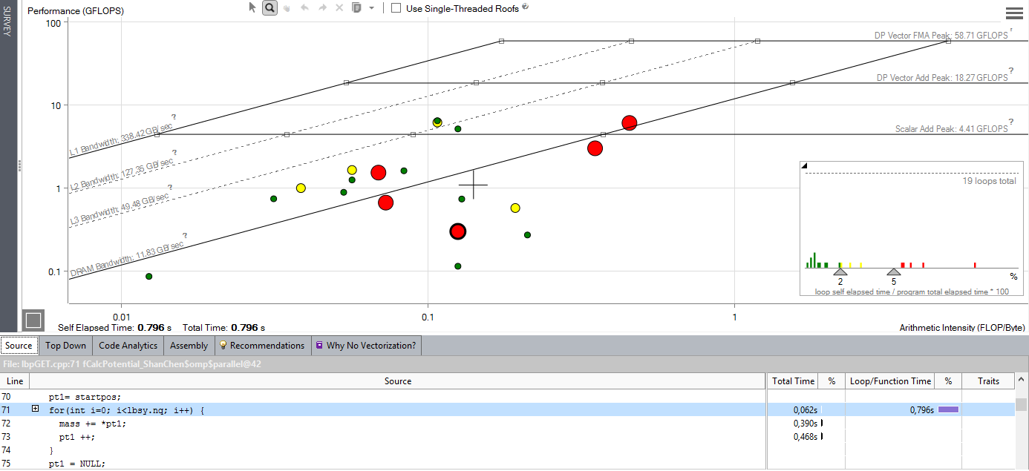
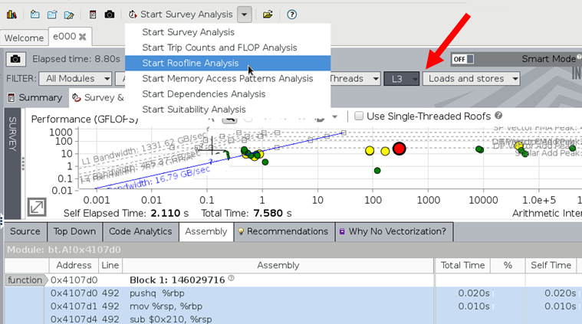
Intel Advisor
Includes Roofline Automation…
Automatically instruments applications
(one dot per loop nest/function)
Computes FLOPS and AI for each function (CARM)
Full AVX-512 integration that incorporates mask values
Integrated Cache Simulator¹ (hierarchical roofline / multiple AI’s)
Automatically benchmarks target system (calculates ceilings)
Full integration with existing Advisor capabilities
Memory-bound, invest into cache blocking etc
Compute bound: invest into SIMD,..
¹Technology Preview, not in official product roadmap so far.
This version will be made available during the hands-on component of this tutorial.

Slide 24
Hierarchical Roofline vs.
Cache-Aware Roofline
…understanding different Roofline formulations in Advisor

Slide 25
There are two Major Roofline Formulations:
Hierarchical Roofline (original Roofline w/ DRAM, L3, L2, …)…
      Williams, et al, “Roofline: An Insightful Visual Performance Model for Multicore Architectures”, CACM, 2009
      Chapter 4 of “Auto-tuning Performance on Multicore Computers”, 2008
      Defines multiple bandwidth ceilings and multiple AI’s per kernel
      Performance bound is the minimum of flops and the memory intercepts (superposition of original, single-metric Rooflines)
Cache-Aware Roofline
      Ilic et al, "Cache-aware Roofline model: Upgrading the loft", IEEE Computer Architecture Letters, 2014
      Defines multiple bandwidth ceilings, but uses a single AI (flop:L1 bytes)
      As one looses cache locality (capacity, conflict, …) performance falls from one BW ceiling to a lower one at constant AI
Why Does this matter?
      Some tools use the Hierarchical Roofline, some use cache-aware == Users need to understand the differences
      Cache-Aware Roofline model was integrated into production Intel Advisor
      Evaluation version of Hierarchical Roofline¹ (cache simulator) has also been integrated into Intel Advisor
      You will be allowed to explore both in the hand—on component of this tutorial
¹Technology Preview, not in official product roadmap so far.
This version will be made available during the hands-on component of this tutorial.

Slide 26
Hierarchical Roofline
Cache-Aware Roofline
Captures cache effects
Captures cache effects
AI is Flop:Bytes after being filtered by lower cache levels
AI is Flop:Bytes as presented to the L1 cache (plus non-temporal stores)
Multiple Arithmetic Intensities
(one per level of memory)
Single Arithmetic Intensity
AI dependent on problem size
(capacity misses reduce AI)
AI independent of problem size
Memory/Cache/Locality effects are observed as decreased AI
Memory/Cache/Locality effects are observed as decreased performance
Requires performance counters or cache simulator to correctly measure AI
Requires static analysis or binary instrumentation to measure AI
Notes:
Some tools use one…
some tools use the other…
some use both.

Slide 27
Example: STREAM
L1 AI…
      2 flops
      2 x 8B load (old)
      1 x 8B store (new)
      = 0.08 flops per byte
    No cache reuse…
      Iteration i doesn’t touch any data associated with iteration i+delta for any delta.
… leads to a DRAM AI equal to the L1 AI
#pragma omp parallel for
for(i=0;i<N;i++){
Z[i] = X[i] + alpha*Y[i];
}

Slide 28
Example: STREAM
Hierarchical Roofline
Cache-Aware Roofline
Peak Flop/s
Peak Flop/s
Performance is bound to
the minimum of the two
Intercepts…
AI_{L1} * L1 GB/s
AI_{DRAM} * DRAM GB/s
Observed performance
is correlated with DRAM
bandwidth
Attainable Flop/s
Attainable Flop/s
L1 GB/s
L1 GB/s
Multiple AI’s….
Flop:DRAM bytes
Flop:L1 bytes (same)
DRAM GB/s
DRAM GB/s
Single AI based on flop:L1 bytes
0.083
0.083
Arithmetic Intensity (Flop:Byte)
Arithmetic Intensity (Flop:Byte)

Slide 29
Example: 7-point Stencil (Small Problem)
L1 AI…
      7 flops
      7 x 8B load (old)
      1 x 8B store (new)
      = 0.11 flops per byte
      some compilers may do register shuffles to reduce the number of loads.
    Moderate cache reuse…
      old[ijk] is reused on subsequent iterations of i,j,k
      old[ijk-1] is reused on subsequent iterations of i.
      old[ijk-jStride] is reused on subsequent iterations of j.
      old[ijk-kStride] is reused on subsequent iterations of k.
… leads to DRAM AI larger than the L1 AI
#pragma omp parallel for
for(k=1;k<dim+1;k++){
for(j=1;j<dim+1;j++){
for(i=1;i<dim+1;i++){
int ijk = i + j*jStride + k*kStride;
new[ijk] = -6.0*old[ijk ]
+ old[ijk-1 ]
+ old[ijk+1 ]
+ old[ijk-jStride]
+ old[ijk+jStride]
+ old[ijk-kStride]
+ old[ijk+kStride];
}}}

Slide 30
Example: 7-point Stencil (Small Problem)
Hierarchical Roofline
Cache-Aware Roofline
Peak Flop/s
Peak Flop/s
Attainable Flop/s
Attainable Flop/s
L1 GB/s
Performance bound is
the minimum of the two
L1 GB/s
Multiple AI’s….
flop:DRAM ~ 0.44
flop:L1 ~ 0.11
DRAM GB/s
DRAM GB/s
0.11
0.44
0.11
Arithmetic Intensity (Flop:Byte)
Arithmetic Intensity (Flop:Byte)

Slide 31
Example: 7-point Stencil (Small Problem)
Hierarchical Roofline
Cache-Aware Roofline
Peak Flop/s
Peak Flop/s
Observed performance
is between L1 and DRAM lines
(== some cache locality)
Attainable Flop/s
Attainable Flop/s
L1 GB/s
Performance bound is
the minimum of the two
L1 GB/s
Multiple AI’s….
flop:DRAM ~ 0.44
flop:L1 ~ 0.11
DRAM GB/s
DRAM GB/s
Single AI based on flop:L1 bytes
0.11
0.44
0.11
Arithmetic Intensity (Flop:Byte)
Arithmetic Intensity (Flop:Byte)

Slide 32
Example: 7-point Stencil (Large Problem)
Hierarchical Roofline
Cache-Aware Roofline
Peak Flop/s
Peak Flop/s
Observed performance
is closer to DRAM line
(== less cache locality)
Attainable Flop/s
Attainable Flop/s
L1 GB/s
Capacity misses reduce
DRAM AI and performance
L1 GB/s
Multiple AI’s….
flop:DRAM ~ 0.20
flop:L1 ~ 0.11
DRAM GB/s
DRAM GB/s
Single AI based on flop:L1 bytes
0.11
0.20
0.11
Arithmetic Intensity (Flop:Byte)
Arithmetic Intensity (Flop:Byte)

Slide 33
Example: 7-point Stencil (Observed Perf.)
Hierarchical Roofline
Cache-Aware Roofline
Peak Flop/s
Peak Flop/s
Observed performance
is closer to DRAM line
(== less cache locality)
Attainable Flop/s
Attainable Flop/s
L1 GB/s
L1 GB/s
Actual observed performance
is tied to the bottlenecked resource
and can be well below a cache
Roofline (e.g. L1).
DRAM GB/s
DRAM GB/s
Single AI based on flop:L1 bytes
0.11
0.20
0.11
Arithmetic Intensity (Flop:Byte)
Arithmetic Intensity (Flop:Byte)

Slide 34
Example: 7-point Stencil (Observed Perf.)
Hierarchical Roofline
Cache-Aware Roofline
Peak Flop/s
Peak Flop/s
Observed performance
is closer to DRAM line
(== less cache locality)
Attainable Flop/s
Attainable Flop/s
L1 GB/s
L1 GB/s
Actual observed performance
is tied to the bottlenecked resource
and can be well below a cache
Roofline (e.g. L1).
DRAM GB/s
DRAM GB/s
Single AI based on flop:L1 bytes
0.11
0.20
0.11
Arithmetic Intensity (Flop:Byte)
Arithmetic Intensity (Flop:Byte)

Slide 35
Questions?

