Slide 1
Channel Reservation Protocol for Over-Subscribed Channels and Destinations
George Michelogiannakis,
Nan Jiang, Daniel Becker, William J. Dally
This work was completed in Stanford University

Slide 2
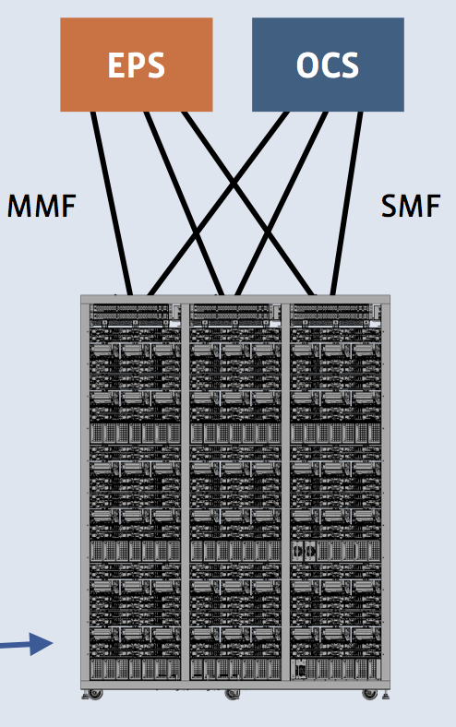
Introduction
HPC and datacenter networks increasingly oversubscribed
Exascale for HPC may need 1 billion-way parallelism
Datacenter server count annual growth 7-17%
Levels of expensive bandwidth:
Between servers (intra-rack)
Between racks (intra-cluster)
Between clusters (intra-datacenter)
Between buildings (metro)
Between regions (longhaul)
Why optical data communications and why now? Applied Physics. 2009
Facebook’s datacenter network architecture. OSI 2013

Slide 3
Introduction
To make it worse, many traffic patterns create unbalanced load
Unbalanced load creates long paths of blocked packets (known as tree saturation)
I’ll present a channel reservation protocol which prevents network and endpoint congestion
We focus on lossless flow control
Tree saturation is a major drawback

Slide 4
Agenda
Motivation and related work
Channel reservation protocol
Evaluation

Slide 5
Oversubscription and Hotspots
Cluster 1
Cluster 2
Oversubscribed
channels
Oversubscribed
H
This setting represents over-subscribed links between
network clusters, or even between racks
Tree saturation root. Affects benign traffic

Slide 6
Impact on Benign Traffic
Adversarial pattern tops at 5% flit injection
Benign pattern slightly higher (6-7%)
Ideal flow control would avoid any interference
Benign traffic is negatively affected

Slide 7
Explicit Congestion Notification
ECN: State of the art congestion handling scheme
Oversubscribed
channels
ECN detects congestion at the root of the congestion tree
Signals to the sources to throttle down

Slide 8
Agenda
Motivation and related work
Channel reservation protocol
Evaluation

Slide 9
Channel Reservation Protocol
Source is
informed to
transmit in cycle 10
Resource available cycles 5 and 10
Cluster 1
Channel is
reserved for
cycle 10
Cluster 2
Oversubscribed
Oversubscribed
Destination
available cycles
10 and 15.
Result: cycle 10
Destination
reserves
cycle 10
H
Reply (ACK) creates reservations for the chosen
time slot in all oversubscribed resources
Encounters congestion. Converted to a
single-flit reservation request
Potentially long packet sent speculatively

Slide 10
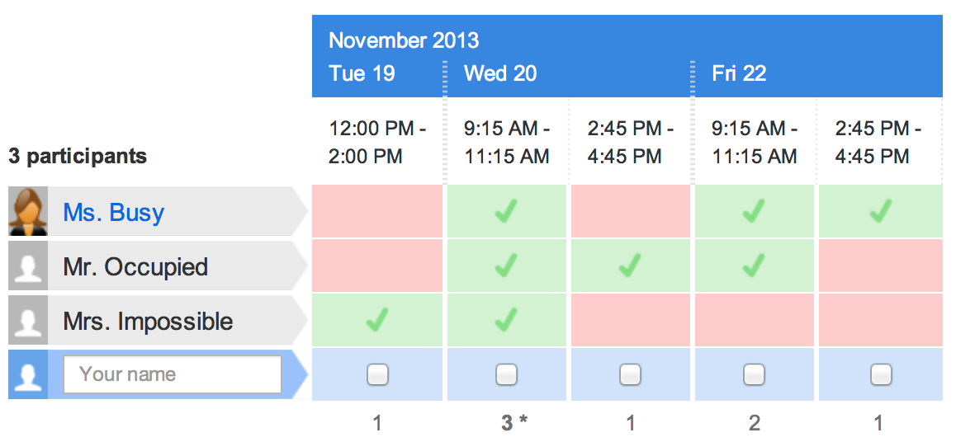
CRP: Doodle for Packets
Challenge: Participant’s availabilities are distributed across the network

Slide 11
Reservation Tables
Reservation table is one line in the Doodle
Doodle asks for the length of time slots
We call a time slot a cell
Cells have C_{max} cycles
We keep a counter per cell because packet sizes differ
Cell labels | A | B | C | D | E | … | V_{cells}
Cell values | 512 | 10 | 100 | 0 | 10 | … | 50

Slide 12
Reservation Vectors
Request packets carry a vector to record what time slots are available in the resources traversed so far
This is used to build up to the final result of the Doodle
Cell labels | A | B | C | D | E | … | V_{cells}
Cell values | T | T | F | F | T | … | F

Slide 13
Request Traversing a Channel
Request size: 80 cycles
Cell labels | A | B | C | D | E | … | V_{cells}
Cell values | 512 | 10 | 100 | 0 | 10 | … | 50
Cell labels | A | B | C | D | E | … | V_{cells}
Cell values | T | T | T | T | T | … | T
Cell labels | A | B | C | D | E | … | V_{cells}
Cell values | T | T | T | F | F | … | F

Slide 14
Request Arriving at Destination
Cell labels | A | B | C | D | E | … | V_{cells}
Cell values | 30 | 40 | 100 | 512 | 100 | … | 90
Cell labels | A | B | C | D | E | … | V_{cells}
Cell values | T | T | T | F | F | … | F
Cell labels | A | B | C | D | E | … | V_{cells}
Cell values | F | T | T | F | F | … | F

Slide 15
CRP: Doodle for Packets
We have identified the common availability. Now we need to inform everybody

Slide 16
Destination Reserving Bandwidth
Original destination table:
Cell labels | A | B | C | D | E | … | V_{cells}
Cell values | 30 | 40 | 100 | 512 | 100 | … | 90
Resulting destination table:
Cell labels | A | B | C | D | E | … | V_{cells}
Cell values | 30 | 0 | 60 | 512 | 100 | … | 90
Subtracts reservation size (80 cycles) from the appropriate cells (time slots)

Slide 17
ACK Traversing the Channel
Reserves 80 cycles starting from the granted timestamp cell (time slot)
Original reservation table:
Cell labels | A | B | C | D | E | … | V_{cells}
Cell values | 512 | 10 | 100 | 0 | 10 | … | 50
Resulting reservation table:
Cell labels | A | B | C | D | E | … | V_{cells}
Cell values | 512 | 0 | 30 | 0 | 10 | … | 50

Slide 18
Protocol Considerations
If participants cannot agree on a time, we wait and then try again
If time slot no longer available, ACK is converted to a retry
If network uncongested, speculative packets succeed and no overhead for reservation

Slide 19
Agenda
Motivation and related work
Channel reservation protocol
Evaluation

Slide 20
Methodology
Two clusters of 144-node fat trees
12x12 routers
Clusters connected with four channels
All channels are 10Gb/s
Messages 2KB, divided into eight packets
CRP applies to the message
Oversubscribed
Oversubscribed
4
H

Slide 21
Uniform Random

Slide 22
Uniform Random
By the time ECN reacts, the flow is done
ECN does not share congestion
state with other destinations in
the same cluster
S
Oversubscribed
A
Oversubscribed
4
B

Slide 23
Combined Traffic
ECN can be configured to
prevent tree saturation in
steady-state traffic

Slide 24
Combined Traffic
3.5% lower for CRP
CRP has extra
control overhead

Slide 25
Transient Traffic
ECN allows congestion occur and reacts to it. CRP prevents it entirely
300,000 cycles to stabilize for ECN

Slide 26
Transient Traffic
ECN allows congestion occur and reacts to it. CRP prevents it entirely
ECN’s maximum latency: 37,000 cycles
300,000 cycles to stabilize for ECN

Slide 27
ECN Sensitivity: Three Clusters
ECN configuration is sensitive
to network topology, routing,
and traffic pattern

Slide 28
ECN Sensitivity: Four Clusters
ECN needs to be reconfigured

Slide 29
Conclusions
CRP is a statistical scheme to avoid overwhelming channels and destinations
CRP effectively prevents congestion
Avoids pitfalls of ECN and reactive techniques
CRP focuses on lossless flow control but similar benefits are possible in lossy flow control
Congestion causes many packet drops

