Slide 1
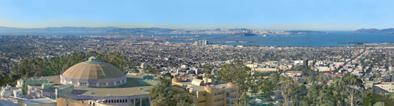



Parallel Sparse Matrix-Matrix Multiplication and Its Use in Triangle Counting and Enumeration
Ariful Azad
Lawrence Berkeley National Laboratory
In collaboration with
Grey Ballard (Sandia), Aydin Buluc (LBNL), James Demmel (UC Berkeley),
John Gilbert (UCSB), Laura Grigori (INRIA), Oded Schwartz (Hebrew University),
Sivan Toledo(Tel Aviv University), Samuel Williams(LBNL)
SIAM ALA 2015, Atlanta

Slide 2
Sparse Matrix-Matrix Multiplication (SpGEMM)
x
=
A
B
C
A, B and C are sparse.
Why sparse matrix-matrix multiplication?
  Algebraic multigrid (AMG),
  Graph clustering,
  Betweenness centrality,
  Graph contraction,
  Subgraph extraction
  Quantum chemistry
  Triangle counting/enumeration

Slide 3
Outline of the talk
3D SpGEMM [A. Azad et al. Exploiting multiple levels of parallelism in sparse matrix-matrix multiplication. arXiv preprint arXiv:1510.00844. ]
  Scalable shared-memory SpGEMM
  Distributed-memory 3D SpGEMM
Parallel triangle counting and enumeration using SpGEMM [A.Azad, A. Buluc, J. Gilbert. Parallel Triangle Counting and Enumeration using Matrix Algebra. IPDPS Workshops, 2015]
  Masked SpGEMM to reduce communication
  1D parallel implementation

Slide 4
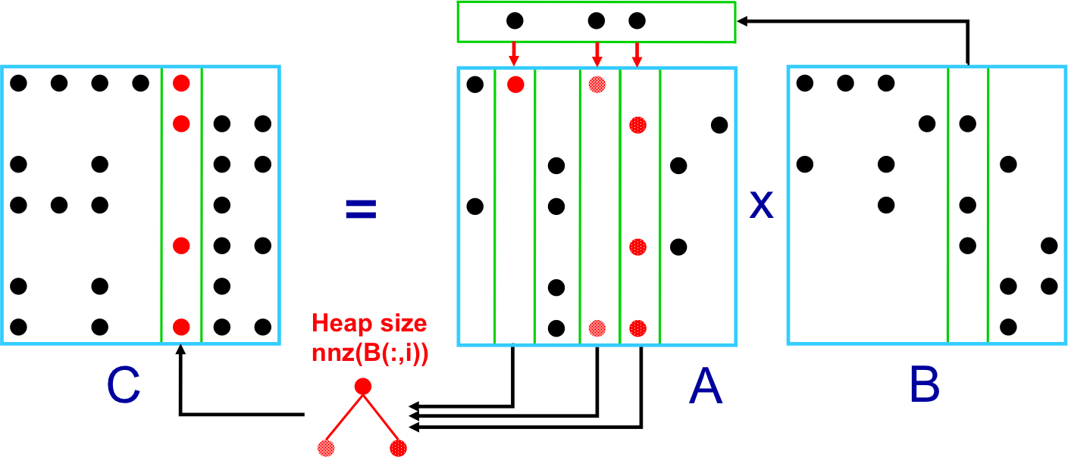
Shared-Memory SpGEMM
i-th column
i-th column of result
Heap-based column-by-column algorithm [Buluc and Gilbert, 2008]
Easy to parallelize in shared-memory via multithreading
Memory efficient and scalable (i.e. temporary per-thread storage is asymptotically negligible)

Slide 5
Performance of Shared-Memory SpGEMM
Faster than Intel’s MKL (mkl_csrmultcsr)
(when we keep output sorted by indices)
(a) cage12 x cage12
(b) Scale 16 G500 x G500
A. Azad, G. Ballard, A. Buluc, J. Demmel, L. Grigori, O. Schwartz, S. Toledo, S. Williams. Exploiting multiple levels of parallelism in sparse matrix-matrix multiplication. arXiv preprint arXiv:1510.00844.

Slide 6
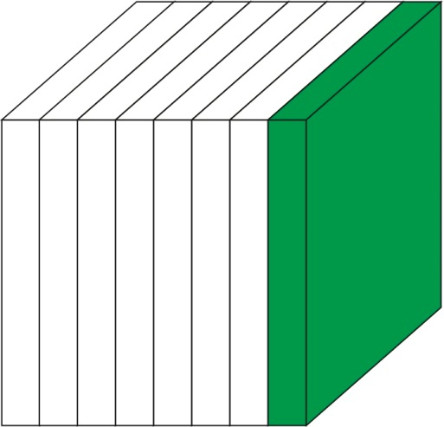
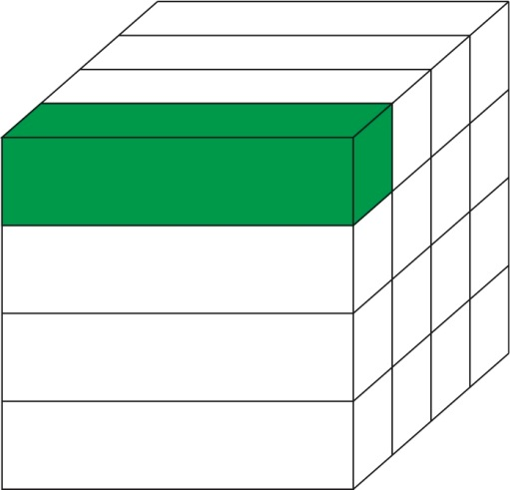
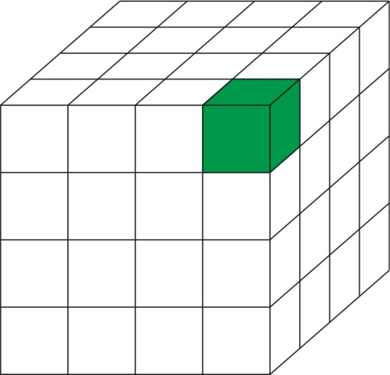
Variants of Distributed-Memory SpGEMM
  Matrix multiplication: ∀(i,j) ∈ n x n, C(i,j) = Σ_{k} A(i,k)B(k,j),
Sparsity independent algorithms:
assigning grid-points to processors is independent of sparsity structure.
[Ballard et al., SPAA 2013]
The computation (discrete) cube:
A face for each (input/output) matrix
A grid point for each multiplication
Categorized by the way work is partitioned
C
A
B
1D algorithms
2D algorithms
3D algorithms
Communicate A or B
Communicate A and B
Communicate A, B and C

Slide 7
2D Algorithm: Sparse SUMMA
Processor Grid
C_{ij} += LocalSpGEMM(A^{recv}, B^{recv})
25K
Processor row
100K
25K
x
=
Processor column
100K
A
C
B
2D Sparse SUMMA (Scalable Universal Matrix Multiplication Algorithm) was the previous state of the art. It becomes communication bound on high concurrency [Buluc & Gilbert, 2012]

Slide 8
3D Parallel SpGEMM in a Nutshell
Processor Grid
Input storage does not increase
3rd dimension (c=3)
A. Azad, G. Ballard, A. Buluc, J. Demmel, L. Grigori, O. Schwartz, S. Toledo, S. Williams. Exploiting multiple levels of parallelism in sparse matrix-matrix multiplication. arXiv preprint arXiv:1510.00844.
Notes:
We don’t create replicates. Penalty: more SUMMA stages. Input and output same distribution … ex

Slide 9
3D Parallel SpGEMM in a Nutshell
Broadcast
(row/column)
AlltoAll (layer)
Communication
Local multiply
Multiway merge
Multiway
merge
Computation
(multithreaded)

Slide 10
Communication Cost
Broadcast
(row/column)
Most expensive step
Communication
#broadcasts targeted to each process (synchronization points / SUMMA stages)
#processes participating in each broadcasts (communicator size)
Total data received in all broadcasts (process)
layers
threads
Threading decreases
Network card contention
Processor Grid
Notes:
We use b = n/sqrt(pc)

Slide 11
How do 3D algorithms gain performance?
On 8,192 cores of Titan when multiplying two scale 26 G500 matrices.
For fixed #layers (c)
Increased #threads (t)
reduces runtime
Notes:
Reduce broadcast

Slide 12
How do 3D algorithms gain performance?
On 8,192 cores of Titan when multiplying two scale 26 G500 matrices.
For fixed #threads (t)
Increased #layers (c)
reduces runtime
Notes:
Reduce broadcast

Slide 13
3D SpGEMM performance (matrix squaring)
Squaring nlpkkt160 on Edison: 1.2 billion nonzeros in the A²
2D (non-threaded) is the previous state-of-the art
3D (threaded) – first presented here – beats it by 8X at large concurrencies

Slide 14
3D SpGEMM performance (matrix squaring)
3D SpGEMM with c=16, t=6 on Edison
It-2004 (web crawl)
nnz(A) = 1.1 billion
nnz(A²) = 14 billion
18x
14x

Slide 15
3D SpGEMM performance (AMG coarsening)
Galerkin triple product in Algebraic Multigrid (AMG)
A_{coarse} = R^{T} A_{fine} R where R is the restriction matrix
R constructed via distance-2 maximal independent set (MIS)
3D is
16x faster
than 2D
Only showing the first product (R^{T}A)

Slide 16
3D SpGEMM performance (AMG coarsening)
Comparing performance with EpetraExt package of Trilinos
AR computation with nlpkkt160 on Edison
Notes:
EpetraExt runs up to 3x faster when computing AR, 3D is less sensitive
1D decomposition used by EpetraExt performs better on matrices with good separators.
2x
Notes:
problem

Slide 17
Application of SpGEMM
Triangle Counting/Enumeration
[A.Azad, A. Buluc, J. Gilbert. Parallel Triangle Counting and Enumeration using Matrix Algebra. IPDPS Workshops, 2015]

Slide 18
Counting Triangles
A
3
4
Wedge: a path of length two
3
4
5
5
3
4
6
A triangle has three wedges
5
1
2
Clustering coefficient:
Pr (wedge i-j-k makes a triangle with edge i-k)
3 * # triangles / # wedges
3 * 2 / 13 = 0.46 in example
may want to compute for each vertex j

Slide 19
Triangle Counting in Matrix Algebra
A
3
hi
hi
4
3
4
5
lo
5
Step1: Count wedges from a pair of vertices (u,v) by finding a path of length 2. Avoid repetition by counting wedges with low index of the middle vertex.
6
1
2
2 wedges between vertex 5 and 6
A
L
U
B
1
1
1
2
1
2
Adjacency matrix
A = L + U (hi->lo + lo->hi)
L × U = B (wedges)
Notes:
The A = L + U splitting need not be into lower triangular
L and upper triangular U. An alternative is to not order rows
of A by vertex degree, but rather to identify a total ordering
perm of the vertices that is consistent with vertex degree. For
each symmetric nonzero pair A(i, j) = A(j, i) = 1 one can
put one of them into L and the other into U depending on the
ordering of perm(i) and perm(j).

Slide 20
Triangle Counting in Matrix Algebra
A
3
3
4
5
4
5
6
Step2: Count wedges as triangles if there is an edge between the selected pair of vertices.
1
2
A
B
C
#triangles
=sum(C)/2
1
1
1
1
1
2
1
1
2
1
L × U = B (wedges)
A ∧ B = C (closed wedge)
Goal: Can we design a parallel algorithm that communicates less data exploiting this observation?

Slide 21
Masked SpGEMM (1D algorithm)
Special SpGEMM: The nonzero structure of the product is contained in the original adjacency matrix A
P₁
P₂
P₃
P₄
P₁
P₂
P₃
P₄
P₁
P₂
P₃
P₄
1
1
2
2
3
3
x
4
4
5
5
6
6
7
7
A
L
U
In this example, nonzeros of L(5,:) (marked with red color) are not needed by P₁ because A₁(5,:) does not contain any nonzeros.
So, we can mask rows of L by A to avoid communication.

Slide 22
Benefits and Overheads of Masked SpGEMM
Benefit
  Reduce communication by a factor of p/d where d is the average degree (good for large p)
Overheads
  Increased index traffic for requesting subset of rows/columns.
    Partial remedy: Compress index requests using bloom filters.
  Indexing and packaging the requested rows (SpRef).
    Remedy (ongoing work): data structures/algorithms for faster SpRef.

Slide 23
Where do algorithms spend time with increased concurrency?
CopapersDBLP on NERSC/Edison
As expected, Masked SpGEMM reduces cost to communicate L
Expensive indexing undermines the advantage
More computation in exchange of communication. [Easy to fix]

Slide 24
Strong Scaling of Triangle Counting
Decent scaling to modest number of cores (p=512 in this case)
Further scaling requires 2D/3D SpGEMM (ongoing/future work)

Slide 25
What about triangle enumeration?
Data access patterns stay intact, only the scalar operations change !
A
B
3
3
{3}
4
5
4
5
{3,4}
{5}
6
6
1
2
1
2
B(i,k) now captures the set of wedges (indexed solely by their middle vertex because i and k are already known implicitly), as opposed to just the count of wedges

Slide 26
Future Work
Develop data structures/algorithms for faster SpRef
Reduce the cost of communicating indices by a factor of t (the number of threads) using in-node multithreading
Use 3D decomposition/algorithms: The requested index vectors would be of shorter length.
Implement triangle enumeration via good serialization support. Larger performance gains are expected using masked-SpGEMM

Slide 27

Acknowledgements
Grey Ballard (Sandia), Aydin Buluc (LBNL),
James Demmel (UC Berkeley),
John Gilbert (UCSB), Laura Grigori (INRIA),
Oded Schwartz (Hebrew University),
Sivan Toledo(Tel Aviv University), Samuel Williams(LBNL)
Work is funded by

Slide 28
Thanks for your attention
?

Slide 29
Supporting slides

Slide 30
How do dense and sparse GEMM compare?
  Dense: Sparse:
  Lower bounds match algorithms. Significant gap
  Allows extensive data reuse Inherent poor reuse?

Slide 31
Communication Lower Bound
Lower bound for Erdős-Rényi(n,d) [Ballard et al., SPAA 2013]:
(Under some technical assumptions)
Few algorithms achieve this bound
1D algorithms do not scale well on high concurrency
2D Sparse SUMMA (Scalable Universal Matrix Multiplication Algorithm) was the previous state of the art. But, it still becomes communication bound on several thousands of processors. [Buluc & Gilbert, 2013]
3D algorithms avoid communications

Slide 32
What dominates the runtime of the 3D algorithm?
Broadcast dominates on all concurrency
Squaring nlpkkt160 on Edison

Slide 33
How do 3D algorithms gain performance?
On 8,192 cores of Titan when multiplying two scale 26 G500 matrices.
90 x 90 grid
1 thread
8x8x16 grid
8 threads
Notes:
Reduce broadcast

Slide 34
3D SpGEMM performance (AMG coarsening)
Galerkin triple product in Algebraic Multigrid (AMG)
A_{coarse} = R^{T} A_{fine} R where R is the restriction matrix
R constructed via distance-2 maximal independent set (MIS)
Limited scalability of
3D in computing R^{T}A
NaluR3
nnz(A) | 474 million
nnz(A²) | 2.1 billion
nnz(R^{T}A) | 77 million
3D is
16x faster
than 2D
Not enough work on
high concurrency
Only showing the first product (R^{T}A)

Slide 35
Communication Reduction in Masked SpGEMM
Communication volume per processor for receiving L
  Assume Erdős-Rényi(n,d) graphs and d<p
  Number of rows of L needed by a processor: nd/p
  Number of columns of L needed by a processor: nd/p
  Data received per processor: O(nd³/p²)
If no output masking is used (“improved 1D” )
  O(nd²/p) [Ballard, Buluc, et al. SPAA 2013]
reduction of a factor of p/d over “improved 1D”
  good for large p
Notes:
shorten

Slide 36
Experimental Evaluation
Higher nnz(B) / nnz(A.*B) ratio => more potential communication reduction due to masked-spgemm for triangle counting
Ranges between 1.7 and 500
Higher Triads / Triangles ratio => more potential communication reduction due to masked-spgemm for triangle enumeration
Ranges between 5 and 1000
Notes:
Remove enumeration

Slide 37
Serial Complexity
A
B
C
sum(C)/2
2 triangles
1
1
1
1
1
2
1
1
2
1
L × U = B (wedges)
A ∧ B = C (closed wedge)
Model: Erdős-Rényi(n,d) graphs aka G(n, p=d/n)
Observation: The multiplication B = L· U costs O(d²n) operations. However, the ultimate matrix C has at most 2dn nonzeros.
Goal: Can we design a parallel algorithm that communicates less data exploiting this observation?
Notes:
If we are computing clustering coefficient, then we still need to count open wedges, don’t we?

Slide 38
Where do algorithms spend time?
On 512 cores of NERSC/Edison
80% time spent in communicating L
And local multiplication.
(increased communication)
70% time spent in communicating
index requests and SpRef
(expensive indexing)

