Slide 1
Hardware Support for Collective Memory Transfers in Stencil Computations
George Michelogiannakis, John Shalf
Computer Architecture Laboratory
Lawrence Berkeley National Laboratory

Slide 2
Overview
This research brings together multiple areas
Stencil algorithms
Programming models
Computer Architecture
Purpose: Develop direct hardware support for hierarchical tiling constructs for advanced programming languages
Demonstrate with 3D stencil kernels

Slide 3
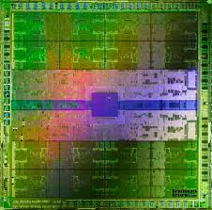
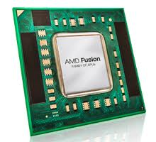
Chip Multiprocessor Scaling
By 2018 we may witness 2048-core chip multiprocessors
Intel 80-core
AMD Fusion:
four full CPUs
and 408 graphics
cores
NVIDIA Fermi: 512 cores
How to stop interconnects from hindering the future of computing. OIC 2013

Slide 4
Data Movement and Memory Dominate
Now: 45nm technology
2018: 11nm technology
Exascale computing technology challenges. VECPAR 2010

Slide 5
Memory Bandwidth
Wide variety of
applications
are memory
bandwidth bound

Slide 6
Collective Memory Transfers

Slide 7
Computation on Large Data
2D plane still too large for
a single processor
3D space
Slice into 2D planes

Slide 8
Domain Decomposition Using Hierarchical Tiled Arrays
Divide array into tiles
One tile per processor
Tiles are sized for
processor local
(and fast) storage
CPU
L1 cache or local store

Slide 9
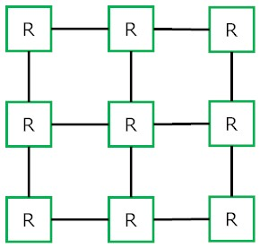
The Problem: Unpredictable Memory Access Pattern
Req
Req
Req
One request per tile line Different tile lines have different memory address ranges
Req
Req
Req
One request
0
N-1
Req
Req
Req
N
2N-1
MEM
Row-major mapping

Slide 10
Random Order Access Patterns Hurt DRAM Performance and Power
Reading tile 1 requires row activation and copying
Tile line 1
Tile line 1
Tile line 1
Tile line 2
Tile line 2
Tile line 2
Tile line 3
Tile line 3
Tile line 3
Tile line 4
Tile line 5
Tile line 6
In order requests:
3 activations
Worst case:
9 activations
Tile line 7
Tile line 8
Tile line 9

Slide 11
Collective Memory Transfers
Req
Requests replaced with one collective request
Reads are presented sequentially to memory
Req
0
N-1
N
2N-1
2
5
3
4
1
MEM
The CMS engine takes control of the collective transfer

Slide 12
Execution Time Impact
Up to 32% application execution time reduction
2.2x DRAM power reduction for reads. 50% for writes
8x8 mesh
Four memory controllers
Micron 16MB 1600MHz
modules with a
64-bit data path
Xeon Phi processors

Slide 13
Relieving Network Congestion

Slide 14
Hierarchical Tiled Arrays
“The hierarchically tiled arrays programming approach”. LCR 2004

Slide 15
Questions for You
What do you think is the best interface to CMS from the software?
A library with an API similar to the one shown?
Left to the compiler to recognize collective transfers?
How would this best work with hardware-managed caches?
Prefetchers may need to recognize collective operations
This work seems to indicate that collective transfers are a good idea for memory bandwidth and network congestion
Any other areas of application?

Slide 16
CMS Engine Implementation
CMS significantly simplifies the memory controller because
shorter FIFO-only transaction queues are adequate
ASIC Synthesis | DMA | CMS
Combinational area (μm²) | 743 | 16231
Non-combinational area (μm²) | 419 | 61313
Minimum cycle time (ns) | 0.6 | 0.75
To offset the cycle time increase, we can add a pipeline stage

