Slide 1
A Generalized Framework for Auto-tuning Stencil Computations
Shoaib Kamil^{1,3}, Cy Chan⁴, Samuel Williams¹,
Leonid Oliker¹, John Shalf^{1,2}, Mark Howison³,
E. Wes Bethel¹, Prabhat¹
¹Lawrence Berkeley National Laboratory (LBNL)
²National Energy Research Scientific Computing Center (NERSC)
³EECS Department, University of California, Berkeley (UCB)
⁴CSAIL, Massachusetts Institute of Technology (MIT)
SAKamil@lbl.gov

Slide 2
The Challenge: Productive Implementation of an Auto-tuner

Slide 3
Conventional Optimization
Take one kernel/application
Perform some analysis of it
Research the literature for appropriate optimizations
Implement a couple of them by hand optimizing for one target machine.
Iterate a couple of times.
Result:
improve performance for one kernel on one computer.

Slide 4
Conventional Auto-tuning
Automate the code generation and tuning process.
Perform some analysis of the kernel
Research the literature for appropriate optimizations
implement a code generator and search benchmark
explore optimization space
report best implementation/parameters
Result:
significantly improve performance for one kernel on any computer.
i.e. provides performance portability
Downside:
autotuner creation time is substantial
must reinvent the wheel for every kernel

Slide 5
Generalized Frameworks for Auto-tuning
Integrate some of the code transformation features of a compiler with the domain-specific optimization knowledge of an auto-tuner
parse high-level source
apply transformations allowed by the domain, but not necessarily safe based on language semantics alone
generate code + auto-tuning benchmark
explore optimization space
report best implementation/parameters
Result:
significantly improve performance for any kernel on any computer for a domain or motif.
i.e. performance portability without sacrificing productivity

Slide 6
Outline
Stencils
Machines
Framework
Results
Conclusions

Slide 7
Benchmark Stencils
Laplacian
Divergence
Gradient
Bilateral Filtering

Slide 8
What’s a stencil ?
Nearest neighbor computations on structured grids (1D…ND array)
stencils from PDEs are often a weighted linear combination
of neighboring values
cases where weights vary in space/time
stencil can also result in a table lookup
stencils can be nonlinear operators
caveat: We only examine implementations like Jacobi’s Method
(i.e. separate read and write arrays)
i,j,k+1
i,j+1,k
i-1,j,k
i,j,k
i+1,j,k
i,j-1,k
i,j,k-1

Slide 9
Laplacian Differential Operator
7-point stencil on scalar grid, produces a scalar grid
Substantial reuse (+high working set size)
Memory-intensive kernel
Elimination of capacity misses may improve performance by 66%
i,j,k+1
read_array[ ]
x dimension
u
i,j+1,k
xy product
i-1,j,k
i,j,k
i+1,j,k
i,j-1,k
i,j,k-1
write_array[ ]
u’

Slide 10
Divergence Differential Operator
6-point stencil on a vector grid, produces a scalar grid
Low reuse per component.
Only z-component demands a large working set
Memory-intensive kernel
Elimination of capacity misses may improve performance by 40%
i,j,k+1
read_array[ ][ ]
x dimension
x
i,j+1,k
y
i-1,j,k
i+1,j,k
z
i,j-1,k
xy product
i,j,k-1
write_array[ ]
u

Slide 11
Gradient Differential Operator
6-point stencil on a scalar grid, produces a vector grid
High reuse (like laplacian)
High working set size
three write streams (+ write allocation streams) = 7 total streams
Memory-intensive kernel
Elimination of capacity misses may improve performance by 30%
i,j,k+1
read_array[ ]
x dimension
u
i,j+1,k
xy product
i-1,j,k
i+1,j,k
i,j-1,k
write_array[ ][ ]
x
i,j,k-1
y
z

Slide 12
3D Bilateral Filtering
Extracted from a medical imaging application (MRI processing)
Normal Gaussian stencils smooth images,
but destroy sharp edges.
This kernel performs anistropic filtering thus preserving edges.
We may scale the size of the stencil (radius=3,5)
7³-pt or 11³-pt stencils.
apply to dataset of 192 x 256x256 slices
originally 8-bit grayscale voxels, but processed as 32-bit floats

Slide 13
3D Bilateral Filtering (pseudo code)
Each point in the stencil mandates a voxel-dependent indirection,
and each stencil also requires one divide.
for all points (xyz) in x,y,z{
voxelSum = 0
weightSum = 0
srcVoxel = src[xyz]
for all neighbors (ijk) within radius of xyz{
neighborVoxel = src[ijk]
neighborWeight = table2[ijk]*table1[neighborVoxel-srcVoxel]
voxelSum +=neighborWeight*neighborVoxel
weightSum+=neighborWeight
}
dstVoxel = voxelSum/weightSum
}
Large radii results in extremely compute-intensive kernels with large working sets

Slide 14
Benchmark Machines

Slide 15
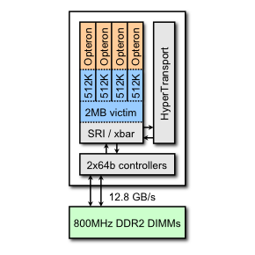
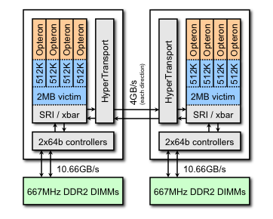
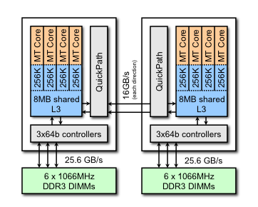
Multicore SMPs
Experiments only explored parallelism within an SMP
We use a Sun X2200 M2 as a proxy for the XT5 (e.g. Jaguar)
We use a Nehalem machine as a proxy for possible future Cray machines.
Barcelona/Nehalem are NUMA
AMD Budapest (XT4)
AMD Barcelona (X2200 M2)
Intel Nehalem (X5550)

Slide 16
Generalized Framework for Auto-tuning Stencils
Copy and Paste auto-tuning

Slide 17
Overview
Given a F95 implementation of an application:
Programmer annotates target stencil loop nests
Auto-tuning System:
converts FORTRAN implementation into internal representation (AST)
builds a test harness
Strategy Engine iterates on:
apply optimization to internal representation
backend generation of optimized C code
compile C code
benchmark C code
using best implementation, automatically produces a library for that kernel/machine combination
Programmer then updates application to call optimized library routine

Slide 18
Strategy Engine: Auto-parallelization
The strategy engines can auto-parallelize cache blocks among hardware thread contexts.
We use a single-program, multiple-data (SPMD) model implemented with POSIX Threads (Pthreads).
All threads are created at the beginning of the application.
We also produce an initialization routine that exploits the first touch policy to ensure proper NUMA-aware allocation.

Slide 19
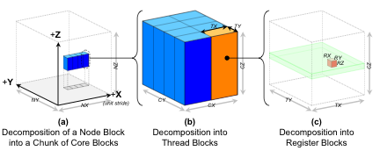
Strategy Engine: Auto-tuning Optimizations
Strategy Engine explores a number of auto-tuning optimizations:
loop unrolling/register blocking
cache blocking
constant propagation / common subexpression elimination
Future Work:
cache bypass (e.g. movntpd)
software prefetching
SIMD intrinsics
data structure transformations

Slide 20
Experimental Results
NOTE: threads are ordered to exploit:
multiple threads within a core (Nehalem only),
then multicore,
then multiple sockets (Barcelona/Nehalem)

Slide 21
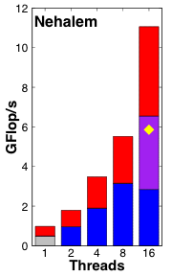
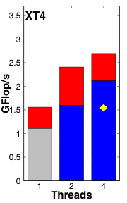
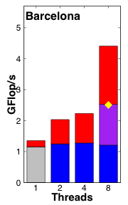
Laplacian Performance
On the memory-bound architecture (Barcelona), auto-parallelization doesn’t make a difference.
Auto-tuning enables scalability.
Barcelona is bandwidth-proportionally faster than the XT4.
Nehalem is ~2.5x faster than Barcelona, and 4x faster than the XT4
Auto-parallelization plus tuning significantly outperforms OpenMP.
OpenMP
Comparison
Auto-tuning
Auto-NUMA
Auto-
parallelization
serial
reference

Slide 22
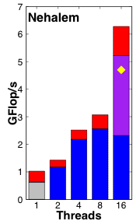
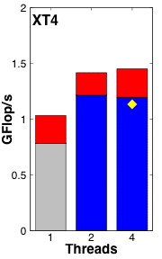
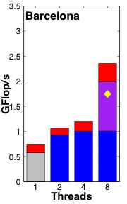
Divergence Performance
No changes to the framework were required (just drop in F95 code)
As there was less reuse in the Divergence than in Laplacian, there are fewer capacity misses.
So auto-tuning has less to improve upon
Nehalem is ~2.5x faster than Barcelona
OpenMP
Comparison
Auto-tuning
Auto-NUMA
Auto-
parallelization
serial
reference

Slide 23
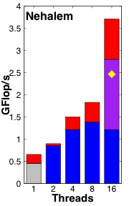
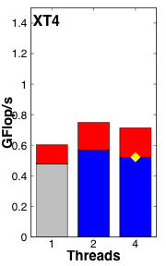
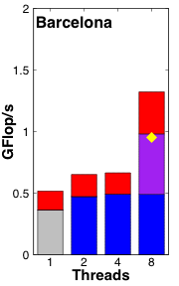
Gradient Performance
No changes to the framework were required (just drop in F95 code)
Gradient has moderate reuse, but a large number of output streams.
Performance gains from auto-tuning are moderate (25-35%)
Parallelization is only valuable in conjunction with auto-tuning
OpenMP
Comparison
Auto-tuning
Auto-NUMA
Auto-
parallelization
serial
reference

Slide 24
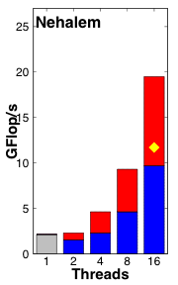
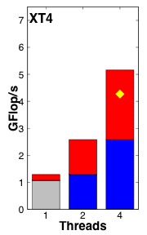
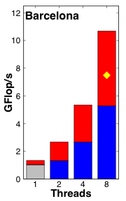
3D Bilateral Filter Performance (radius=3)
No changes to the framework were required (just drop in F95 code)
Essentially a 7x7x7 (343-pt) stencil
Performance is much more closely tied to GHz
instead of GB/s.
Auto-parallelization yielded near perfect parallel efficiency
wrt cores on Barcelona/Nehalem (Nehalem has HyperThreading)
Auto-tuning significantly outperformed OpenMP (75% on Nehalem)
OpenMP
Comparison
Auto-tuning
Auto-
parallelization
serial
reference

Slide 25
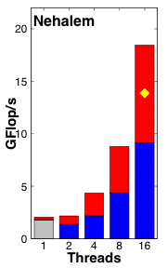
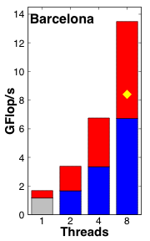
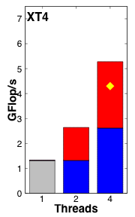
3D Bilateral Filter Performance (radius=5)
basically the same story as radius=3
XT4/Nehalem delivered approximately same performance as they did with radius=3
Barcelona delivered somewhat better performance.
OpenMP
Comparison
Auto-tuning
Auto-
parallelization
serial
reference

Slide 26
Summary

Slide 27
Summary: Framework for auto-tuning stencils
Dramatic step forward in auto-tuning technology
Although the framework required substantial up front work,
it provides performance portability across the breadth of architectures AND stencil kernels.
Delivers very good performance, and well in excess of OpenMP.
Future work will examine relevant optimizations
e.g. cache bypass would significantly improve gradient performance.

Slide 28
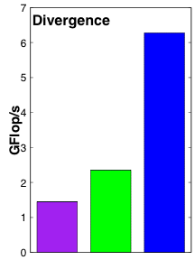
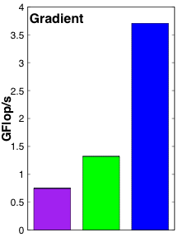
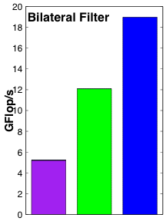
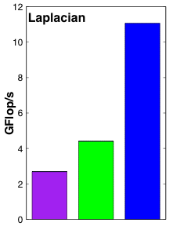
Summary: Machine Comparison
Barcelona delivers bandwidth-proportionally better performance on the memory-intensive differential operators.
Surprisingly, Barcelona delivers ~2.5x better performance on the compute intensive bilateral filter.
Nehalem clearly sustains dramatically better performance than either Opteron.
Despite having a 15% faster clock, nehalem realizes a much better bilateral filter performance.

Slide 29
Acknowledgements
Research supported by DOE Office of Science under contract number DE-AC02-05CH11231
Microsoft (Award #024263)
Intel (Award #024894)
U.C. Discovery Matching Funds (Award #DIG07-10227)
All XT4 simulations were performed on the XT4 (Franklin) at the National Energy Research Scientific Computing Center (NERSC)

Slide 30
Questions?

