Slide 1
Resource-Efficient, Hierarchical Auto-tuning of a Hybrid Lattice Boltzmann Computation on the Cray XT4
Samuel Williams, Jonathan Carter,
Leonid Oliker, John Shalf, Katherine Yelick
Lawrence Berkeley National Laboratory (LBNL)
National Energy Research Scientific Computing Center (NERSC)
SWWilliams@lbl.gov

Slide 2
Outline
Background
LBMHD
Previous work: Auto-tuning LMBHD on Multicore SMPs
Hybrid MPI-Pthreads implementations
Distributed, Hybrid LBMHD Auto-tuning
Results
Summary

Slide 3
Background

Slide 4
Arithmetic Intensity
O( log(N) )
O( 1 )
O( N )
A r i t h m e t i c I n t e n s i t y
SpMV, BLAS1,2
FFTs
Stencils (PDEs)
Dense Linear Algebra
(BLAS3)
Lattice Methods
Particle Methods
True Arithmetic Intensity (AI) ~ Total Flops / Total DRAM Bytes
Some HPC kernels have an arithmetic intensity that scales with problem size (increased temporal locality), but remains constant on others
Arithmetic intensity is ultimately limited by compulsory traffic
Arithmetic intensity is diminished by conflict or capacity misses.

Slide 5
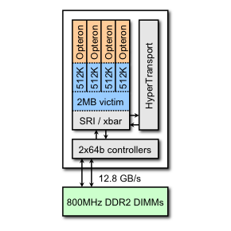
Kernel Arithmetic Intensity and Architecture
For a given architecture, one may calculate its flop:byte ratio.
For a 2.3GHz Quad Core Opteron (like in the XT4),
1 SIMD add + 1 SIMD multiply per cycle per core
12.8GB/s of DRAM bandwidth
= 36.8 / 12.8 ~ 2.9 flops per byte
When a kernel’s arithmetic intensity is substantially
less than the architecture’s flop:byte ratio, transferring
data will take longer than computing on it
→ memory-bound
When a kernel’s arithmetic intensity is substantially greater than the architecture’s flop:byte ratio, computation will take longer than data transfers
→ compute-bound

Slide 6
LBMHD

Slide 7
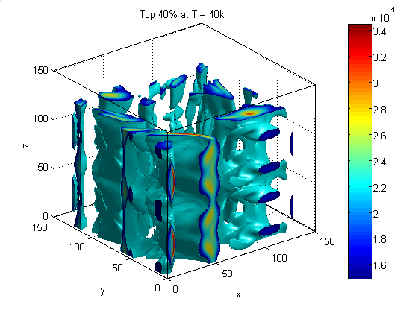
LBMHD
Plasma turbulence simulation via Lattice Boltzmann Method
Two distributions:
momentum distribution (27 scalar components)
magnetic distribution (15 vector components)
Three macroscopic quantities:
Density
Momentum (vector)
Magnetic Field (vector)
0
12
12
+Z
15
+Z
25
4
15
+Z
25
6
8
2
14
14
10
23
18
21
23
18
21
20
26
9
20
26
1
11
13
22
13
22
+Y
+Y
17
24
5
+Y
17
24
+X
7
3
16
16
19
+X
19
+X
macroscopic variables
momentum distribution
magnetic distribution

Slide 8
LBMHD
Code Structure
time evolution through a series of collision( ) and stream( ) functions
When parallelized, stream( ) should constitute 10% of the runtime.
collision( )’s Arithmetic Intensity:
Must read 73 doubles, and update 79 doubles per lattice update (1216 bytes)
Requires about 1300 floating point operations per lattice update
Just over 1.0 flops/byte (ideal architecture)
Suggests LBMHD is memory-bound on the XT4.
Structure-of-arrays layout (component’s are separated) ensures that cache capacity requirements are independent of problem size
However, TLB capacity requirement increases to >150 entries
periodic boundary conditions

Slide 9
Previous Work: Auto-tuning LBMHD on Multicore SMPs
Samuel Williams, Jonathan Carter, Leonid Oliker, John Shalf, Katherine Yelick, "Lattice Boltzmann Simulation Optimization on Leading Multicore Platforms", International Parallel & Distributed Processing Symposium (IPDPS), 2008.
Best Paper, Application Track

Slide 10
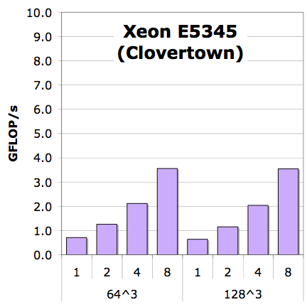
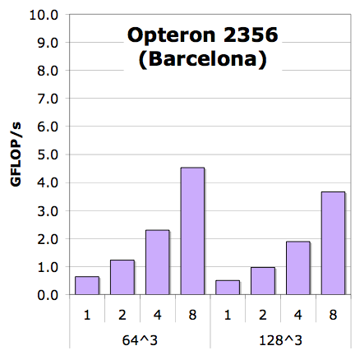
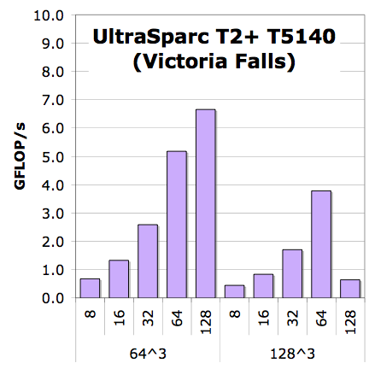
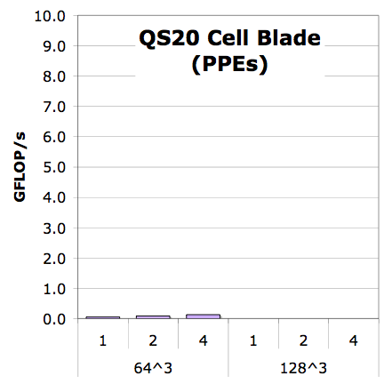
LBMHD Performance (reference implementation)
Generally, scalability looks good
Scalability is good
but is performance good?
Naïve+NUMA
*collision() only
Notes:
PPE performance is abysmal

Slide 11
Lattice-Aware Padding
For a given lattice update, the requisite velocities can be mapped to a relatively narrow range of cache sets (lines).
As one streams through the grid, one cannot fully exploit the capacity of the cache as conflict misses evict entire lines.
In an structure-of-arrays format, pad each component such that when referenced with the relevant offsets (±x,±y,±z) they are uniformly distributed throughout the sets of the cache
Maximizes cache utilization and minimizes conflict misses.

Slide 12
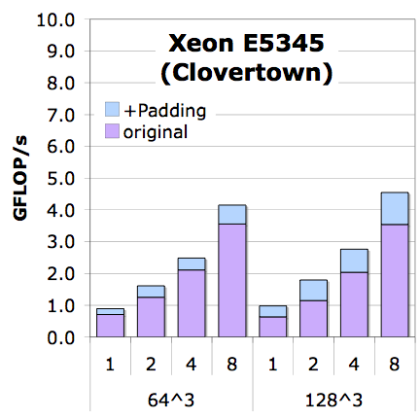
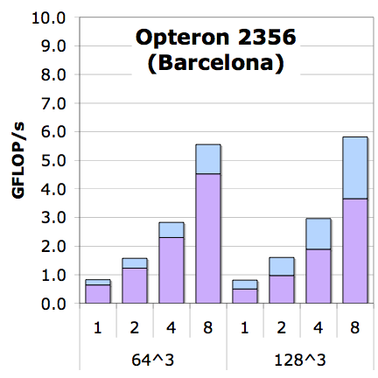
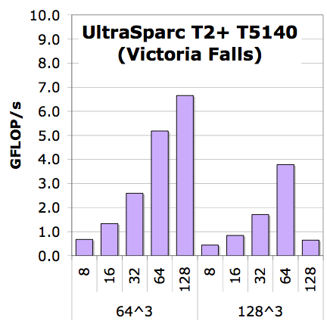
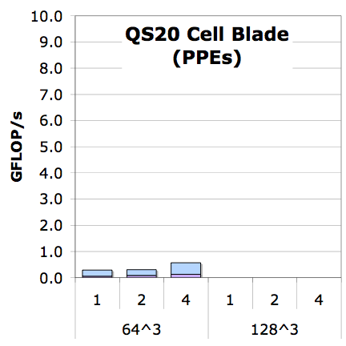
LBMHD Performance (lattice-aware array padding)
LBMHD touches >150 arrays.
Most caches have limited associativity
Conflict misses are likely
Apply heuristic to pad arrays
+Padding
Naïve+NUMA

Slide 13
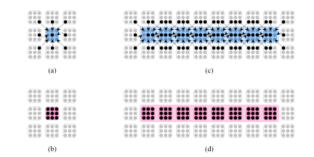
Vectorization
Two phases with a lattice method’s collision() operator:
reconstruction of macroscopic variables
updating discretized velocities
Normally this is done one point at a time.
Change to do a vector’s worth at a time (loop interchange + tuning)

Slide 14
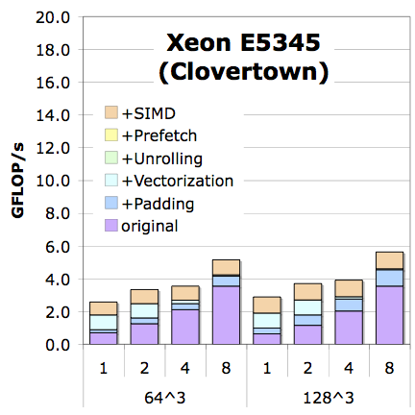
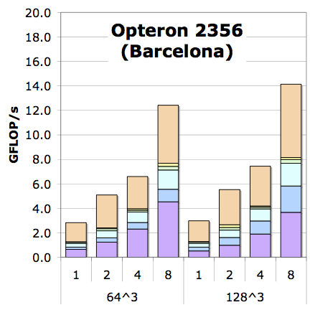
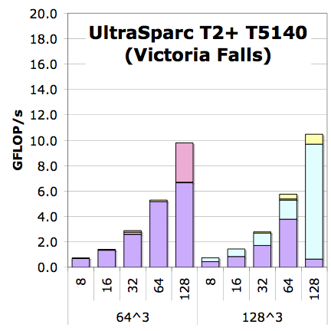
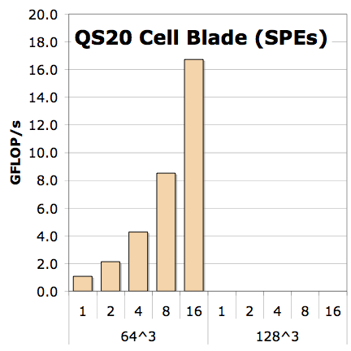
LBMHD Performance (architecture specific optimizations)
Add unrolling and reordering of inner loop
Additionally, it exploits SIMD where the compiler doesn’t
Include a SPE/Local Store optimized version
+small pages
+Explicit SIMDization
+SW Prefetching
+Unrolling
+Vectorization
+Padding
Naïve+NUMA
*collision() only

Slide 15
LBMHD Performance (architecture specific optimizations)
Add unrolling and reordering of inner loop
Additionally, it exploits SIMD where the compiler doesn’t
Include a SPE/Local Store optimized version
1.6x
4x
3x
130x
+small pages
+Explicit SIMDization
+SW Prefetching
+Unrolling
+Vectorization
+Padding
Naïve+NUMA
*collision() only

Slide 16
Limitations
Ignored MPP (distributed) world
Kept problem size fixed and cubical
When run with only 1 process per SMP, maximizing threads per process always looked best

Slide 17
Hybrid MPI+Pthreads Implementations

Slide 18
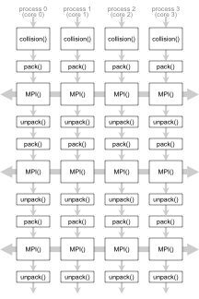
Flat MPI
In the flat MPI world, there is one process per core, and only one thread per process
All communication is through MPI

Slide 19
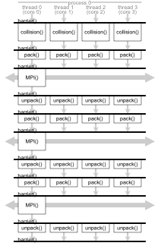
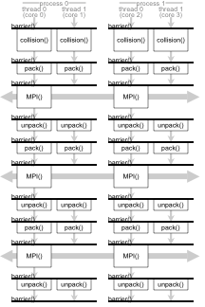
Hybrid MPI
As multicore processors already provide cache coherency for free, we can exploit it to reduce MPI overhead and traffic.
We use pthreads for threading
(other possibilities exist)
For correctness, we are required to include a intra-process (thread) barrier between function calls for correctness.
(we wrote our own)
We can choose any balance between processes/node and threads/process
(we explored powers of 2)
We did not assume a thread-safe MPI implementation. As such, only thread 0 performs MPI calls

Slide 20
Distributed, Hybrid Auto-tuning

Slide 21
The Distributed Auto-tuning Problem
We believe that even for relatively large problems, only auto-tuning the local computation (e.g. IPDPS’08) will deliver sub-optimal MPI performance.
We have a combinatoric explosion in the search space coupled with a large problem size (number of nodes)
at each concurrency:
for all aspect ratios
for all process/thread balances
for all thread grids
for all data structures
for all coding styles (reference, vectorized, vectorized+SIMDized)
for all prefetching
for all vector lengths
for all code unrollings/reorderings
benchmark

Slide 22
Our Approach
We employ a resource-efficient 3-stage greedy algorithm that successively prunes the search space:
for all data structures
for all coding styles (reference, vectorized, vectorized+SIMDized)
for all prefetching
for all vector lengths
for all code unrollings/reorderings
benchmark
at limited concurrency (single node):
for all aspect ratios
for all process/thread balances
for all thread grids
benchmark
at full concurrency:
for all process/thread balances
benchmark

Slide 23
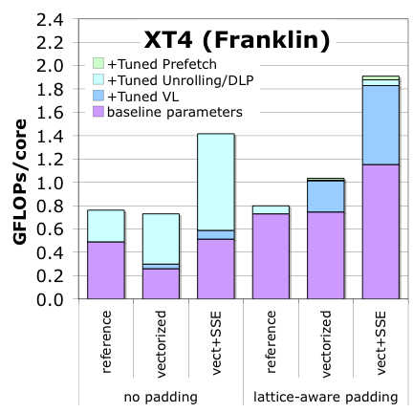
Stage 1
In stage 1, we prune the code generation space.
We ran this as a 128³ problem with 4 threads.
As VL, unrolling, and
reordering may be problem
dependent, we only prune:
padding
coding style
prefetch distance
We observe that vectorization
with SIMDization, and a
prefetch distance of 1 cache
line worked best

Slide 24
Stage 2
Suppose we wish to explore this color-coded optimization space.
In the serial world (or fully threaded nodes),
the tuning is easily run
However, in the MPI or hybrid world a problem arises as processes are not guaranteed to be synchronized.
As such, one process may execute some optimizations faster than others simply due to fortuitous scheduling with another processes’ trials
Solution: add an MPI_barrier() around each trial
process0
process0
process1
process1
.
.
.
.
.
.
.
.
time

Slide 25
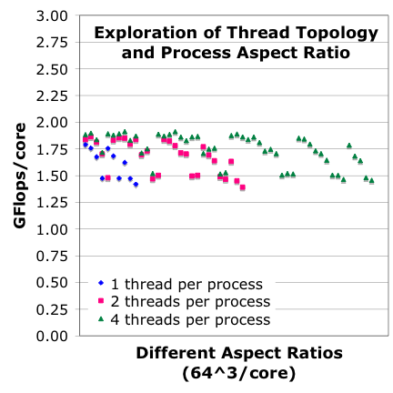
Stage 2 (continued)
We create a database of optimal VL/unrolling/DLP parameters for each thread/process balance, thread grid, and aspect ratio

Slide 26
Stage 3
Given the data base from Stage 2,
we run few large problem using the best known parameters/thread grid for different thread/process balances.
We select the parameters based on minimizing
overall local time
collision( ) time
local stream( ) time

Slide 27
Results

Slide 28
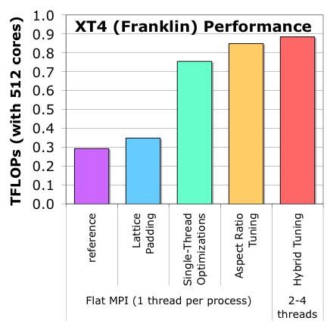
XT4 Results (512³ problem on 512 cores)
Finally, we present the best data for progressively more aggressive auto-tuning efforts/
Note each of the last 3 bars may have unique MPI decompositions as well as VL/unroll/DLP
Observe that for this large problem, auto-tuning flat MPI delivered significant boosts (2.5x)
However, expanding auto-tuning to include the domain decomposition and balance between threads and processes provided an extra 17%
2 processes with 2 threads was best

Slide 29
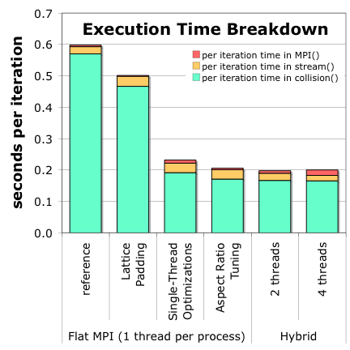
XT4 Results (512³ problem on 512 cores)
When examining the execution time breakdown, we see how the auto-tuner consistently favored faster collision() times.
In the hybrid world we see a trade off between MPI time and stream() time
As threads/process increase, we get less bandwidth, but less traffic.

Slide 30
Summary

Slide 31
Conclusions
Multicore cognizant auto-tuning dramatically improves even flat MPI performance.
Tuning the domain decomposition and hybrid implementations yielded almost an additional 20% performance boost.
Although hybrid MPI promises improved performance through reduced communication, it is critical all components be thread-parallelized.
Future work will move to other architectures (like the XT5), examine a range of problem sizes, and attempt to thread-parallelize the MPI.

Slide 32
Acknowledgements
Research supported by DOE Office of Science under contract number DE-AC02-05CH11231
All XT4 simulations were performed on the XT4 (Franklin) at the National Energy Research Scientific Computing Center (NERSC)
George Vahala and his research group provided the original (FORTRAN) version of the LBMHD code.

Slide 33
Questions?

